Slide 1
How can we look after God’s Wonderful World?

Slide 2
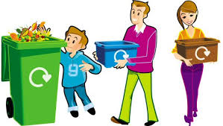
How can we help to look after the world?
Remember the 3 Rs
Reduce
Reuse
Recycle

Slide 3

What can we do to help?
Turn off the tap when brushing your teeth.

Slide 4

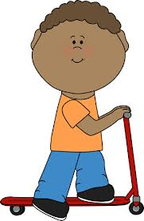
What can we do to help?
Don’t take the car if it’s not far!
Walking is better for our world and for you!
You could even ride your bike or scooter!

Slide 5


What can we do to help?
Don’t be a litterbug!
Put all your litter in the bin!

Slide 6

What can we do to help?
Save energy!
Turn off lights, computers and televisions when you are not using them.
Put on a jumper instead of turning up the heating.

Slide 7
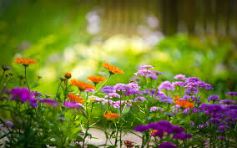
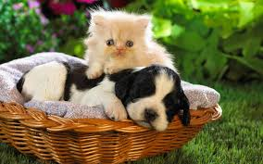
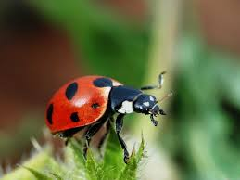
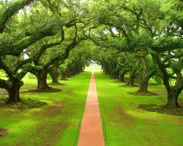
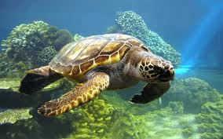
What can we do to help?
Take care of all the animals and plants.

Slide 8
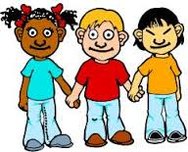
Who should look after the world?
All of us! We can all take responsibility for looking after God’s wonderful world and keeping it amazing.

