Slide 1
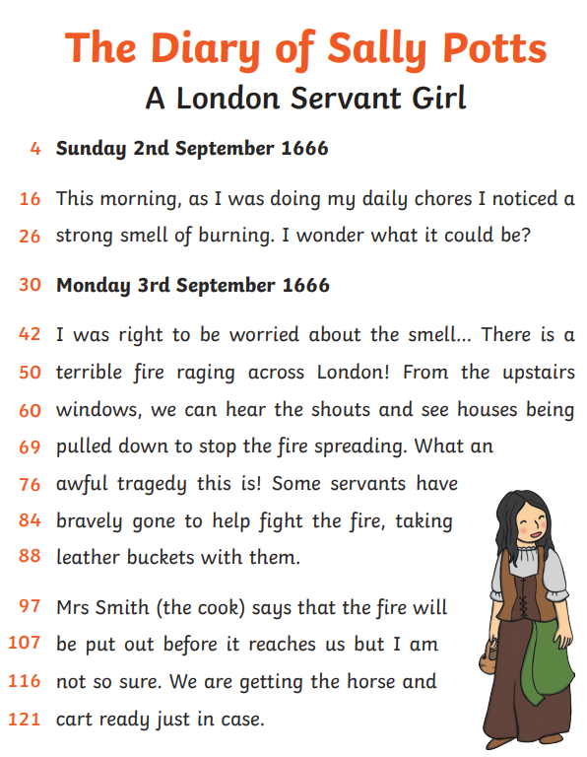
English Tuesday 23 February
Have you noticed that Sally writes ‘I was’ a few times.
Read through her diary again and underline ‘I was’.
Could she write ‘I were doing my daily chores’?
Mmmm, no, it does not sound right and it is not grammatically correct either.
was is used by one person.
were is used by more than one person.
Like this:
I was eating a biscuit.
Three children were playing outside.

Slide 2
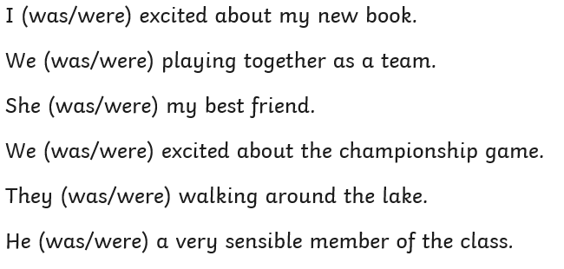
English Tuesday 23 February
Task 1
Choose the correct word was or were in these sentences.
Task 2
Write out these sentences filling in the blank with was or were.
The children ……………… getting ready for school.
He …………. playing on his scooter.
They ………….. having a picnic.
The cat ……….. snoozing in the sun.

Slide 3
English Tuesday 23 February
Task 3
Now think about Sally and the other servants. Complete the following sentences use was or were correctly.
Sally …………………………………………………………………………………………………………………………………………………….
Some servants …………………………………………………………………………………………………………………………………….
Mrs Smith ……………………………………………………………………………………………………………………………………………
People …………………………………………………………………………………………………………………………………………………

