Slide 2
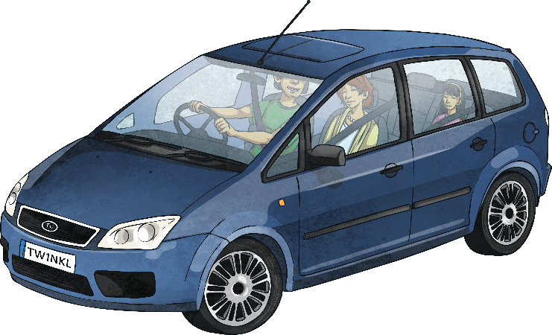
Adjectives
Adjectives are describing words. They are used in poetry to create many different effects and visual pictures to the reader. The adjectives can be used for a more in-depth description of a noun, or they can be used to add more excitement and attention within a line or verse.
Some examples of couplets within poems:
Roaring roads,
Noisy cars,
Beaming headlights,
Tall streetlamps,
Dark, cold night.

Slide 3
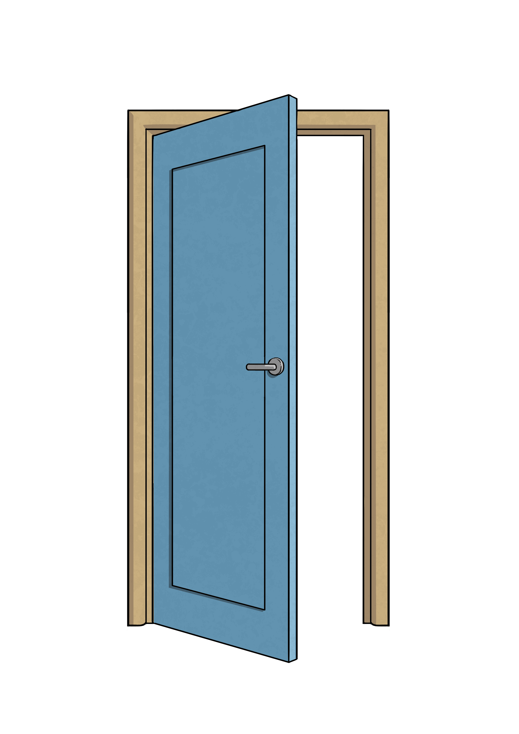
Using Onomatopoeia
Onomatopoeia is when a word imitates its natural sound,
or suggests the sound a certain object makes.
It is used in poetry to create a sound effect to make
the description more expressive and interesting.
Some examples of onomatopoeia:
bang
crash
pop
smash
drip
buzz
tick tock
whoosh
wham
pow

Slide 4
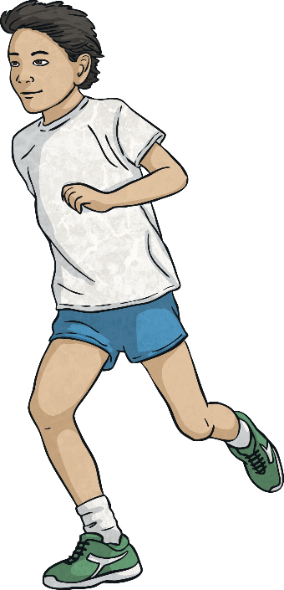
Verb
Verbs are doing words. They show actions within a sentence.
Verbs are used in poetry to create a range of effects. They are used to create more interesting sentences, and to help describe what different people and objects are doing.
Some examples of verbs:
The boy ran along the shoreline.
The women held her baby tightly.
It followed her to school one day.

Slide 5
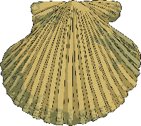
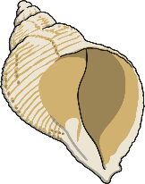
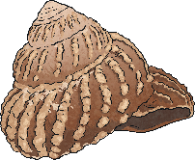

Alliteration
Alliteration is when the sound or letter at the beginning of each or most of the words in a sentence is the same.
Alliteration is used in poetry to create many different effects.
It can be used to create a greater and more interesting description
of different themes, people and objects.
Some examples of alliteration:
Sally sells sea shells by the sea shore.
All authors allow authority after midnight.
Theresa tripped and tumbled tremendously over the tree.

Slide 6

Simile
A simile is a figure of speech. It is when one thing
is compared to another using the words ‘like’ or ‘as’.
Similes can be as descriptive as the writer chooses.
Similes are used in poetry to give the reader a more descriptive and
in-depth understanding about a particular object or person.
Some examples of simile:
As busy as a bee – This is comparing someone’s level of energy to the speed of a bee.
As snug as a bug in a rug – This is comparing someone who is very cosy to how comfortable a bug would be in a rug.
Runs like a cheetah – This is comparing the speed that someone can run to the speed of a cheetah which is quite fast.
As white as a ghost – This is comparing a person’s skin colour to a ghost, usually because they are frightened, sick or scared of something.

Slide 7
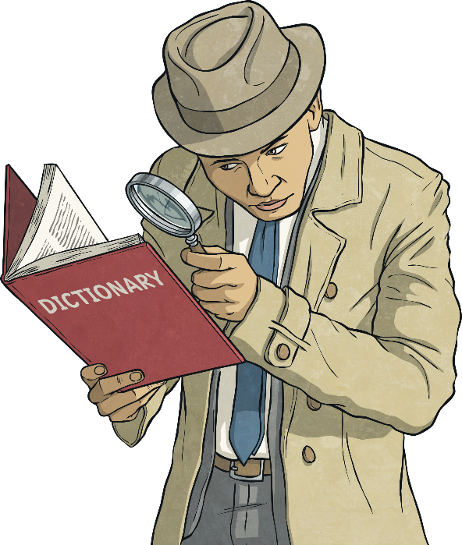
Synonym
A synonym is a word that has the same, or similar, meaning
as another word. Synonyms can be found in a thesaurus.
Synonyms are used in poetry to be more graphic
and to give a broader description.
Some examples of synonyms:
Beautiful – attractive, pretty, gorgeous, stunning
Funny – hysterical, humorous, amusing, entertaining
Student – pupil, scholar, schoolboy, schoolgirl
Lazy – idle, sluggish, indolent, slothful

Slide 8
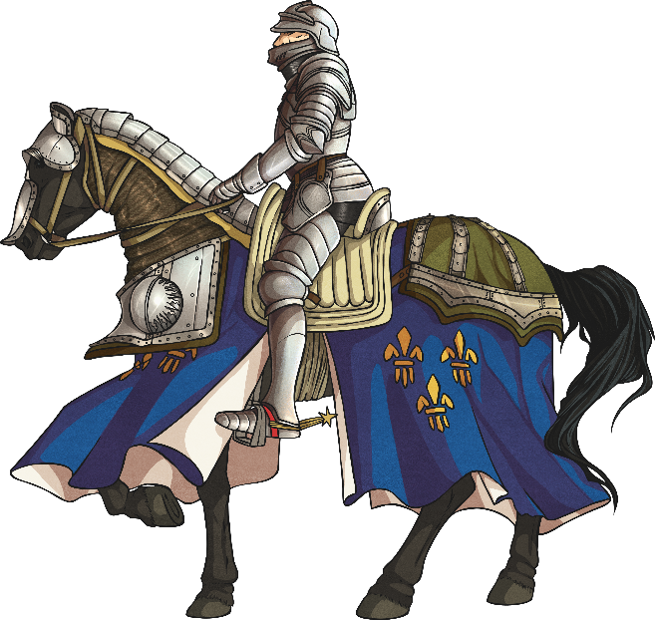
Metaphor
A metaphor is a figure of speech which describes a place,
object or subject as something unlikely and uncommon.
Metaphors are used in poetry to create an image of
judgement and comparison in the mind of the reader.
Some examples of metaphor:
Her eyes were glistening jewels.
She is the sunshine which brightens up our day.
The kids at school are all brains.
In Andrew’s eyes, Rebecca is the sun.
He is my knight in shining armour.
The world is a stage.

