Slide 1


Slide 3




1) Convert these mixed numbers to improper fractions.
2) Convert these improper fractions to mixed numbers.
5 $\frac{\text{3}}{\text{5}}$
3 $\frac{\text{8}}{\text{9}}$
$\frac{\text{102}}{\text{10}}$
$\frac{\text{124}}{\text{12}}$

Slide 4

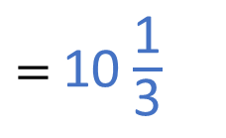


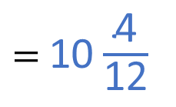

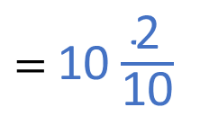



1) Convert these mixed numbers to improper fractions.
2) Convert these improper fractions to mixed numbers.
$=$ $\frac{\text{28}}{\text{5}}$
$=$ $\frac{\text{35}}{\text{9}}$
5 $\frac{\text{3}}{\text{5}}$
3 $\frac{\text{8}}{\text{9}}$
5 $\text{×}\frac{\text{5}}{\text{5}}=$ $\frac{\text{25}}{\text{5}}$
$\frac{\text{25}}{\text{5}}+$ $\frac{\text{3}}{\text{5}}$
3 $\text{×}\frac{\text{9}}{\text{9}}=$ $\frac{\text{27}}{\text{9}}$
$\frac{\text{27}}{\text{9}}+$ $\frac{\text{8}}{\text{9}}$
$\frac{\text{102}}{\text{10}}$
$=$ 10 $\frac{\text{2}}{\text{10}}$
$\frac{\text{124}}{\text{12}}$
$=$ 10 $\frac{\text{4}}{\text{12}}$
$=$ 10 $\frac{\text{1}}{\text{5}}$
$=$ 10 $\frac{\text{1}}{\text{3}}$

Slide 6
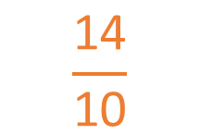



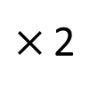
$\frac{\text{7}}{\text{5}}$ $−$ $\frac{\text{3}}{\text{10}}$ $=$
$$\frac{\text{11}}{\text{10}}$$
or 1 $\frac{\text{1}}{\text{10}}$
$×$ 2
$$\frac{\text{1}\text{4}}{\text{10}}$$

Slide 7

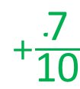


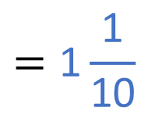

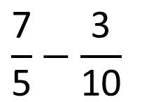


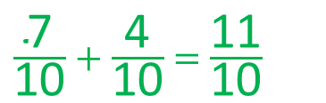


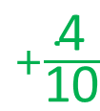
$$\frac{\text{7}}{\text{5}}−\frac{\text{3}}{\text{10}}$$
$$=\frac{\text{11}}{\text{10}}$$
$$=\text{1}\frac{\text{1}}{\text{10}}$$
$\frac{\text{14}}{\text{10}}$
$\frac{\text{3}}{\text{10}}$
$\frac{\text{7}}{\text{5}}$
$+\frac{\text{7}}{\text{10}}$
$+\frac{\text{4}}{\text{10}}$
0
1
2
$\frac{\text{5}}{\text{5}}$
$\frac{\text{10}}{\text{10}}$
$\frac{\text{10}}{\text{5}}$
$\frac{\text{20}}{\text{10}}$
$\frac{\text{7}}{\text{10}} + \frac{\text{4}}{\text{10}} = \frac{\text{11}}{\text{10}}$

Slide 8

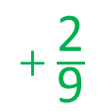
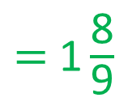

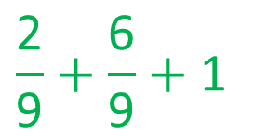


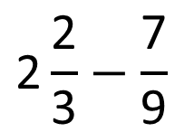

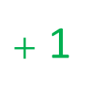
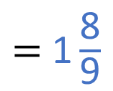
Have a think
$$\text{2}\frac{\text{2}}{\text{3}}−\frac{\text{7}}{\text{9}}$$
$=$ $\text{1}\frac{\text{8}}{\text{9}}$
$$+ \frac{\text{2}}{\text{9}}$$
$\text{+}\frac{\text{6}}{\text{9}}$
$+$ 1
0
$$\frac{\text{7}}{\text{9}}$$
1
2
$$\text{2}\frac{\text{2}}{\text{3}}$$
3
$$\text{2}\frac{\text{6}}{\text{9}}$$
$$\frac{\text{2}}{\text{9}}+\frac{\text{6}}{\text{9}}+\text{1}$$
$=$ $\text{1}\frac{\text{8}}{\text{9}}$

Slide 9
Have a go at questions
1 - 3 on the worksheet

Slide 10

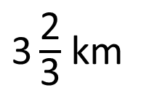
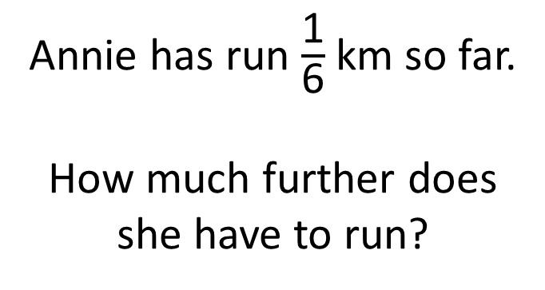

A race is 3 $\frac{\text{2}}{\text{3}}$ km in length.
$\text{3}\frac{\text{2}}{\text{3}}$ km
Annie has run $\frac{\text{1}}{\text{6}}$ km so far.
How much further does she have to run?
Have a think

Slide 11


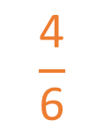


$$\frac{\text{3}}{\text{6}}$$
$\text{3}\frac{\text{2}}{\text{3}}$ $−$ $\frac{\text{1}}{\text{6}}$
$$\frac{\text{1}}{\text{2}}$$
$$=$$
3
$$\frac{\text{4}}{\text{6}}$$

Slide 12

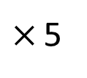

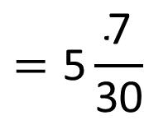

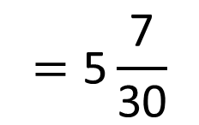
14
$$=\text{5}\frac{\text{7}}{\text{30}}$$
12
1
5 $\frac{}{\text{30}}$ $−$ $\frac{}{\text{6}}$
$×$ 5
7
$$\frac{}{\text{30}}$$
5
Have a think
17
2
$$=\text{5}\frac{\text{7}}{\text{30}}$$
5 $\frac{}{\text{30}}$ $−$ $\frac{}{\text{6}}$

Slide 13



Alex cycles for 8 km.
Mo cycles for 7 $\frac{\text{5}}{\text{8}}$ km.
How much further does Alex cycle than Mo?
$\frac{\text{3}}{\text{8}}$
km
Have a think
Mo
Alex
$\frac{\text{3}}{\text{8}}$
7
8

Slide 14







Jack eats 1 $\frac{\text{2}}{\text{5}}$ of pie.
$\frac{\text{4}}{\text{10}}$
1
Dora eats $\frac{\text{9}}{\text{10}}$ of a pie less than Jack.
$\frac{\text{1}}{\text{2}}$
pie
How much pie does Dora eat?
$− \frac{\text{9}}{\text{10}}$
1
$\frac{\text{4}}{\text{10}}$
0
$\frac{\text{5}}{\text{10}}$
1
2

Slide 15
Have a go at questions
4 - 6 on the worksheet

