Slide 1


Slide 3





$\frac{\text{3}}{\text{5}}$ $−$ $\frac{\text{2}}{\text{5}}$ $=$
1)
2)
3) Complete the addition pyramid – a number is the sum of the two numbers below it.
$\frac{\text{5}}{\text{9}}$ $− \frac{\text{1}}{\text{3}}$ $=$
1
$$\frac{\text{3}}{\text{10}}$$
$$\frac{\text{1}}{\text{5}}$$
$$\frac{\text{1}}{\text{10}}$$

Slide 4








$\frac{\text{3}}{\text{5}}$ $−$ $\frac{\text{2}}{\text{5}}$ $=$
$\frac{\text{1}}{\text{5}}$
1)
2)
3) Complete the addition pyramid – a number is the sum of the two numbers below it.
$\frac{\text{5}}{\text{9}}$ $− \frac{\text{1}}{\text{3}}$ $=$
$\frac{\text{5}}{\text{9}}$ $−$
$\frac{\text{3}}{\text{9}}$ $=$
$\frac{\text{2}}{\text{9}}$
1
$$\frac{\text{7}}{\text{10}}$$
$$\frac{\text{3}}{\text{10}}$$
$$\frac{\text{5}}{\text{10}}$$
$$\frac{\text{1}}{\text{5}}$$
$$\frac{\text{1}}{\text{10}}$$
$$\frac{\text{1}}{\text{2}}$$
$$\frac{\text{2}}{\text{10}}$$

Slide 6

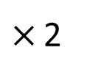
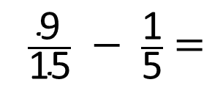
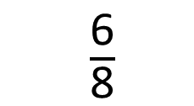
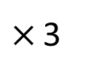






$$\frac{\text{3}}{\text{8}}$$
$\frac{\text{3}}{\text{4}}$ $−$ $\frac{\text{3}}{\text{8}}$ $=$
$×$ 2
$\frac{\text{6}}{\text{8}}$
Have a think
$\frac{\text{9}}{\text{15}}$ $−$ $\frac{\text{1}}{\text{5}}$ $=$
$$\frac{\text{6}}{\text{15}}$$
$$\frac{\text{2}}{\text{5}}$$
$$=$$
$×$ 3
$$\frac{\text{3}}{\text{15}}$$

Slide 7
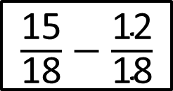
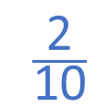
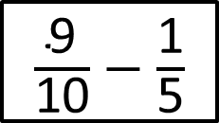
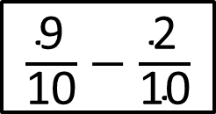
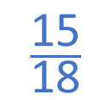
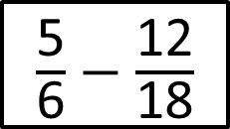
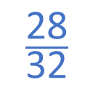
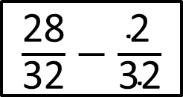
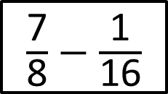
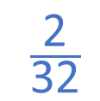
$\frac{\text{5}}{\text{6}}$ $−$ $\frac{\text{12}}{\text{18}}$
$\frac{\text{9}}{\text{10}}$ $−$ $\frac{\text{2}}{\text{10}}$
$$\frac{\text{15}}{\text{18}}$$
$\frac{\text{7}}{\text{8}}$ $−$ $\frac{\text{1}}{\text{16}}$
$\frac{\text{15}}{\text{18}}$ $−$ $\frac{\text{12}}{\text{18}}$
$$\frac{\text{28}}{\text{32}}$$
$$\frac{\text{2}}{\text{32}}$$
$\frac{\text{9}}{\text{10}}$ $−$ $\frac{\text{1}}{\text{5}}$
$\frac{\text{28}}{\text{32}}$ $−$ $\frac{\text{2}}{\text{32}}$
$$\frac{\text{2}}{\text{10}}$$
Have a think

Slide 8
Have a go at questions
1 - 4 on the worksheet

Slide 9





$$\frac{\text{4}}{\text{7}}$$
On Monday Whitney reads for of an hour.
$$\frac{\text{3}}{\text{14}}$$
On Tuesday she reads for of an hour less than on Monday.
For how long does Whitney read on Monday and Tuesday altogether?
M
$$\frac{\text{4}}{\text{7}}$$
Have a think
$$\frac{\text{3}}{\text{14}}$$
T

Slide 10
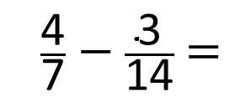
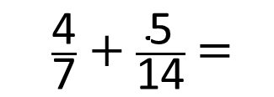




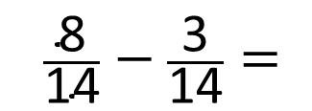

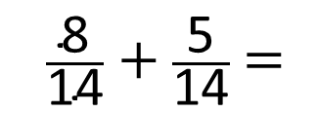
M
$$\frac{\text{4}}{\text{7}}$$
$$\frac{\text{3}}{\text{14}}$$
T
$$\frac{\text{5}}{\text{14}}$$
$\frac{\text{4}}{\text{7}}$ $−$ $\frac{\text{3}}{\text{14}}$ $=$
$\frac{\text{8}}{\text{14}}$ $−$ $\frac{\text{3}}{\text{14}}=$
$$\frac{\text{5}}{\text{14}}$$
For how long does Whitney read on Monday and Tuesday altogether?
$\frac{\text{4}}{\text{7}}$ $+$ $\frac{\text{5}}{\text{14}}$ $=$
$\frac{\text{8}}{\text{14}}$ $+$ $\frac{\text{5}}{\text{14}}$ $=$
$$\frac{\text{13}}{\text{14}}$$
of an hour

Slide 11
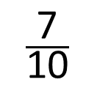
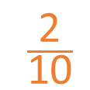



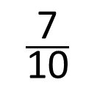
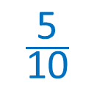
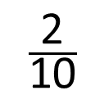
$$\frac{\text{7}}{\text{10}}$$
$$\frac{\text{1}}{\text{5}}$$
What is the difference between and ?
$$\frac{\text{2}}{\text{10}}$$
$$\frac{\text{2}}{\text{10}}$$
$$\frac{\text{7}}{\text{10}}$$
0
$$\frac{\text{5}}{\text{10}}$$
$$\frac{\text{1}}{\text{2}}$$
1
$$=$$

Slide 12








Have a think
$$\frac{\text{2}}{\text{3}}$$
$$\frac{\text{3}}{\text{9}}$$
What is the difference between and ?
$$\frac{\text{6}}{\text{9}}$$
$$\frac{\text{3}}{\text{9}}$$
$$\frac{\text{1}}{\text{3}}$$
$$=$$
0
$$\frac{\text{3}}{\text{9}}$$
$$\frac{\text{6}}{\text{9}}$$
1

Slide 13
Have a go at questions
5 - 7 on the worksheet

