Slide 1


Slide 3











1) = 54 + 77 + 46
2)
3)
$\frac{\text{2}}{\text{3}}$
$\frac{\text{1}}{\text{12}}$
$\frac{\text{1}}{\text{6}}$
$$+$$
$$+$$
$$=$$
$$\frac{\text{3}}{\text{7}}$$
$$\frac{\text{1}}{\text{21}}$$
$$\frac{\text{15}}{}$$
$$=$$
$$=$$

Slide 4






1) = 54 + 77 + 46
2)
3)
$$\text{177}$$
= 54 + 46 + 77
$\frac{\text{2}}{\text{3}}$
$\frac{\text{1}}{\text{12}}$
$\frac{\text{1}}{\text{6}}$
$\frac{\text{11}}{\text{12}}$
$$+$$
$$+$$
$$=$$
$\frac{\text{8}}{\text{12}}$
$\frac{\text{2}}{\text{12}}$
$$\text{9}$$
$$\frac{\text{15}}{}$$
$$\frac{\text{3}}{\text{7}}$$
$$\frac{\text{1}}{\text{21}}$$
$$=$$
$$=$$
$$\text{35}$$

Slide 6


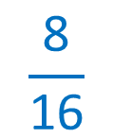





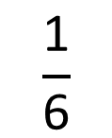
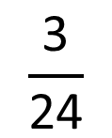
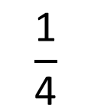
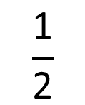


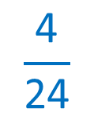
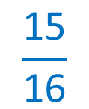
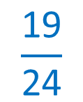
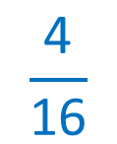
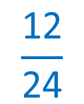
$$\frac{\text{3}}{\text{16}}$$
$$\frac{\text{1}}{\text{4}}$$
$$\frac{\text{1}}{\text{2}}$$
$$\frac{\text{15}}{\text{16}}$$
$$+$$
$$+$$
$$=$$
$$\frac{\text{4}}{\text{16}}$$
$$\frac{\text{8}}{\text{16}}$$
Have a think
$$\frac{\text{1}}{\text{2}}$$
$$\frac{\text{1}}{\text{6}}$$
$$\frac{\text{3}}{\text{24}}$$
$$\frac{\text{19}}{\text{24}}$$
$$+$$
$$+$$
$$=$$
$$\frac{\text{12}}{\text{24}}$$
$$\frac{\text{4}}{\text{24}}$$

Slide 7
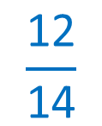
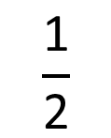

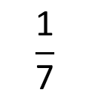
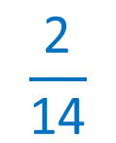

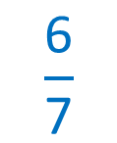
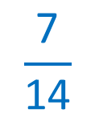
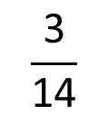

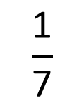



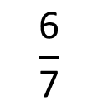

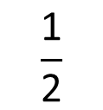
$$\frac{\text{3}}{\text{14}}$$
Dexter eats of a cake.
Have a think
$$\frac{\text{1}}{\text{7}}$$
Eva eats of the same cake.
$$\frac{\text{3}}{\text{14}}$$
Mo eats one half of the same cake.
$$\frac{\text{6}}{\text{7}}$$
$$\frac{\text{1}}{\text{7}}$$
How much of the cake is eaten?
$$\frac{\text{3}}{\text{14}}$$
$$\frac{\text{1}}{\text{7}}$$
$$\frac{\text{1}}{\text{2}}$$
$$\frac{\text{12}}{\text{14}}$$
$$\frac{\text{6}}{\text{7}}$$
$$\frac{\text{1}}{\text{2}}$$
$$+$$
$$+$$
$$=$$
$$=$$
$$\frac{\text{2}}{\text{14}}$$
$$\frac{\text{7}}{\text{14}}$$

Slide 8
Have a go at questions
1 - 4 on the worksheet

Slide 9





























$$\text{6}$$
$$\text{1}$$
$$\frac{\text{3}}{\text{5}}$$
$$\frac{\text{7}}{\text{30}}$$
$$\frac{\text{1}}{\text{6}}$$
$$\frac{}{\text{5}}$$
$$\frac{\text{7}}{\text{30}}$$
$$+$$
$$+$$
$$=$$
$$\text{6}$$
$$\frac{\text{5}}{\text{30}}$$
$$\frac{\text{18}}{\text{30}}$$
$$\frac{\text{5}}{\text{30}}$$
$$\frac{}{\text{30}}$$
$$\frac{\text{18}}{\text{30}}$$
$$=$$
$$\frac{\text{6}}{\text{30}}$$
Have a think
$$\text{4}$$
$$\frac{}{\text{14}}$$
$$\frac{\text{8}}{\text{28}}$$
$$\frac{\text{1}}{\text{7}}$$
$$\frac{\text{5}}{\text{7}}$$
$$+$$
$$+$$
$$=$$
$$\text{2}$$
$$\frac{}{\text{7}}$$
$$\frac{\text{2}}{\text{7}}$$

Slide 10
Have a go at questions
5 - 6 on the worksheet

