Slide 1


Slide 3













$$\frac{\text{3}}{\text{10}}$$
$$\frac{}{\text{5}}$$
$$\frac{\text{7}}{\text{10}}$$
$$\frac{\text{2}}{\text{10}}$$
1)
2)
3)
$$+$$
$$+$$
$$=$$
$$\frac{\text{8}}{\text{24}}$$
$$\frac{}{\text{6}}$$
$$=$$
$$\frac{\text{2}}{}$$
$$\frac{\text{6}}{\text{9}}$$
$$=$$

Slide 4






$$\frac{}{\text{5}}$$
$$\frac{\text{3}}{\text{10}}$$
$$\text{3}$$
$$\frac{\text{7}}{\text{10}}$$
$$\frac{\text{2}}{\text{10}}$$
1)
2)
3)
$$+$$
$$+$$
$$=$$
$$\frac{}{\text{10}}$$
$$\text{6}$$
$$\frac{\text{9}}{\text{10}}$$
$$\text{2}$$
$$\frac{\text{8}}{\text{24}}$$
$$\frac{}{\text{6}}$$
$$=$$
$$\frac{\text{2}}{}$$
$$\frac{\text{6}}{\text{9}}$$
$$=$$
$$\text{3}$$

Slide 6











$$\frac{\text{1}}{\text{3}}$$
$$\frac{\text{1}}{\text{6}}$$
$$+$$
$$=$$
$$\frac{\text{2}}{\text{6}}$$
$$\frac{\text{1}}{\text{6}}$$
$$\frac{\text{3}}{\text{6}}$$
$$\frac{\text{1}}{\text{2}}$$
$$+$$
$$=$$
$$=$$

Slide 7



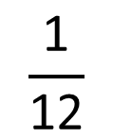

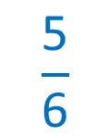

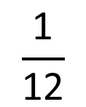



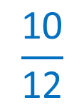
$$\frac{\text{3}}{\text{4}}$$
$$\frac{\text{1}}{\text{12}}$$
Have a think
$$+$$
$$=$$
$$\frac{\text{9}}{\text{12}}$$
$$\frac{\text{1}}{\text{12}}$$
$$\frac{\text{10}}{\text{12}}$$
$$\frac{\text{5}}{\text{6}}$$
$$+$$
$$=$$
$$=$$

Slide 8
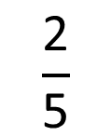
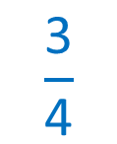




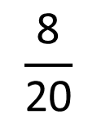


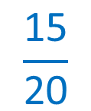





$$\frac{\text{7}}{\text{20}}$$
Annie runs of a route.
$$\frac{\text{2}}{\text{5}}$$
Ron runs of the same route.
How much of the route do they run altogether?
$$\frac{\text{7}}{\text{20}}$$
$$\frac{\text{2}}{\text{5}}$$
Have a think
$$+$$
$$=$$
$÷$ 5
$×$ 4
$$\frac{\text{7}}{\text{20}}$$
$$\frac{\text{8}}{\text{20}}$$
$$\frac{\text{15}}{\text{20}}$$
$$\frac{\text{3}}{\text{4}}$$
$$+$$
$$=$$
$$=$$

Slide 9
Have a go at questions
1 - 3 on the worksheet

Slide 10











$$\frac{}{\text{3}}$$
$$\frac{}{\text{9}}$$
4
1
1
$$\frac{\text{7}}{\text{9}}$$
2
$$+$$
$$=$$
$÷$ 3
Have a think
$$\frac{}{\text{9}}$$
$$\frac{}{\text{9}}$$
5
2
$$\frac{\text{7}}{\text{9}}$$
$$+$$
$$=$$
3
4
6
1

Slide 11









$$\frac{\text{19}}{\text{20}}$$
$$\frac{\text{1}\text{0}}{\text{20}}$$
$$\frac{\text{9}}{\text{20}}$$
$$\frac{\text{1}}{\text{2}}$$
8
Have a think
$$\frac{\text{1}}{\text{5}}$$
$$\frac{\text{3}}{\text{10}}$$
$$\frac{\text{3}}{\text{20}}$$
3
5
$$\frac{\text{4}}{\text{20}}$$
$$\frac{\text{6}}{\text{20}}$$

Slide 12
Have a go at questions
4 - 7 on the worksheet

