Slide 1
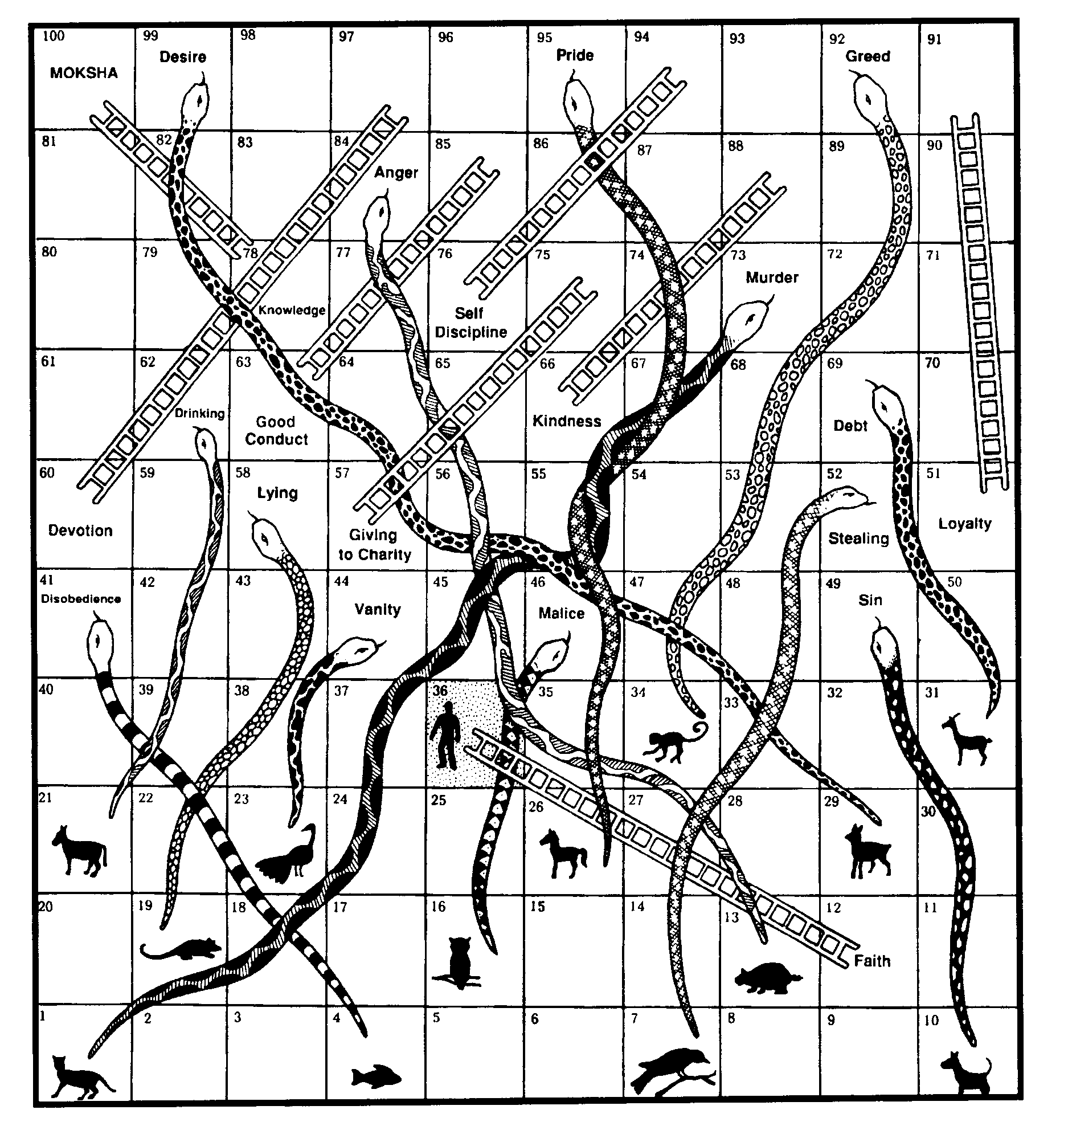
Notes:
Hindu game and questions

