Slide 1
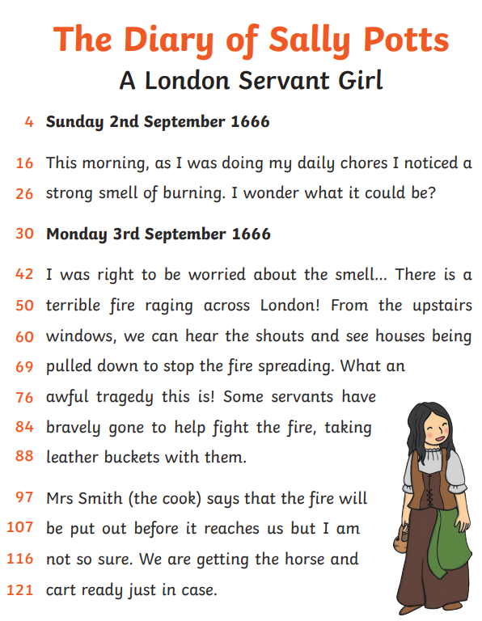
English Monday 22 February
This week we are looking at diary writing.
Some people write a diary everyday and some people write a diary only when special things happen to them.
This is Sally Potts’ diary.
She has written about events from her life over two days.
What are the features of diary writing?
Dates
First person writing – I, me, my, mine
Past tense
Personal thoughts, feelings, emotions
Adverbs of time – words that tell you ‘when’
Events in order
Can you spot these features in Sally’s diary?

Slide 2
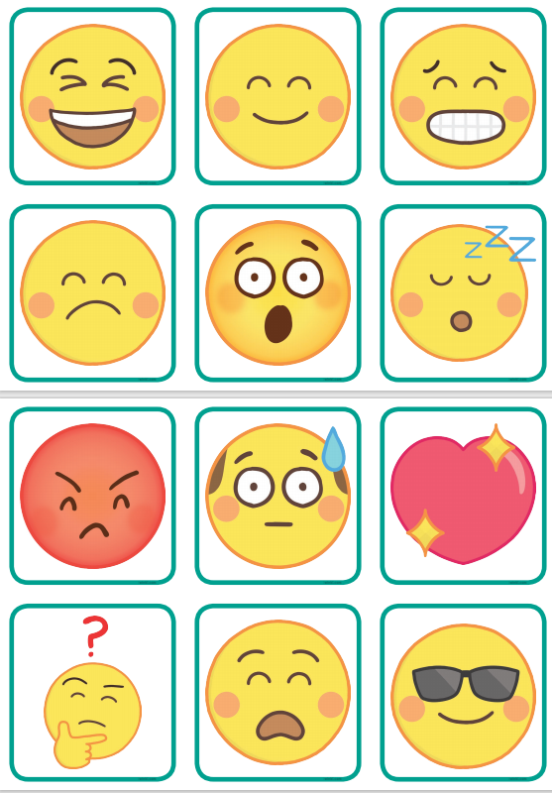
English Monday 22 February
Today, we are going to practise writing in the past tense and including our own thoughts feelings and emotions.
Task 1
How many emojis can you identify?
happy sad shocked tired angry puzzled frightened amused worried loved chilled frustrated

Slide 3
English Monday 22 February
Task 2
Think about what you have been doing over the half term holiday.
Choose two days.
Write at least three sentences for each day and include your thoughts or feelings or emotions.
Friday 19 February
This afternoon, I went for a walk with Mr Weatherby. I was surprised at how far we walked and how muddy my boots were. We walked around the bailey of a medieval castle it was very exciting.
Saturday 20 February
It was weigh day today for Marshmallow. He hasn’t eaten as much this week, so my heart was racing when I lifted him out of the hutch and onto the scales. He has lost 56g in the last week. I wonder if he is trying to hibernate.
Can you spot any of these features in my diary writing?
Dates
First person writing – I, me, my, mine
Past tense
Personal thoughts, feelings, emotions
Adverbs of time – words that tell you ‘when’
Events in order
You try. Please send me your sentences via Seesaw, thank you.

Slide 4
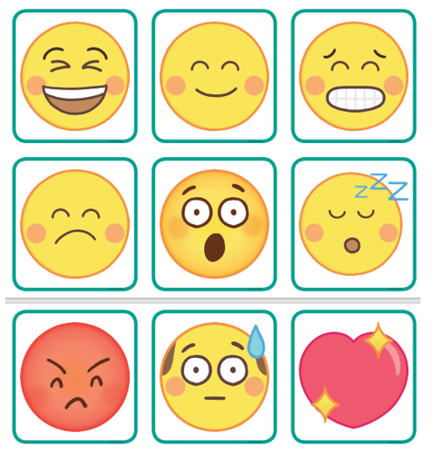
Emoji Snap
Cut out a set of cards for each person.
Shuffle and deal the cards to all the players.
Take it in turns to place a card face up on the table and name the emoji.
When an identical card is placed on top of another card, the first person to shout snap wins the pile of cards.
This can be noisy! But fun!

