Slide 1
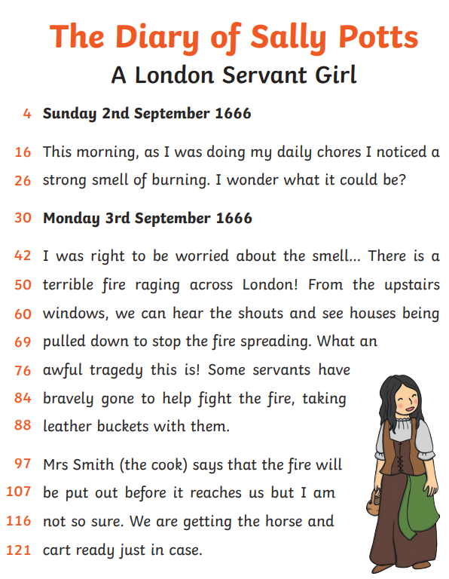
What can Sally see from the upstairs window?
………………………………………………………………………………………
What do you think the servants are planning to do with their leather buckets?
………………………………………………………………………………………
Write out the sentence that finishes with the exclamation mark.
………………………………………………………………………………………
What do you think Sally will do on Tuesday?
………………………………………………………………………………………
‘chores’ means ………………………………………………………………
Find the words ‘put out’ in the last paragraph. Think of a better word to replace them ……………………………………

