Slide 1



LIFE/work balance
We have started a #LIFEworkbalance campaign and we need your help to complete our LIFE/work balance survey.
We hope to publish the results soon, so please give 15 minutes of your time to help us get a true picture of school life.
Want to be a part of this campaign? Take the survey on our website and share it with your colleagues!
© Classroom Secrets Limited 2019

Slide 2
Year 2 – Spring Block 4 – Fractions – Find a Half
About This Resource:
This PowerPoint has been designed to support your teaching of this small step. It includes a starter activity and an example of each question from the Varied Fluency and Reasoning and Problem Solving resources also provided in this pack. You can choose to work through all examples provided or a selection of them depending on the needs of your class.
National Curriculum Objectives:
Mathematics Year 2: (2F1a) Recognise, find, name and write fractions 1/3, 1/4, 2/4 and 3/4 of a length, shape, set of objects or quantity
Mathematics Year 2: (2F1b) Write simple fractions for example, 1/2 of 6 = 3
More Year 2 Fractions resources.
Did you like this resource? Don’t forget to review it on our website.
© Classroom Secrets Limited 2019

Slide 3
Year 2 – Spring Block 4 – Fractions
Step 3: Find a Half
© Classroom Secrets Limited 2019

Slide 4
Introduction
Circle the images which represent a half.

Slide 5
Introduction
Circle the images which represent a half.

Slide 6

Varied Fluency 1
Find half of the flowers. Tick a box to show the answer.
9
8
7

Slide 7
Varied Fluency 1
Find half of the flowers. Tick a box to show the answer.
9
8 | 
7

Slide 8
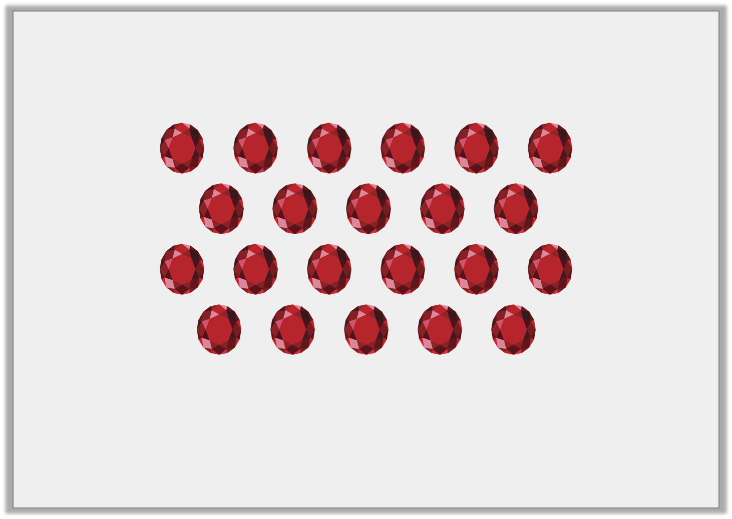
Varied Fluency 2
Circle of the jewels below.
1
2
© Classroom Secrets Limited 2019

Slide 9
Varied Fluency 2
Circle of the jewels below.
of 22 = 11
1
2
1
2
© Classroom Secrets Limited 2019

Slide 10
Varied Fluency 3
Use counters to complete the bar model.
The whole is . Half of is .
16
© Classroom Secrets Limited 2019

Slide 11
Varied Fluency 3
Use counters to complete the bar model.
The whole is . Half of is .
16
16
16
8
© Classroom Secrets Limited 2019

Slide 12

Varied Fluency 4
Complete the part-whole model.
of is .
1
2
© Classroom Secrets Limited 2019

Slide 13
Varied Fluency 4
Complete the part-whole model.
of is .
1
2
80
40
© Classroom Secrets Limited 2019

Slide 14
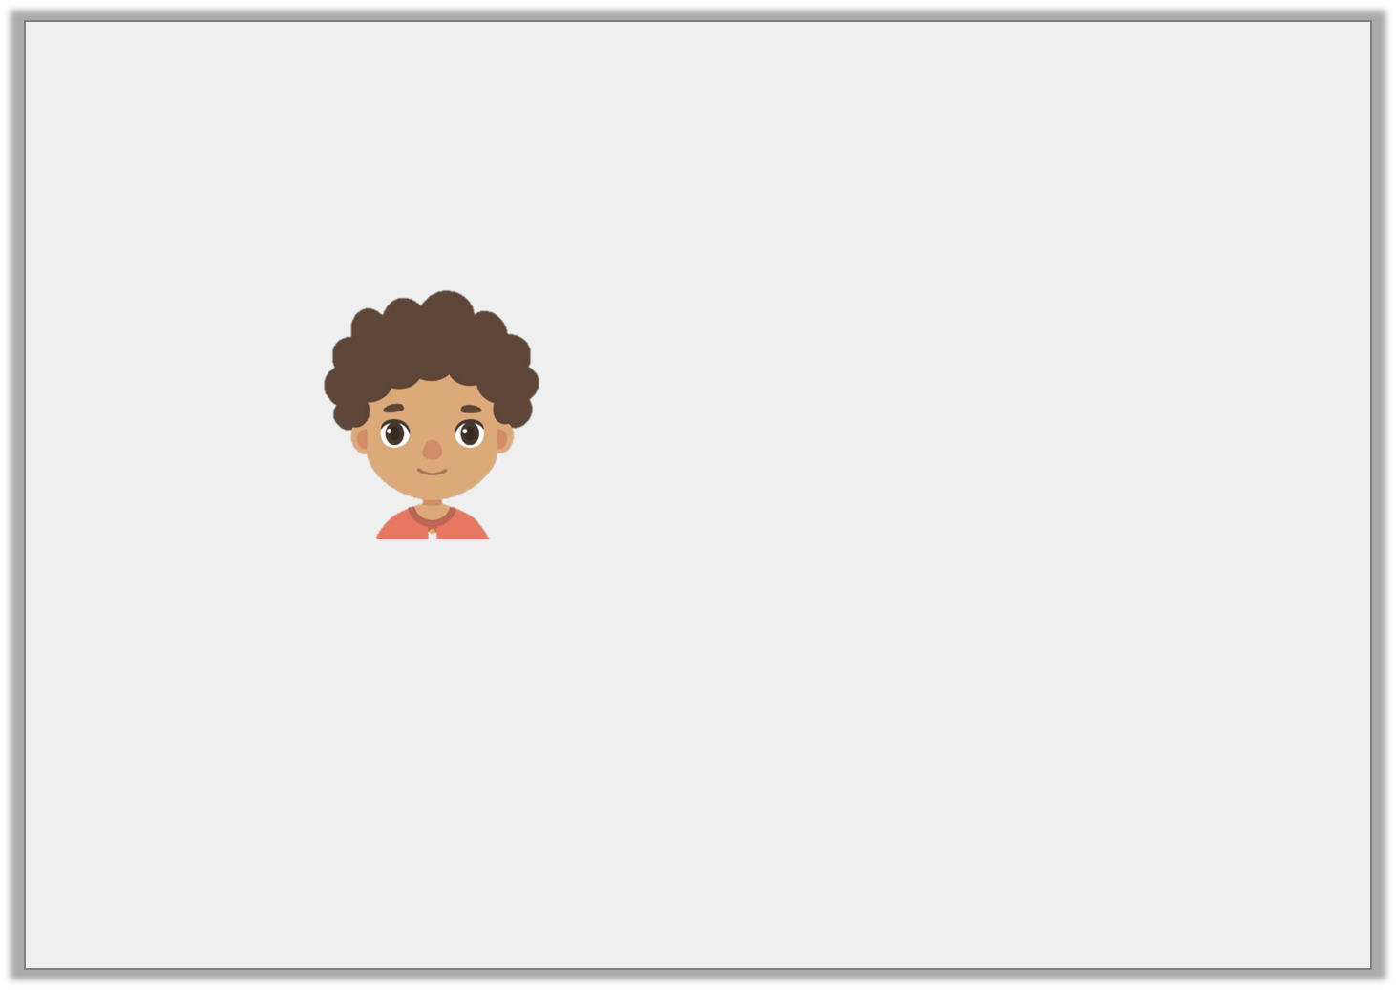

Reasoning 1
Is Ahmed correct?
Explain why.
I had 12 marbles. I gave half of them to Shadi. Now we have 7 marbles each.
© Classroom Secrets Limited 2019

Slide 15
Reasoning 1
Is Ahmed correct?
Explain why.
Ahmed is incorrect because…
I had 12 marbles. I gave half of them to Shadi. Now we have 7 marbles each.
© Classroom Secrets Limited 2019

Slide 16
Reasoning 1
Is Ahmed correct?
Explain why.
Ahmed is incorrect because half of 12 is 6.
I had 12 marbles. I gave half of them to Shadi. Now we have 7 marbles each.
© Classroom Secrets Limited 2019

Slide 17
Problem Solving 1
Using the digit cards, complete the statements below.
18
22
11
9
1
2
A. |  | of |  | =
1
2
B. |  | of |  | =
© Classroom Secrets Limited 2019

Slide 18
Problem Solving 1
Using the digit cards, complete the statements below.
18
22
11
9
1
2
A. |  | of | 18 | = | 9
1
2
B. |  | of | 22 | = | 11
© Classroom Secrets Limited 2019

Slide 19
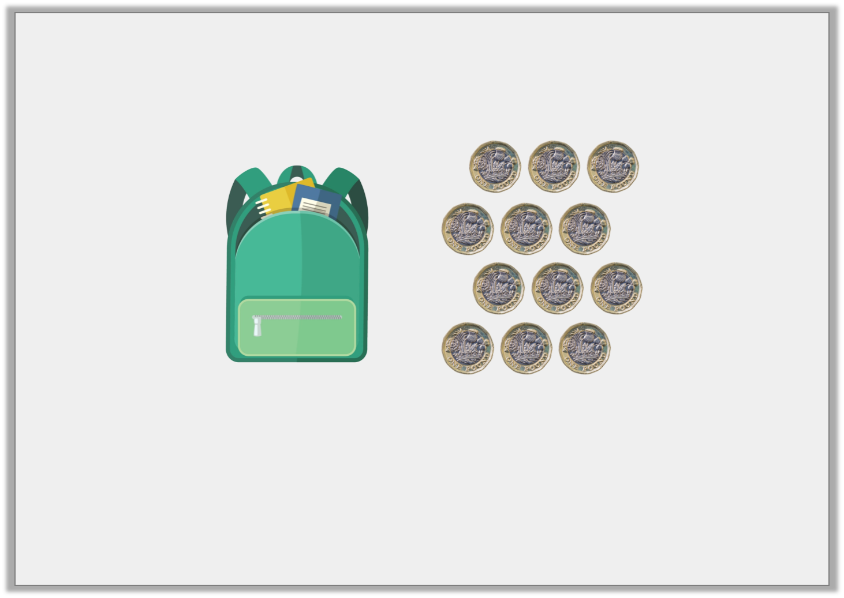
Reasoning 2
Henry has £12. He wants to buy a new school bag which costs half of his money. How much does the school bag cost?
Explain how you know.
© Classroom Secrets Limited 2019

Slide 20
Reasoning 2
Henry has £12. He wants to buy a new school bag which costs half of his money. How much does the school bag cost?
Explain how you know.
The school bag will cost £6 because…
© Classroom Secrets Limited 2019

Slide 21
Reasoning 2
Henry has £12. He wants to buy a new school bag which costs half of his money. How much does the school bag cost?
Explain how you know.
The school bag will cost £6 because half of £12 is £6.
© Classroom Secrets Limited 2019

