Slide 1
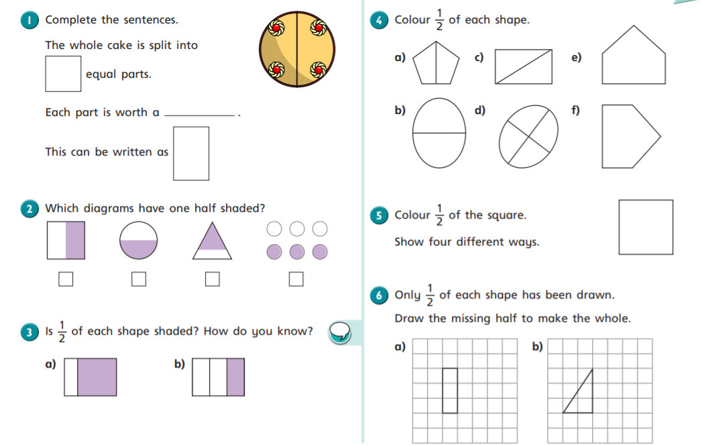

Slide 2
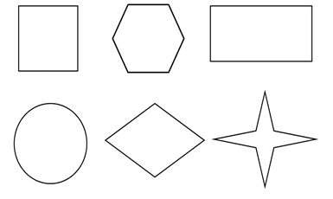
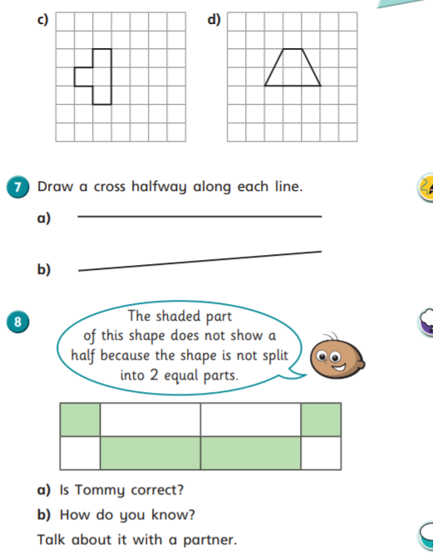
Cut out these shapes and fold to show halves. You could colour half.
Or, draw lines to show halves and colour half of each shape.
Remember that halves are equal parts.

Slide 3
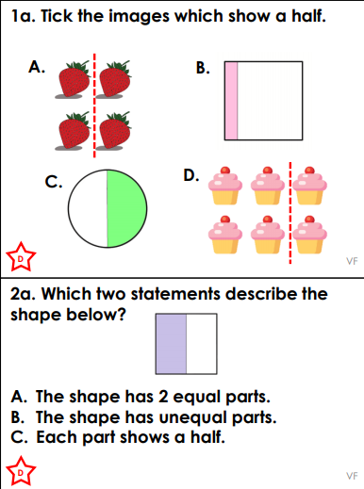
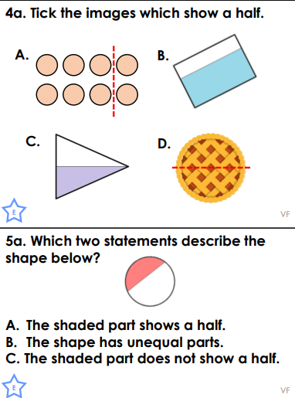
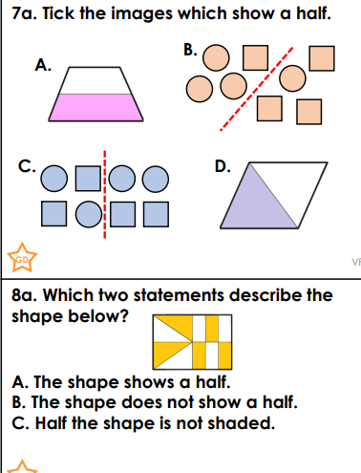
*
**
***
Choose a set of questions to answer.

