Slide 1
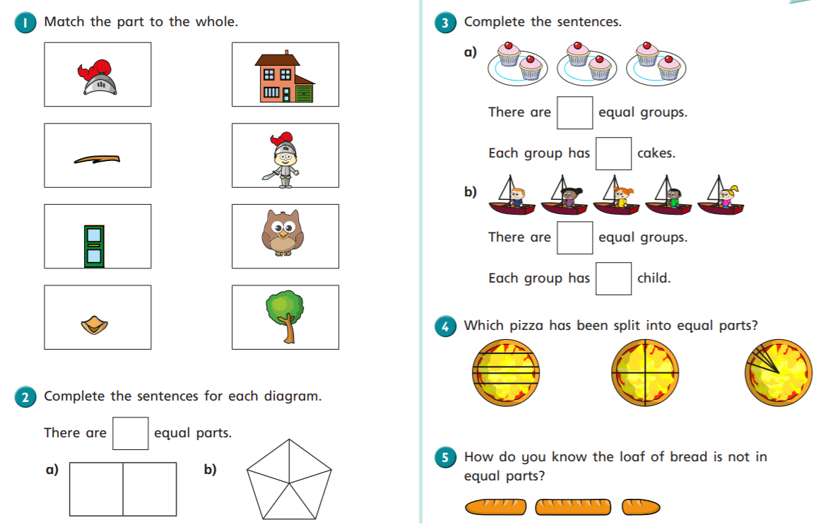

Slide 2
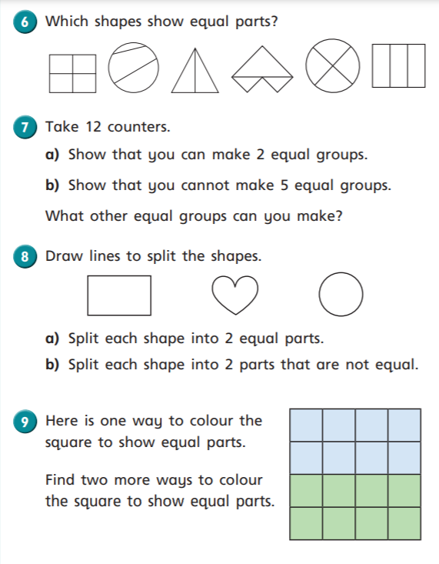
Challenge!
Can you find two more ways to show equal parts?
How many blue squares do you need to colour?
How many green squares do you need to colour?
Do all the blue squares need to touch?
Do all the green squares need to touch?

Slide 3
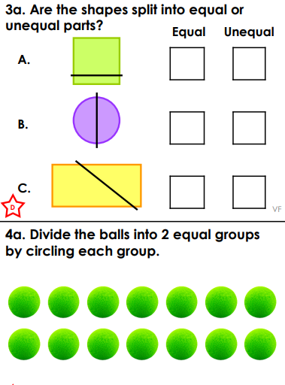
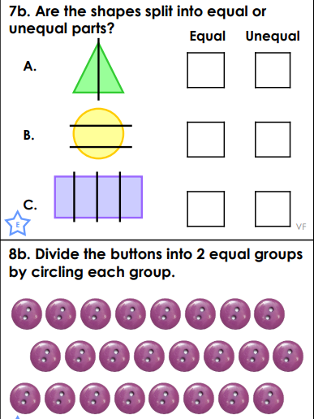
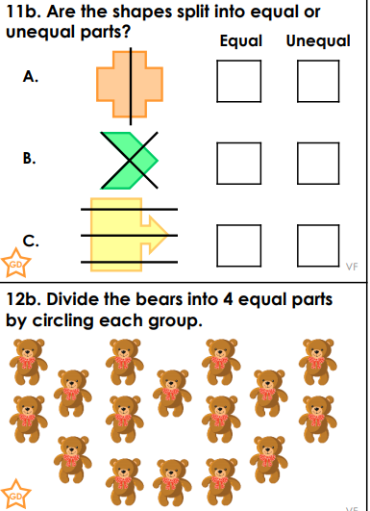
*
**
***
Choose a set of questions to answer, but look carefully before ticking ‘equal’ or ‘unequal’.

