Slide 1
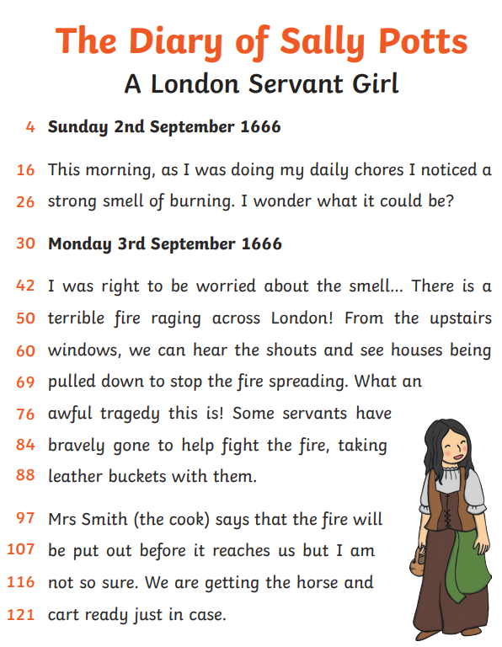
Can you read 90 words in 60 seconds?
This sounds like a lot but it isn’t really.
Read this diary extract and see how far you get in 60 seconds.
Try it again the next day and the next day and the next day.
You will be amazed at your progress.
You could keep a record of your improvement.
Day | Number of words in 60 seconds
Monday
Tuesday
Wednesday
Thursday
Friday

