Slide 1


Year 4 – Spring Block 3 – Fractions
Step 9: Fractions of a Quantity
© Classroom Secrets Limited 2019

Slide 2
Problem Solving 1
Below is the recipe for 4 brownies. Sinead only needs to make 3 brownies.
How much of each ingredient will she need?
Brownie Ingredients
4 eggs
100g plain flour
120g cocoa powder
80g chocolate
© Classroom Secrets Limited 2019

Slide 3
Problem Solving 1
Below is the recipe for 4 brownies. Sinead only needs to make 3 brownies.
How much of each ingredient will she need?
She will need 3 eggs, 75g of plain flour, 90g of cocoa powder and 60g of chocolate.
Brownie Ingredients
4 eggs
100g plain flour
120g cocoa powder
80g chocolate
© Classroom Secrets Limited 2019

Slide 4
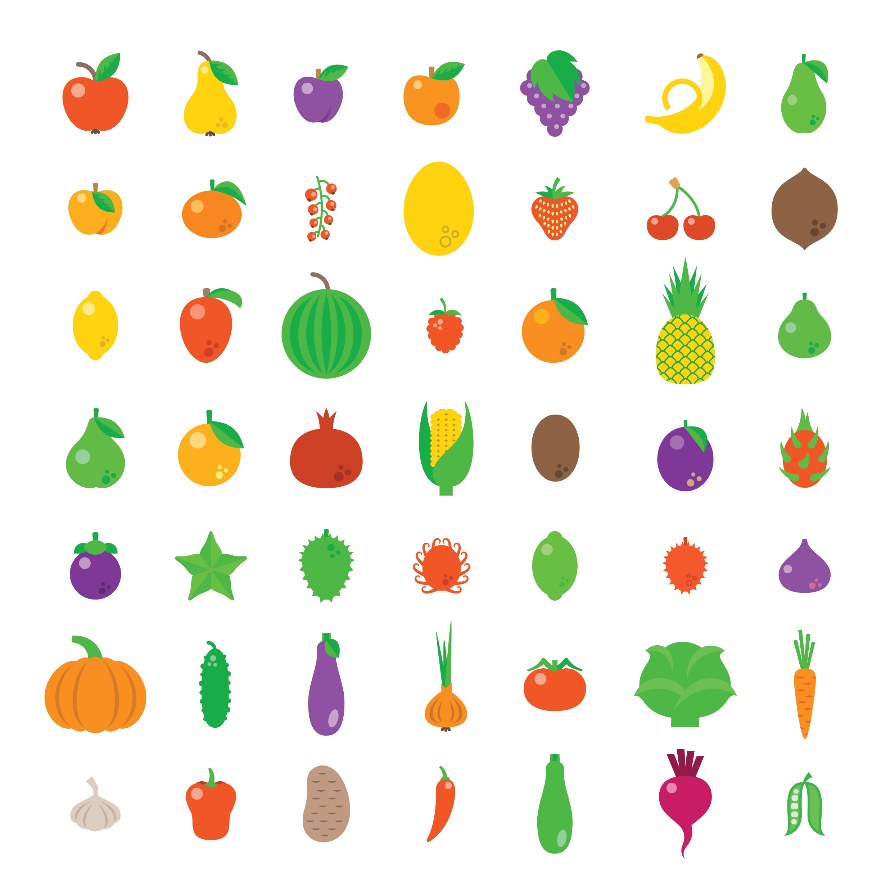
Reasoning 1
Lori is making lunch. The recipe says to use as many aubergines as courgettes. Lori uses 12 courgettes but she’s unsure of how many aubergines to use.
How many aubergines does Lori need? Explain how you know.
3
4
© Classroom Secrets Limited 2019

Slide 5
Reasoning 1
Lori is making lunch. The recipe says to use as many aubergines as courgettes. Lori uses 12 courgettes but she’s unsure of how many aubergines to use.
How many aubergines does Lori need? Explain how you know.
Lori needs to use 9 aubergines because…
3
4
© Classroom Secrets Limited 2019

Slide 6
Reasoning 1
Lori is making lunch. The recipe says to use as many aubergines as courgettes. Lori uses 12 courgettes but she’s unsure of how many aubergines to use.
How many aubergines does Lori need? Explain how you know.
Lori needs to use 9 aubergines because of 12 courgettes is 3 and 3 x 3 = 9.
3
4
1
4
© Classroom Secrets Limited 2019

Slide 7
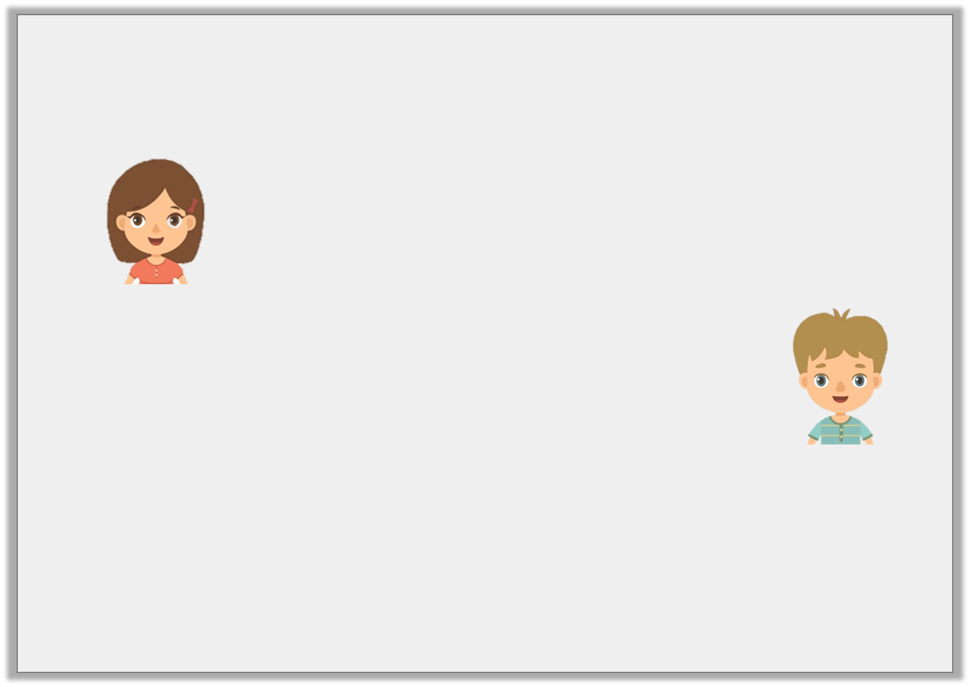
Reasoning 2
Steph and Jake are calculating of 24.
Who is correct? Explain how you know.
3
8
The answer is 9.
Steph
The answer is 64.
Jake
© Classroom Secrets Limited 2019

Slide 8
Reasoning 2
Steph and Jake are calculating of 24.
Who is correct? Explain how you know.
Steph is correct because…
3
8
The answer is 9.
Steph
The answer is 64.
Jake
© Classroom Secrets Limited 2019

Slide 9
Reasoning 2
Steph and Jake are calculating of 24.
Who is correct? Explain how you know.
Steph is correct because 24 ÷ 8 = 3 and 3 x 3 = 9. Jake has divided by the numerator first then multiplied by the denominator.
3
8
The answer is 9.
Steph
The answer is 64.
Jake
© Classroom Secrets Limited 2019

