Slide 1


Year 4 – Spring Block 3 – Fractions
Step 6: Add 2 or More Fractions
© Classroom Secrets Limited 2019

Slide 2
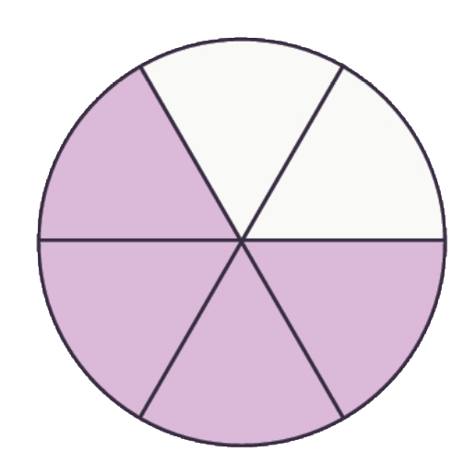
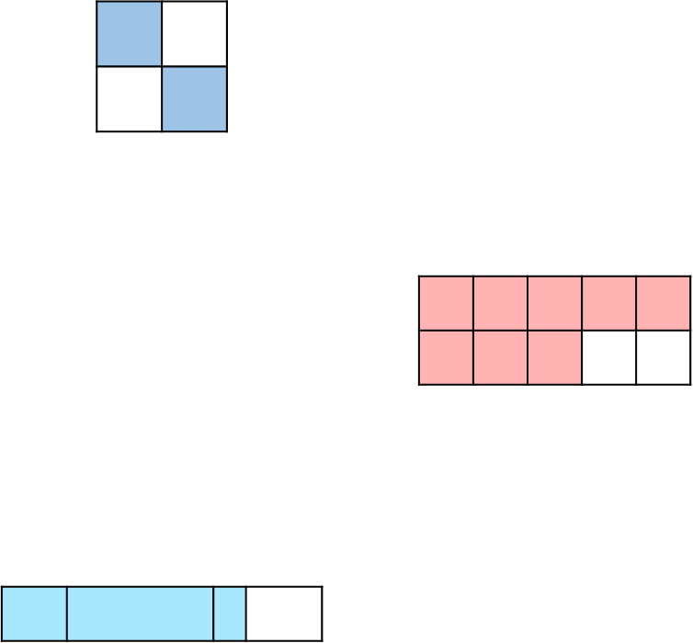

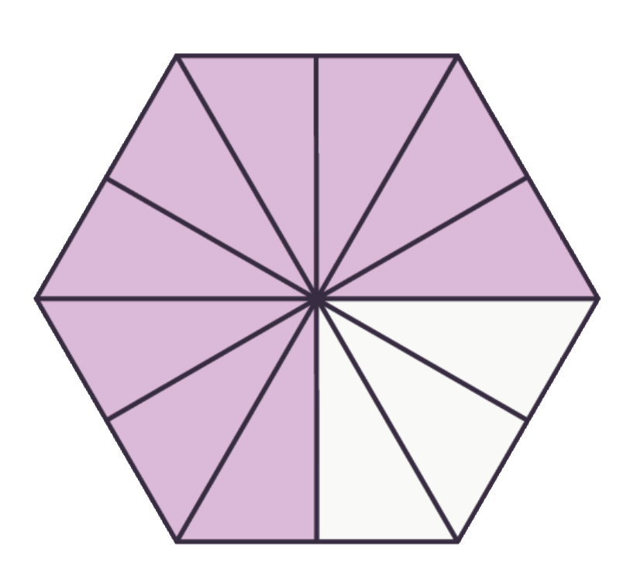



Introduction
Circle the shapes below that are equivalent to .
3
4
© Classroom Secrets Limited 2019

Slide 3
Introduction
Circle the shapes below that are equivalent to .
3
4
© Classroom Secrets Limited 2019

Slide 4
Varied Fluency 1
Shade the model to complete the following calculation.
4 | + | 9 | =
10 |  | 10
© Classroom Secrets Limited 2019

Slide 5
Varied Fluency 1
Shade the model to complete the following calculation.
4 | + | 9 | = | 13
10 |  | 10 |  | 10
© Classroom Secrets Limited 2019

Slide 6
Varied Fluency 2
Complete the calculation below.
7 | + | 4 | + | 5 | =
9 |  | 9 |  | 9
© Classroom Secrets Limited 2019

Slide 7
Varied Fluency 2
Complete the calculation below.
7 | + | 4 | + | 5 | = | 16
9 |  | 9 |  | 9 |  | 9
© Classroom Secrets Limited 2019

Slide 8
Varied Fluency 3
Tick the correct answer. Use the empty number line to help you.
5 | + | 11 | + | 4 | =
7 |  | 7 |  | 7
20
21
18
7
20
7
© Classroom Secrets Limited 2019

Slide 9
Varied Fluency 3
Tick the correct answer. Use the empty number line to help you.
5 | + | 11 | + | 4 | = | 20
7 |  | 7 |  | 7 |  | 7
✓
20
21
18
7
20
7
© Classroom Secrets Limited 2019

Slide 10
Varied Fluency 4
Fill in the missing numbers.
A. |  | 7 | + | 9 | = |  | + | 5 | =
 |  |  |  | 12 |  | 12 |  | 12 |  | 12
B. |  | 11 | + | 12 | = |  | + | 5 | =
 |  | 8 |  |  |  | 8 |  | 8
© Classroom Secrets Limited 2019

Slide 11
Varied Fluency 4
Fill in the missing numbers.
A. |  | 7 | + | 9 | = | 11 | + | 5 | = | 16
 |  | 12 |  | 12 |  | 12 |  | 12 |  | 12
B. |  | 11 | + | 12 | = | 18 | + | 5 | = | 23
 |  | 8 |  | 8 |  | 8 |  | 8 |  | 8
© Classroom Secrets Limited 2019

