Slide 2





Hundredths
Diving
Fill in the missing hundredths to complete the number lines.
Find the equivalents.
30
3
=
0
1
2
3
4
5
10
100
100
100
100
100
100
70
7
=
10
100
37
39
42
45
47
100
100
100
4
100
100
=
40
10
100

Slide 3



Hundredths
Diving
Fill in the missing tenths or hundredths to complete the sequence.
36
37
38
39
4
41
42
100
100
100
100
10
100
100
Which fractions do you think could be shown by the arrows on the number line?
30
6
32
Do you think would be a correct answer here? What about ? Why?
100
10
100
50
29
100
100

Slide 4

Hundredths
Deeper
Cara has been writing equivalents between tenths and hundredths.
Tick or cross each statement. If there is a mistake, write the
correct answer.
Equivalents
✓ or ×
Correction
8
80
=
✓
10
100
87
=
8
and
7
×
87
8
and
7
100
100
100
=
100
100
10
1
and
83
=
93
✓
10
100
100
79
=
7
and
9
79
7
and
9
×
=
100
100
100
10
100
10

Slide 5




Hundredths
Deepest
Write a different digit in each box to complete the statement correctly.
20
2
<
40
4
>
38
=
=
100
10
100
10
100
There are
lots of different ways to complete this correctly.
Here is one
example:

Slide 6

Hundredths
Deepest
Use these fractions to make comparing statements. One is done for you.
There are lots of possible answers. Here is one example:
40
50
 | =
 | >
 | <
 | =
100
100
60
4
and
2
100
10
10
37
92
100
100
9
and
10
38
4
100
10
79
79
and
2
39
100
100
10
10
40
and
4
8
7
100
10
10
10

Slide 7


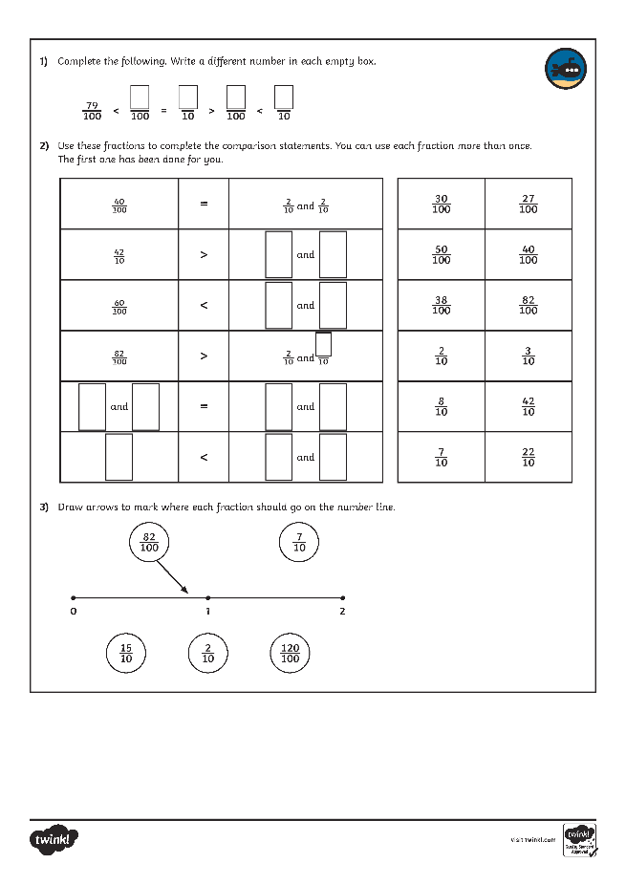
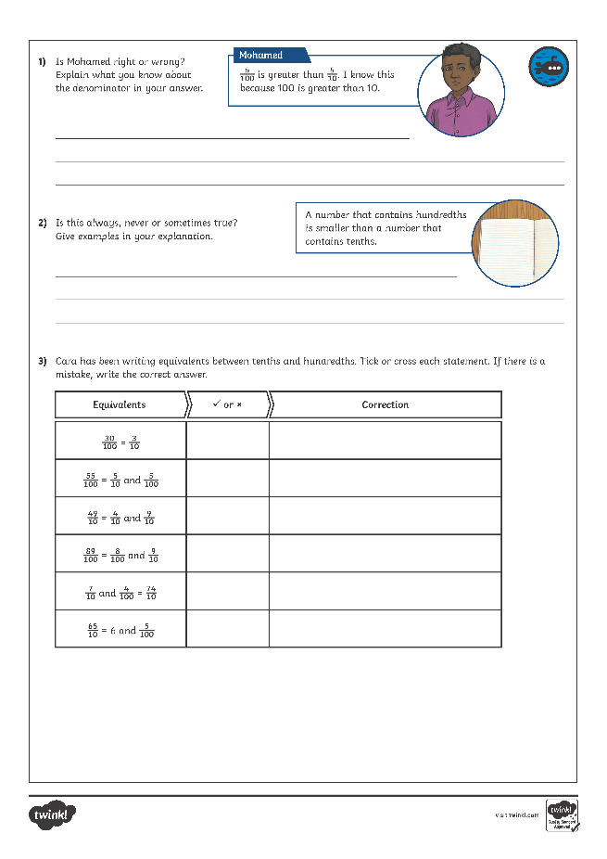
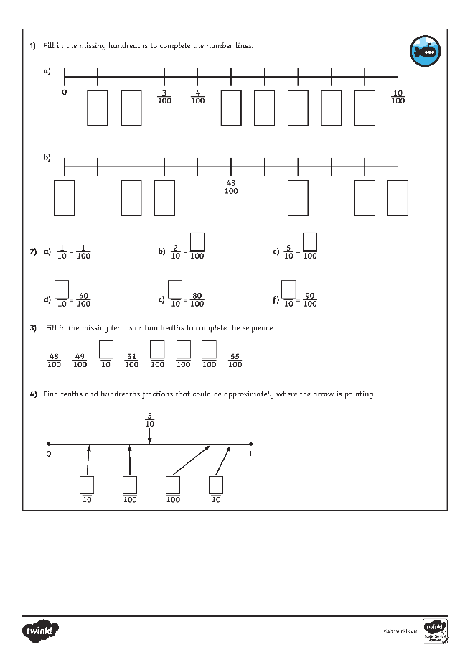
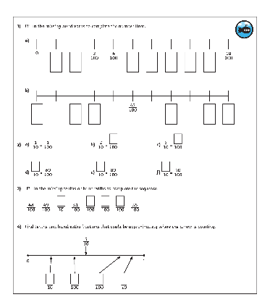
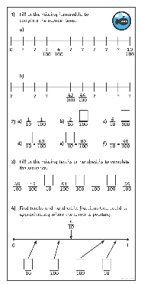
Hundredths
Dive in by completing your own activity!

