Slide 1
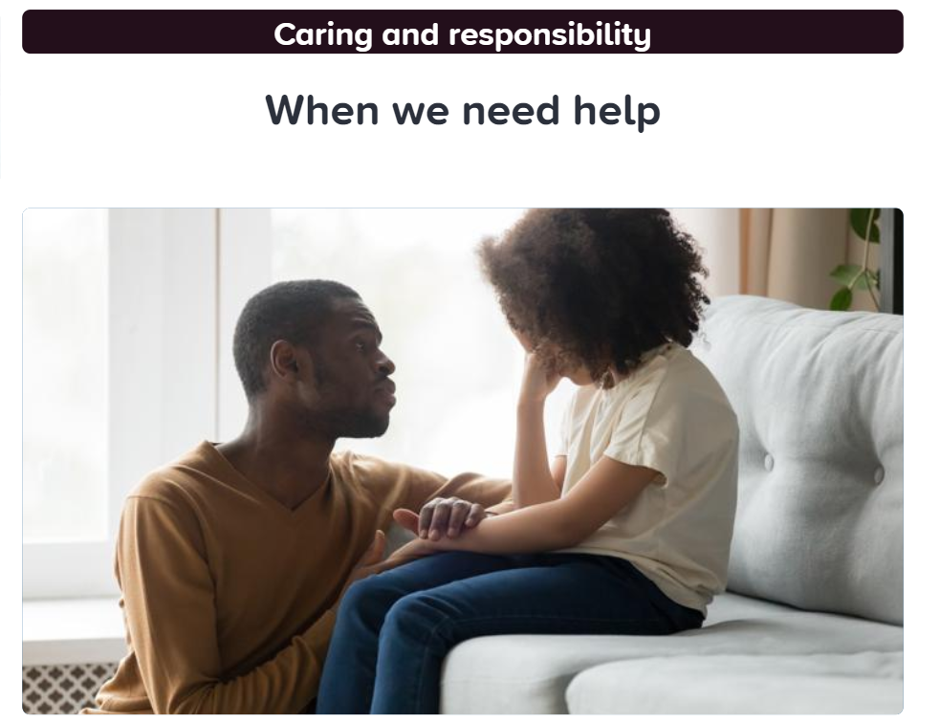
Caring and Responsibility Lesson 2
When we need help
Ways of staying safe in our communities and when we may need to ask for help.
These slides may prompt some important questions about who a trusted adult might be.
At school?
In a shop?
Playing outside?

Slide 2
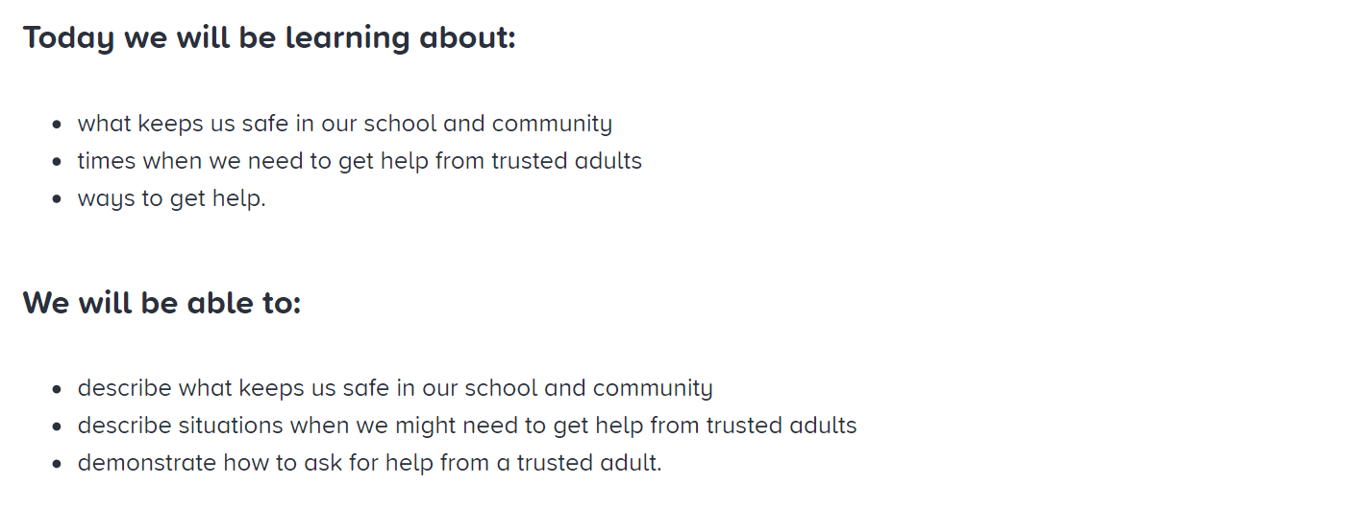
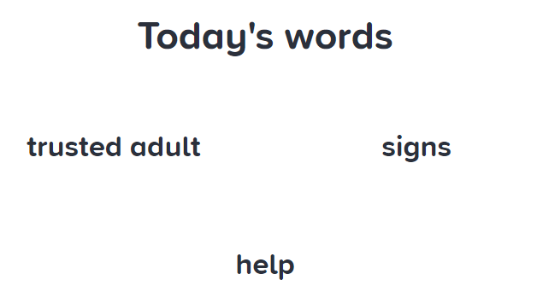

Slide 3
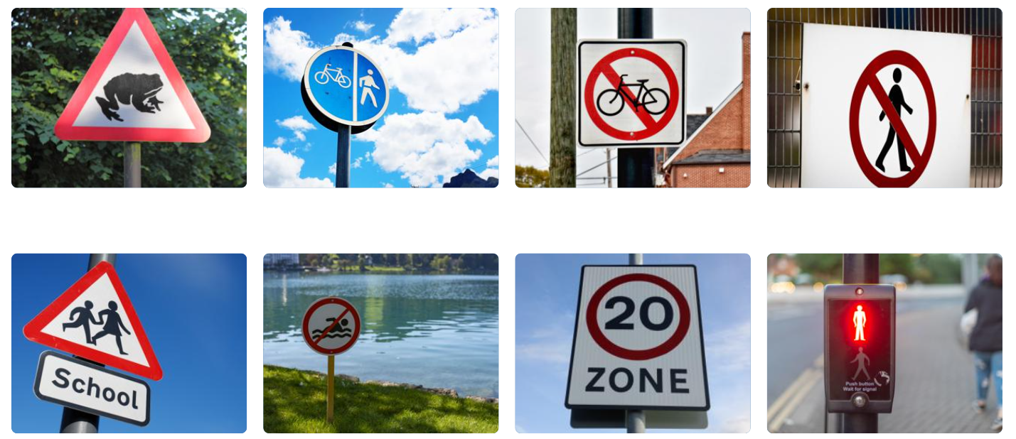
Have you seen any of these signs?
Why are they there?
They are there to remind us to obey the rules. Some tell us not to do something (red circle), some are warnings (red triangle) and some give information (blue/green or white).

Slide 4
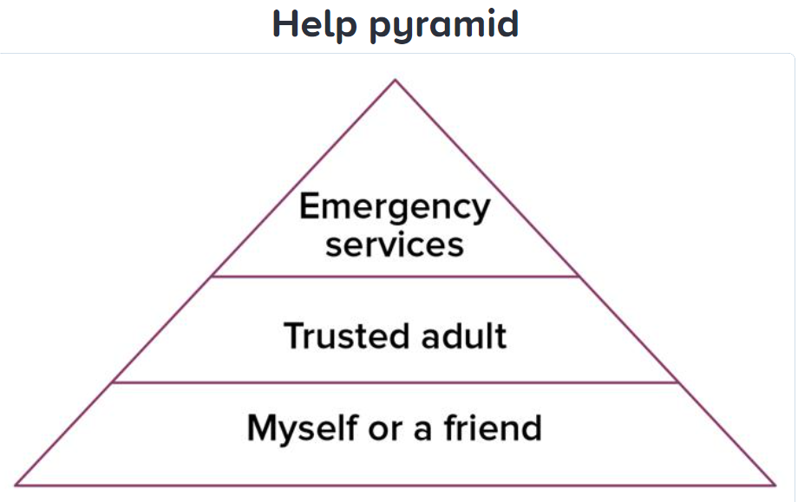
Sometimes things happen that we are not expecting and we may need to ask for help.
Who should we ask?
Occasionally, we may need help from the emergency services.
Sometimes, we may need help from a trusted adult.
Often, we can sort out things ourselves or with friends.

Slide 5
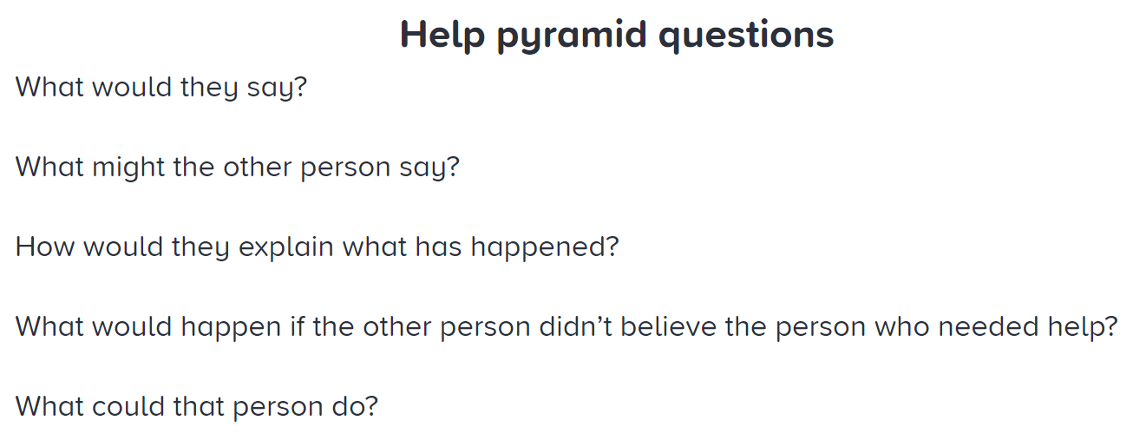
Use these questions to guide your conversations while discussing the scenarios on the next slide.

