Slide 1


Year 5 – Spring Block 2 – Fractions
I can compare and order fractions
© Classroom Secrets Limited 2018

Slide 2
Introduction
Match the equivalent fractions.
2
3
70
90
1. | A.
2. | B.
3. | C.
4. | D.
5. | E.
8
11
24
33
7
9
15
18
5
6
4
6
3
10
12
40
© Classroom Secrets Limited 2018

Slide 3
Introduction
Match the equivalent fractions.
2
3
70
90
1. | A.
2. | B.
3. | C.
4. | D.
5. | E.
8
11
24
33
7
9
15
18
5
6
4
6
3
10
12
40
© Classroom Secrets Limited 2018

Slide 4
Varied Fluency 1
Finish the model to show and .
Compare using <, > or =.
2
5
5
20
© Classroom Secrets Limited 2018

Slide 5
Varied Fluency 1
Finish the model to show and .
Compare using <, > or =.
2
5
5
20
>
© Classroom Secrets Limited 2018

Slide 6
Varied Fluency 2
Match the fraction with its representation then put them in descending order.
8
9
1. | A.
2. | B.
3. | C.
11
18
2
3
© Classroom Secrets Limited 2018

Slide 7
Varied Fluency 2
Match the fraction with its representation then put them in descending order.
Descending order: 1, 3, 2
8
9
1. | A.
2. | B.
3. | C.
11
18
2
3
© Classroom Secrets Limited 2018

Slide 8
Varied Fluency 3
True or false?
4 | > | 4
7 |  | 9
© Classroom Secrets Limited 2018

Slide 9
Varied Fluency 3
True or false?
True
4 | > | 4
7 |  | 9
© Classroom Secrets Limited 2018

Slide 10
Varied Fluency 4
Circle the largest fraction. Use the models to help you.
7
10
3
5
11
20
© Classroom Secrets Limited 2018

Slide 11
Varied Fluency 4
Circle the largest fraction. Use the models to help you.
7
10
3
5
11
20
© Classroom Secrets Limited 2018

Slide 12
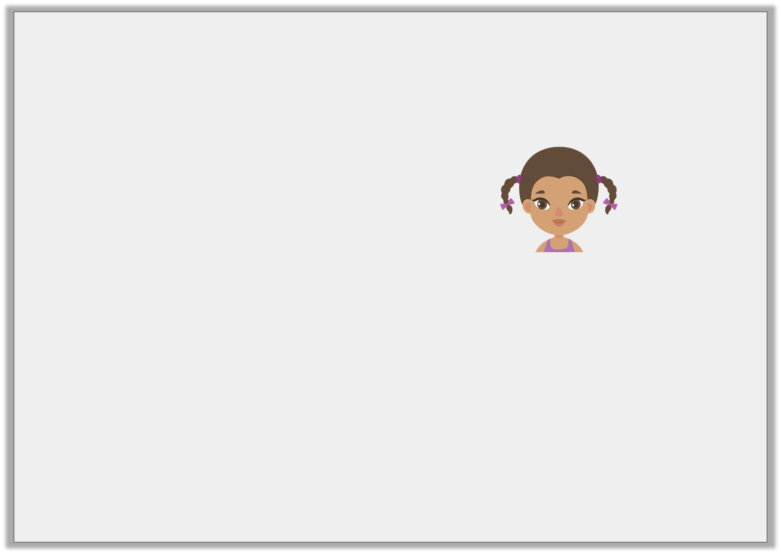
Reasoning 1
Aoife is comparing the fractions and .
Is she correct? Show how she could use a diagram to check her answer.
2
6
4
7
I know that .
Twelfths are double the size of sixths, so is greater than .
2 | equals | 4
6 |  | 12
4 |  | 4
12 |  | 7
© Classroom Secrets Limited 2018

Slide 13
Reasoning 1
Aoife is comparing the fractions and .
Is she correct? Show how she could use a diagram to check her answer.
Aoife is incorrect because…
2
6
4
7
I know that .
Twelfths are double the size of sixths, so is greater than .
2 | equals | 4
6 |  | 12
4 |  | 4
12 |  | 7
© Classroom Secrets Limited 2018

Slide 14
Reasoning 1
Aoife is comparing the fractions and .
Is she correct? Show how she could use a diagram to check her answer.
Aoife is incorrect because twelfths are smaller than sixths.
Therefore, .
2
6
4
7
I know that .
Twelfths are double the size of sixths, so is greater than .
2 | equals | 4
6 |  | 12
4 |  | 4
12 |  | 7
2 | = | 4
6 |  | 12
4
7
4 | < | 4
12 |  | 7
© Classroom Secrets Limited 2018

Slide 15
Problem Solving 1
Use two number cards to complete the equation.
Find two possibilities.
1 | < |  | < | 2
3 |  |  |  | 3
5
9
12
8
15
© Classroom Secrets Limited 2018

Slide 16
Problem Solving 1
Use two number cards to complete the equation.
Find two possibilities.
Possible answers:
1 | < |  | < | 2
3 |  |  |  | 3
5
9
12
8
15
5 | , | 5 | , | 8
9 |  | 12 |  | 15
© Classroom Secrets Limited 2018

Slide 17
Reasoning 2
Tahiba has put these fractions in descending order.
Explain her mistake.
Rewrite the fractions in the correct order with the same denominators.
9 | , | 7 | , | 4 | , | 1
20 |  | 10 |  | 5 |  | 5
© Classroom Secrets Limited 2018

Slide 18
Reasoning 2
Tahiba has put these fractions in descending order.
Explain her mistake.
Rewrite the fractions in the correct order with the same denominators.
Tahiba has ordered the fractions by…
9 | , | 7 | , | 4 | , | 1
20 |  | 10 |  | 5 |  | 5
© Classroom Secrets Limited 2018

Slide 19
Reasoning 2
Tahiba has put these fractions in descending order.
Explain her mistake.
Rewrite the fractions in the correct order with the same denominators.
Tahiba has ordered the fractions by their denominator, but has not found their equivalent fractions.
The correct order is .
9 | , | 7 | , | 4 | , | 1
20 |  | 10 |  | 5 |  | 5
16 | , | 14 | , | 9 | , | 4
20 |  | 20 |  | 20 |  | 20
© Classroom Secrets Limited 2018

