Slide 1


Slide 2


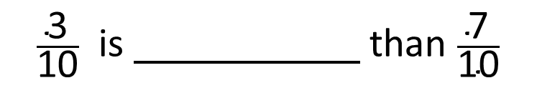

Write $>, <$ or $=$ to compare the fractions
$\frac{\text{3}}{\text{10}}$ $\frac{\text{7}}{\text{10}}$
$$<$$
$\frac{\text{3}}{\text{10}}$ is than $\frac{\text{7}}{\text{10}}$
smaller
greater
smaller
When the denominators are the same, the the numerator, the the fraction.
greater
smaller

Slide 3







greater
smaller
When the denominators are the same, the the numerator, the the fraction.
greater
smaller
Write $>, <$ or $=$ to compare the fractions
$\frac{\text{2}}{\text{5}}$ $\frac{\text{7}}{\text{15}}$
$$<$$
$×$ 3
Multiples of 5: 5, 10, 15
6
$\frac{\text{2}}{\text{5}}$ $=$ $\frac{}{\text{15}}$
$\frac{\text{6}}{\text{15}}$ $<$ $\frac{\text{7}}{\text{15}}$
$×$ 3

Slide 4




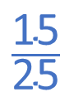

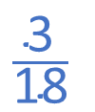



Have a think
Write $>, <$ or $=$ to compare the fractions
$$\frac{\text{3}}{\text{18}}$$
$\frac{\text{1}}{\text{6}}$ $\frac{\text{5}}{\text{18}}$
$$<$$
$\frac{\text{12}}{\text{25}}$ $\frac{\text{3}}{\text{5}}$
$$\frac{\text{15}}{\text{25}}$$
$$<$$
$\frac{\text{36}}{\text{36}}$ $\frac{\text{9}}{\text{9}}$
$$=$$

Slide 5

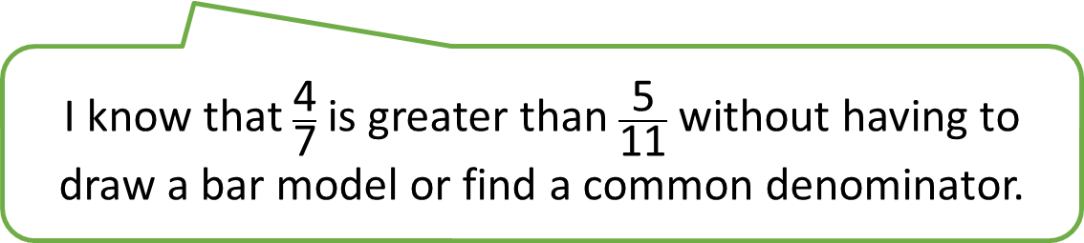
Have a think
I know that $\frac{\text{4}}{\text{7}}$ is greater than $\frac{\text{5}}{\text{11}}$ without having to draw a bar model or find a common denominator.

Slide 6


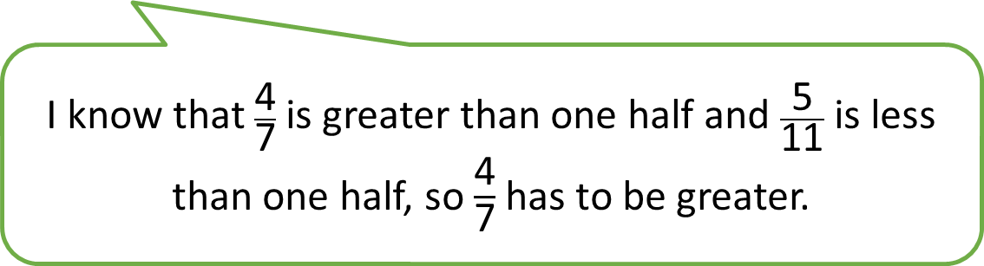


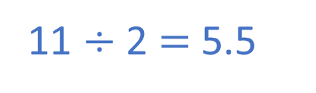
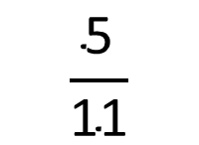
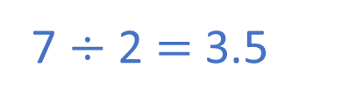
I know that $\frac{\text{4}}{\text{7}}$ is greater than one half and $\frac{\text{5}}{\text{11}}$ is less than one half, so $\frac{\text{4}}{\text{7}}$ has to be greater.
I know that $\frac{\text{4}}{\text{7}}$ is greater than $\frac{\text{5}}{\text{11}}$ without having to draw a bar model.
$$\frac{\text{5}}{\text{11}}$$
$$>\frac{\text{1}}{\text{2}}$$
$$<\frac{\text{1}}{\text{2}}$$
$$\frac{\text{4}}{\text{7}}$$
7 $÷$ 2 $=$ 3.5
11 $÷$ 2 $=$ 5.5

Slide 7





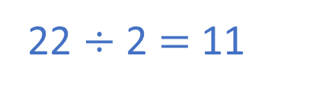

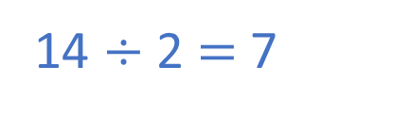
Have a think
$\frac{\text{8}}{\text{14}}$ $\frac{\text{10}}{\text{22}}$
$$>$$
14 $÷$ 2 $=$ 7
22 $÷$ 2 $=$ 11
$$>\frac{\text{1}}{\text{2}}$$
$$\frac{\text{8}}{\text{14}}$$
$$<\frac{\text{1}}{\text{2}}$$
$$\frac{\text{10}}{\text{22}}$$

Slide 8




$\frac{\text{4}}{\text{9}}$ $\frac{\text{4}}{\text{5}}$
$$<$$
$\frac{\text{2}}{\text{3}}$ $\frac{\text{2}}{\text{7}}$
$$>$$
Have a think
What’s the same and what’s different?
What do you notice?
greater
smaller
When the numerators are the same, the the denominator, the the fraction.
greater
smaller

Slide 9

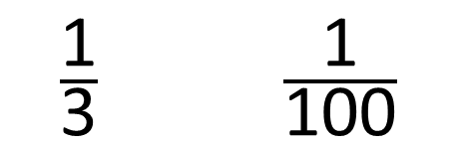
$\frac{\text{1}}{\text{3}}$ $\frac{\text{1}}{\text{100}}$
$$>$$
greater
When the numerators are the same, the the denominator, the the fraction.
smaller
smaller
When the numerators are the same, the the denominator, the the fraction.
greater

Slide 10




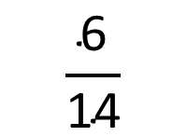

Write $>, <$ or $=$ to compare the fractions
$\frac{\text{3}}{\text{7}}$ $\frac{\text{6}}{\text{11}}$
$$<$$
When the numerators are the same, the greater the denominator, the smaller the fraction.
$\frac{\text{3}}{\text{7}}$ $\frac{\text{6}}{\text{11}}$
$×$ 2
$$\frac{\text{6}}{\text{14}}$$

Slide 11



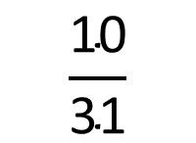





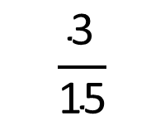

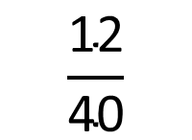
Have a think
When the numerators are the same, the greater the denominator, the smaller the fraction.
$\frac{\text{3}}{\text{10}}$ $\frac{\text{12}}{\text{37}}$
$\frac{\text{10}}{\text{27}}$ $\frac{\text{20}}{\text{62}}$
$$<$$
$$>$$
$×$ 4
$÷$ 2
$$\frac{\text{10}}{\text{31}}$$
$$\frac{\text{12}}{\text{40}}$$
$\frac{\text{3}}{\text{8}}$ $\frac{\text{1}}{\text{5}}$
$$>$$
$×$ 3
$$\frac{\text{3}}{\text{15}}$$

Slide 12
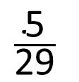
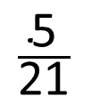
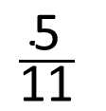
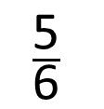
Write these fractions in ascending order.
$$\frac{\text{5}}{\text{11}}$$
$$\frac{\text{5}}{\text{21}}$$
$$\frac{\text{5}}{\text{6}}$$
$$\frac{\text{5}}{\text{29}}$$
When the numerators are the same, the greater the denominator, the smaller the fraction.

Slide 13
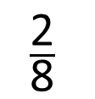
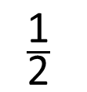
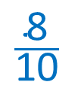
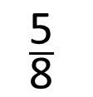
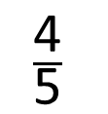
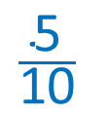
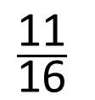
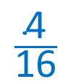
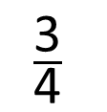
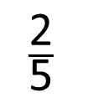
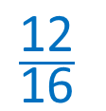
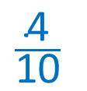
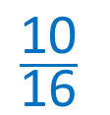
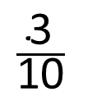
$$\frac{\text{10}}{\text{16}}$$
$$\frac{\text{12}}{\text{16}}$$
$$\frac{\text{4}}{\text{16}}$$
$$\frac{\text{11}}{\text{16}}$$
$$\frac{\text{5}}{\text{8}}$$
$$\frac{\text{3}}{\text{4}}$$
$$\frac{\text{2}}{\text{8}}$$
Smallest
Greatest
When the denominators are the same, the greater the numerator, the greater the fraction.
$$\frac{\text{5}}{\text{10}}$$
$$\frac{\text{8}}{\text{10}}$$
$$\frac{\text{4}}{\text{10}}$$
Have a think
$$\frac{\text{1}}{\text{2}}$$
$$\frac{\text{3}}{\text{10}}$$
$$\frac{\text{4}}{\text{5}}$$
$$\frac{\text{2}}{\text{5}}$$
Smallest
Greatest

Slide 14
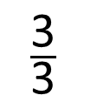
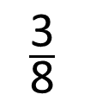
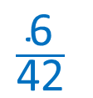
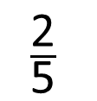









$$\frac{\text{14}}{\text{35}}$$
$$\frac{\text{14}}{\text{18}}$$
1
$$\frac{\text{14}}{\text{33}}$$
$$\frac{\text{2}}{\text{5}}$$
$$\frac{\text{7}}{\text{9}}$$
$$\frac{\text{3}}{\text{3}}$$
Smallest
Greatest
When the numerators are the same, the greater the denominator, the smaller the fraction.
$$\frac{\text{6}}{\text{42}}$$
$$\frac{\text{6}}{\text{16}}$$
$$\frac{\text{6}}{\text{27}}$$
Have a think
$$\frac{\text{1}}{\text{7}}$$
$$\frac{\text{3}}{\text{8}}$$
$$\frac{\text{2}}{\text{9}}$$
$$\frac{\text{6}}{\text{13}}$$
Smallest
Greatest

Slide 15





What is the missing denominator?
$$\frac{\text{16}}{}$$
$$\frac{\text{16}}{\text{26}}$$
24 or 25
25
24
$$\frac{\text{16}}{\text{23}}$$
>
$$\frac{\text{2}}{}$$
>
$$\frac{\text{8}}{\text{13}}$$
3

