Slide 1


Slide 2

Delia Derbyshire
Doctor Who Theme
(original theme composed by Ron Grainer)
Primary / KS2 / 2nd Level Classroom Lesson Plan
Written by
Rachel Leach

Slide 3

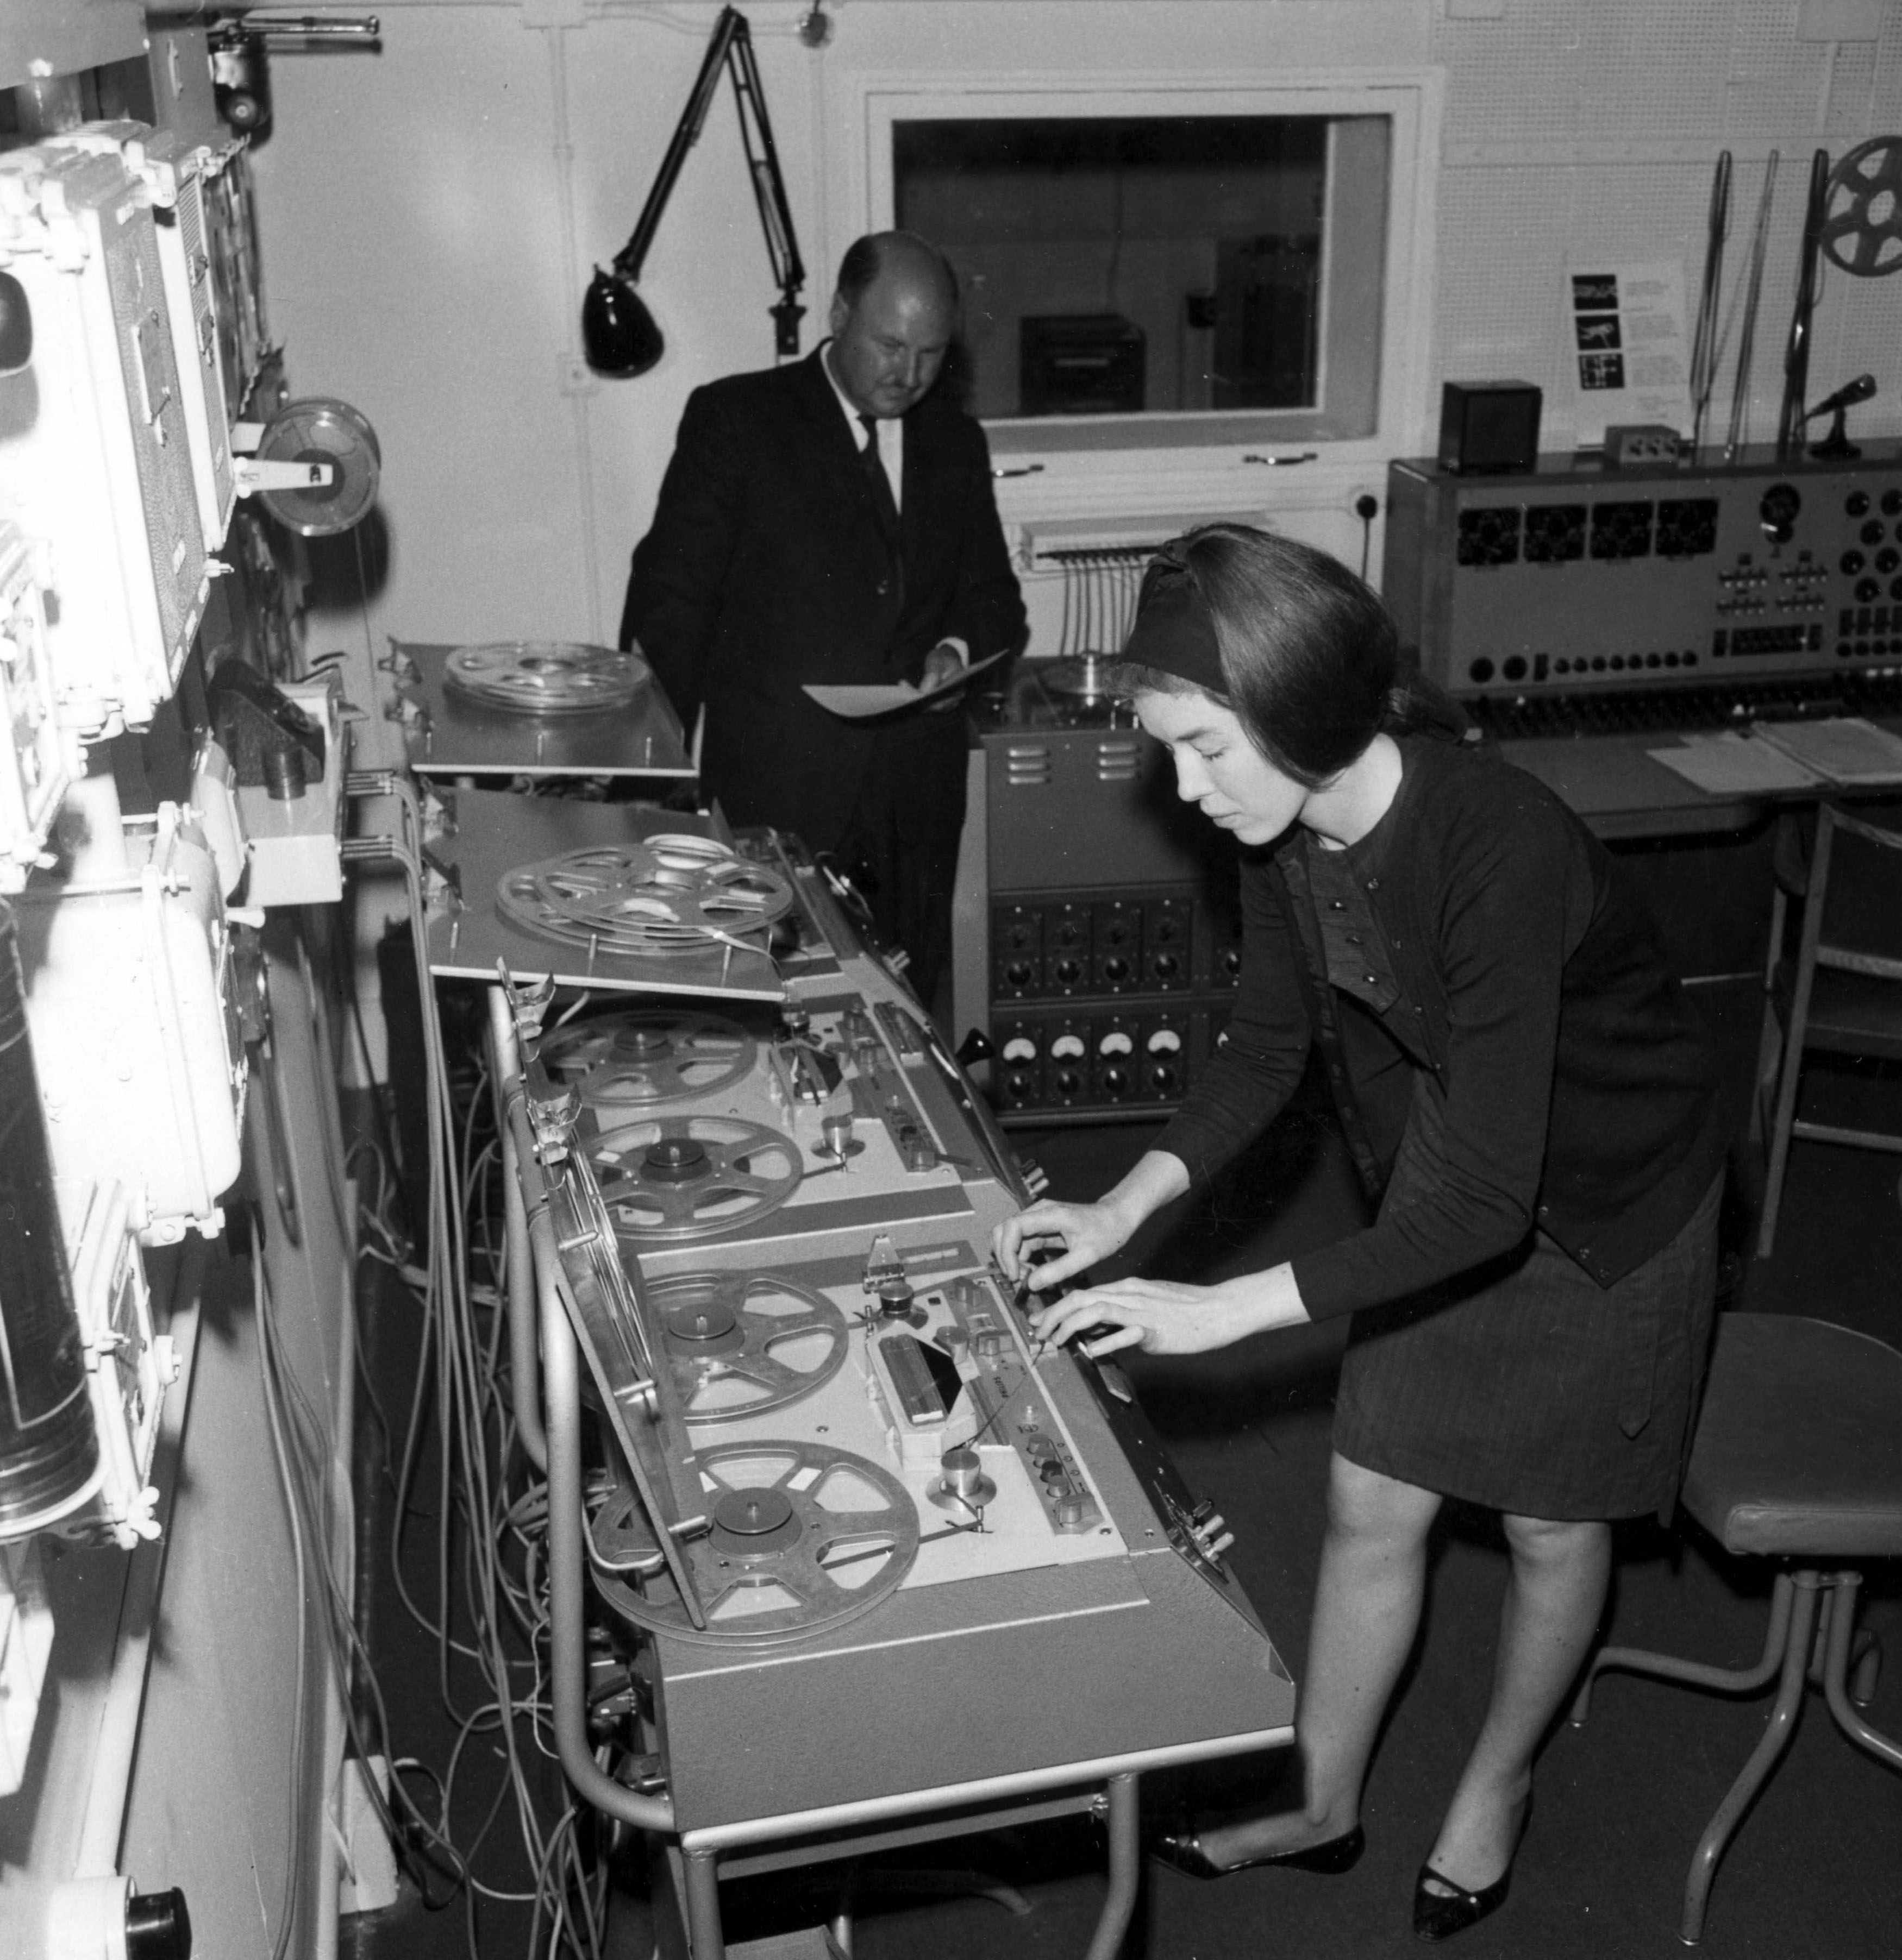
Trailblazer
Composer Delia Derbyshire created a new soundworld using electronic sounds, using these to arrange the melody for Doctor Who – one of the most famous TV shows ever!

Slide 4
Background – the composer
Delia DERBYSHIRE (1937–2001)
British composer of electronic music
Member of the legendary BBC Radiophonic Workshop – a group of pioneering musicians and engineers responsible for producing sound effects and incidental sounds for TV and radio

Slide 5

Background – the music
Doctor Who Theme
The famous melody was actually written by Australian composer Roy Grainer. Delia’s task was to ‘realise’ or ‘arrange’ the theme using electronic sounds to match the futuristic sci-fi nature of the programme
Derbyshire’s version uses ‘found sounds’ that were manipulated electronically. She recorded the sound of everyday objects onto tape and then changed the speed of the tape to create different pitches or looped single sounds over and over to create rhythms. This was back in 1963 before computers made such experiments easy!
Scandalously, Derbyshire was not credited with the composition of the now iconic original version and received very little money for it

Slide 6
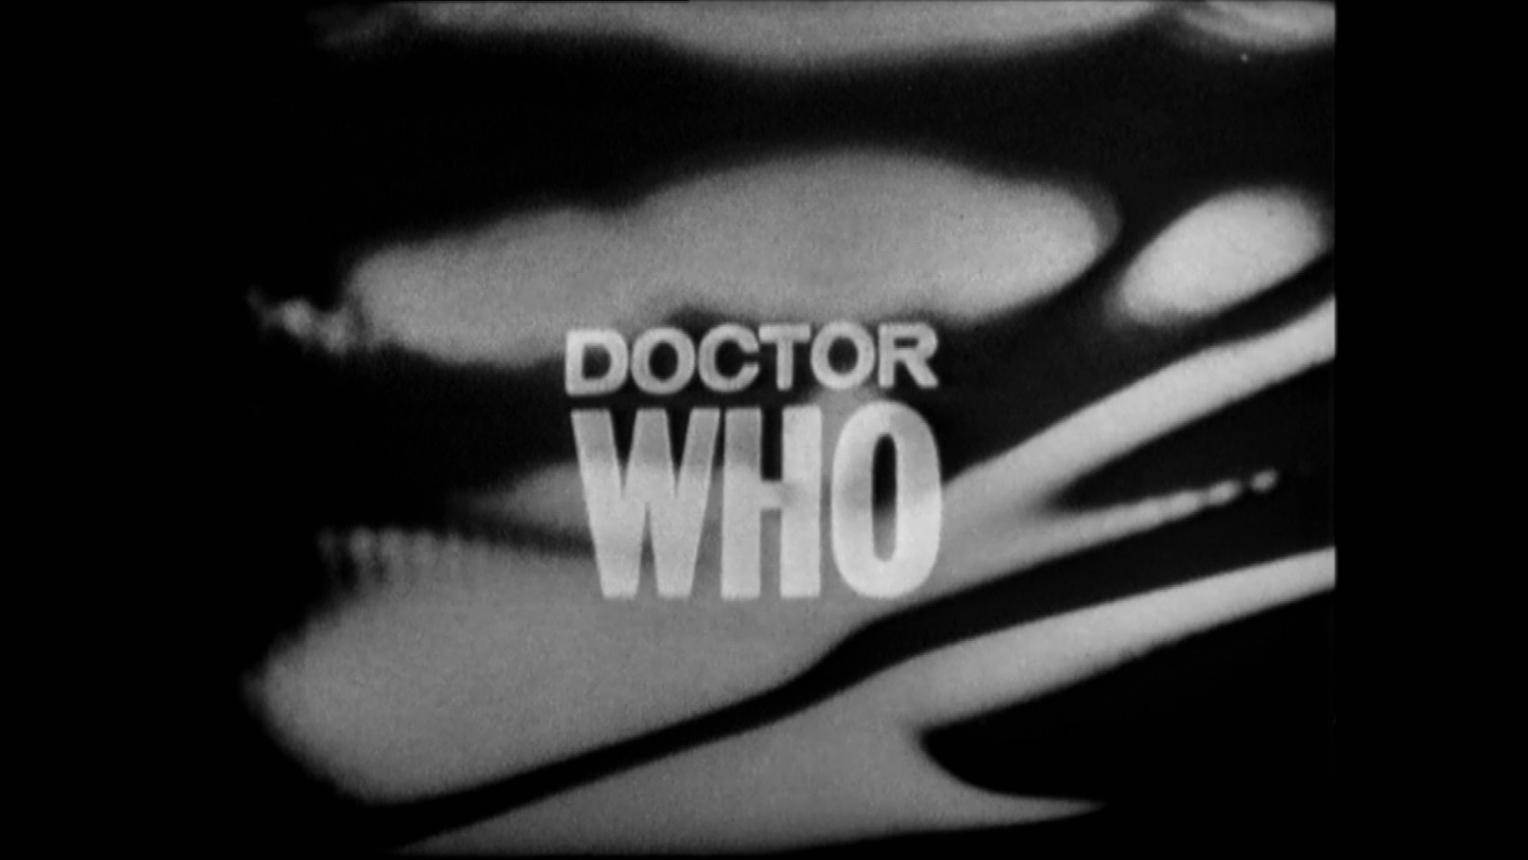

Watch/ listen to the opening theme!

Slide 7
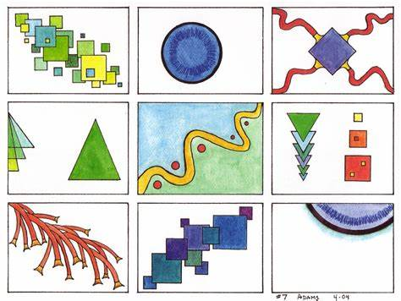
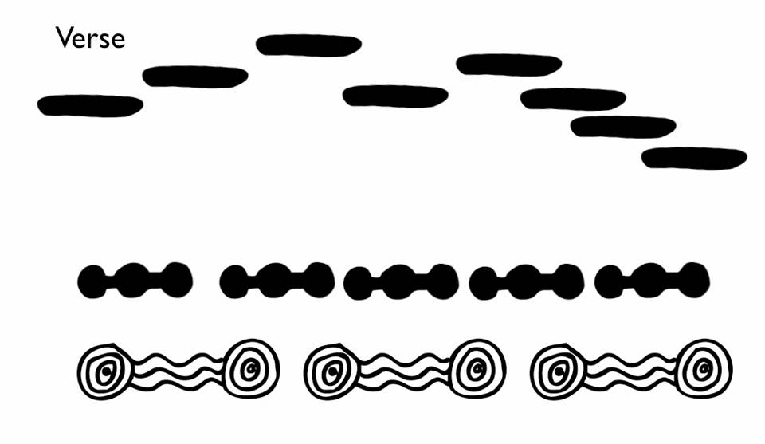
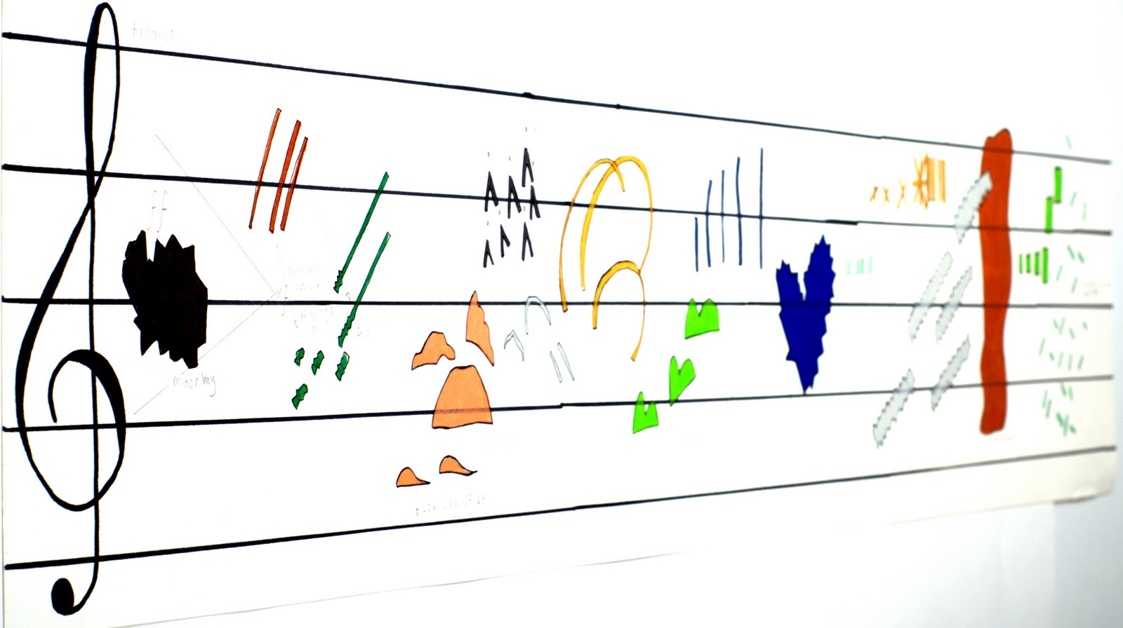
These are all examples of graphic scores.
A graphic score is a way in which a composer can compose a piece without using common music notation (notes on a stave).
Symbols are used to represent instruments and changes in pitch (high and low notes) and dynamics (loud and soft).

Slide 8
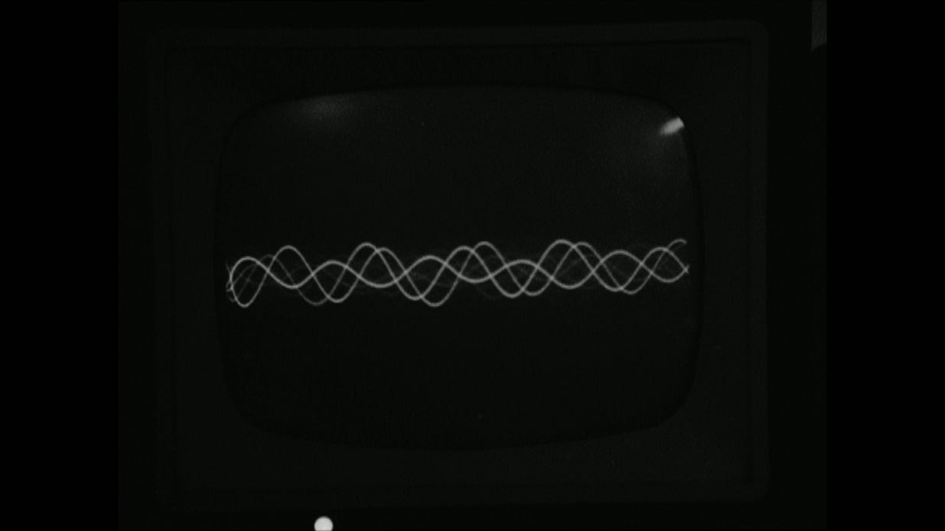
As you listen to the music, draw the bass line and the swooping melody with two different colours.
What other shapes and colours can you add to your picture to represent the sounds in the music.

Slide 9
What other movie or TV music do you like?
Listen to it and draw shapes, lines and colours to represent what you can hear.

