Slide 1
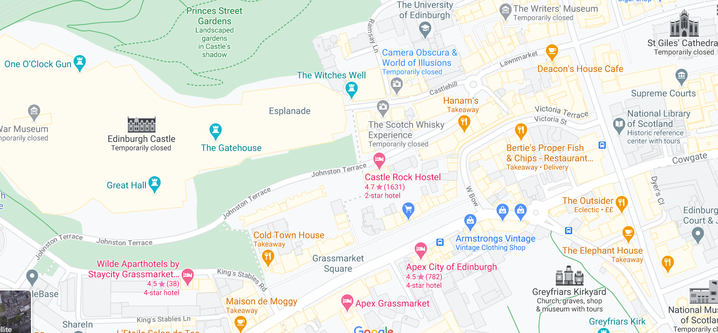
Geography Wednesday 10 February
So, off we go again on our travels, Edinburgh today, capital city of Scotland.
Google Edinburgh and zoom in so that you can see the street names. If you drop the Google man onto ‘Lawn Market’ near St. Giles’ Cathedral you can ‘walk’ up to the castle. It is very steep.
Drop the Google man onto Johnstone Terrace south of the castle and look up to see how high the castle is.

Slide 2
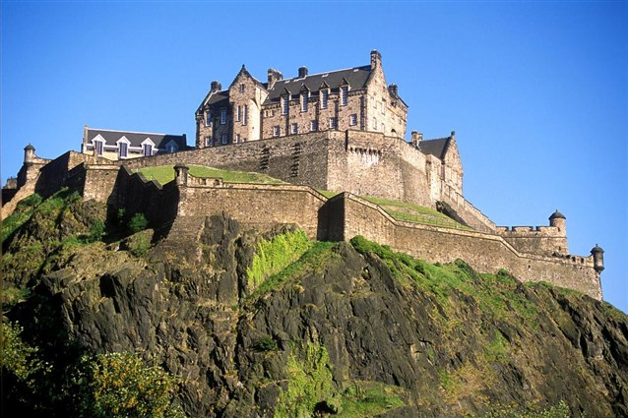
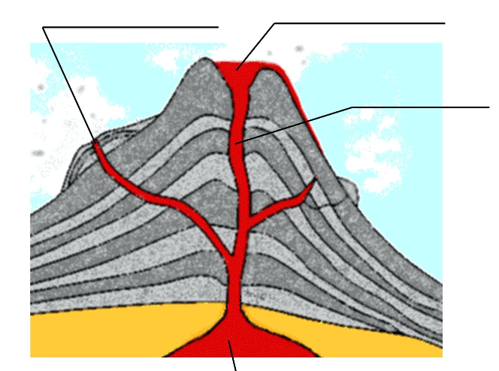
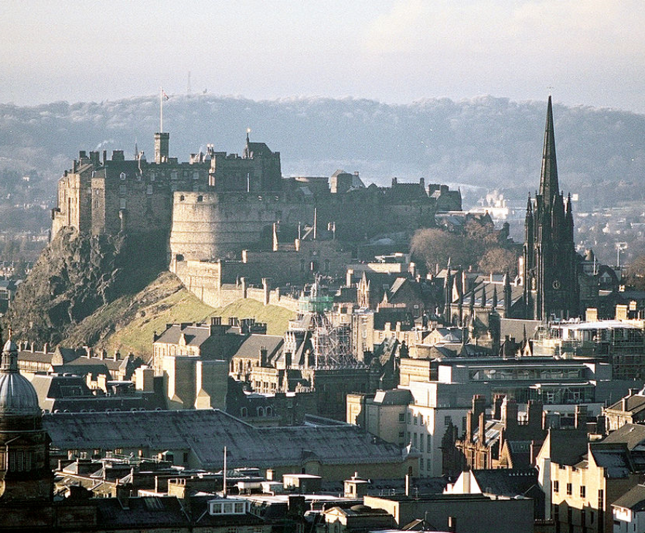
Edinburgh Castle
Edinburgh Castle is built on top of an extinct volcano.
What does extinct mean? ………………………………………………………………………………..
Can you label the volcano?
Use these words:
magma chamber vent crater lava

Slide 3
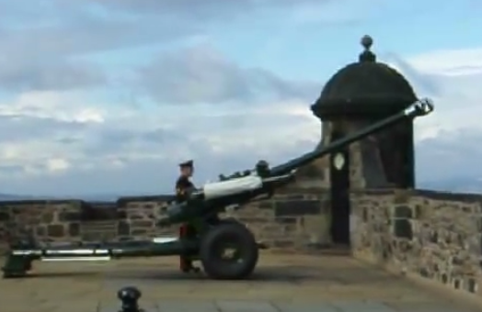
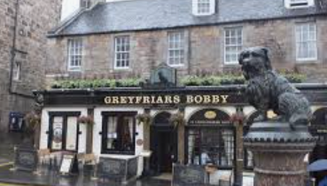
Did you notice on the map near the castle it said ‘One O’clock Gun’?
A cannon is fired across the city every day at one o’clock. If you would like to see the ceremony use the link below.
There is a true story about a dog called Bobby which took place in Edinburgh. Use the link below to hear the story.
Can you find Greyfriars Kirk on the map? That is where Bobby’s owner Auld Jock is buried.
https://www.youtube.com/watch?v=1G5oY5OF2qM
https://www.youtube.com/watch?v=ElGuE-8PM7Y

Slide 4
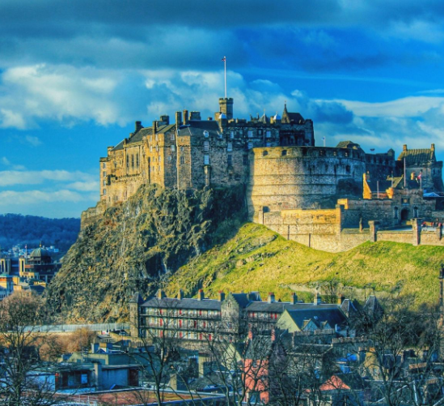
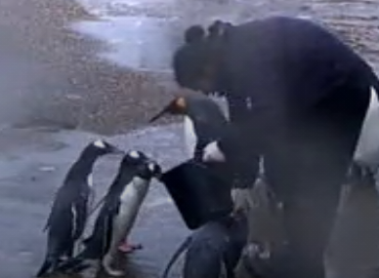
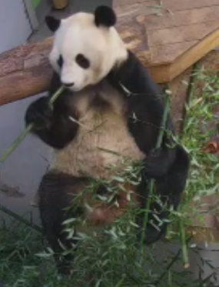
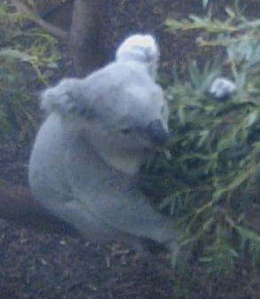
Just outside the city is Edinburgh Zoo. It has live web cams. You can see penguins being fed at 3 o’clock, a panda, a koala bear, a tiger and maybe a lion.
Use the link to explore the live webcams.
Edinburgh is the capital city of ……………………………………..
The national flower is the ……………………………………….
North, South, East or West?
Edinburgh is in the ……………………………………….. of Scotland.
https://www.edinburghcastle.scot/
Explore Edinburgh Castle.
Edinburgh is next to the River ……………
Draw the national flower.
https://www.edinburghzoo.org.uk/webcams/panda-cam/#pandacam

