Slide 1
Maths Thursday 11 February
Subtraction
Use an empty number line to subtract a single digit. Count backwards.
29 – 5 = 75 – 8 =
___________________________ _____________________________
29 75
63 – 7 = 89 – 7 =
___________________________ _____________________________
63 89

Slide 2
What if we subtract a 2 digit number from a 2 digit number?
It’s our favourite!
Chips and peas. Remember to show your chips and peas working out.
36 – 24 = 12 Draw 36 in chips and peas.
Cross out 24 that’s 2 tens and 4 ones.
What is left? How many tens? How many ones?
1 2
49 – 25 = 57 – 32 = 89 – 53 =

Slide 3
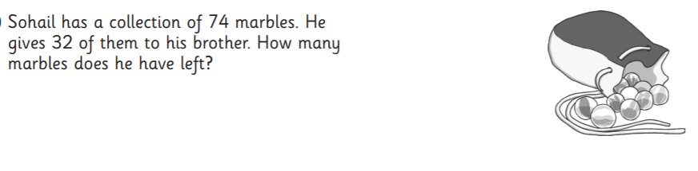
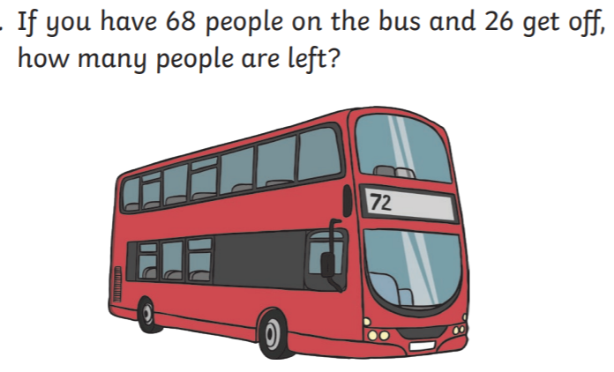

Now choose a question on the next page.

Slide 4





