Slide 1
Maths Wednesday 10 February
Addition
Use an empty number line to calculate the answers.
+ 5 = 56 + 8 =
______________________ ________________________
56
+ 6 = 49 + 9 =
______________________ _________________________
37 49

Slide 2
Show your shark fin adding to solve these questions.
3 4 + 4 2 =
4 5 + 2 3 =
6 2 + 3 5 =
4 6 + 4 7 =

Slide 3
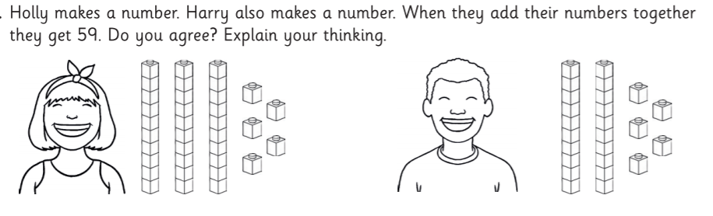

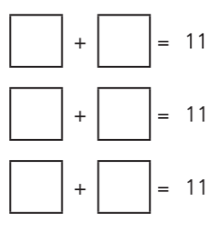
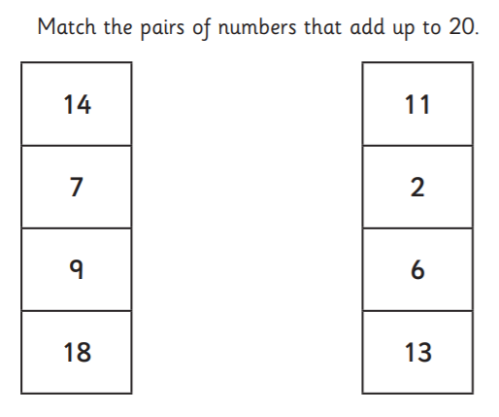
………………………………………………………………………………………………………………………………………………
Answer two questions on the next page.

Slide 4
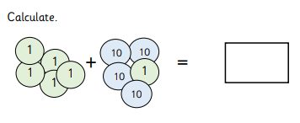
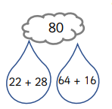
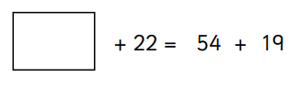
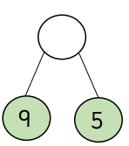
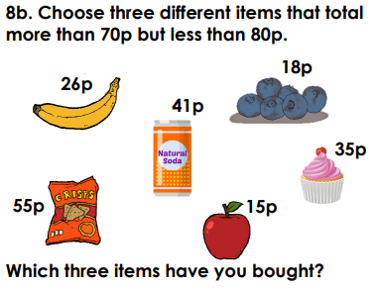
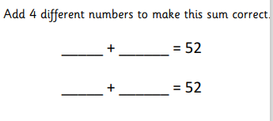
*
**
***
Calculate the answer. Show your working out. Use the space on the page if you want to.
Fill in the missing number.
Which sum gives the correct answer?

