Slide 1


Slide 3
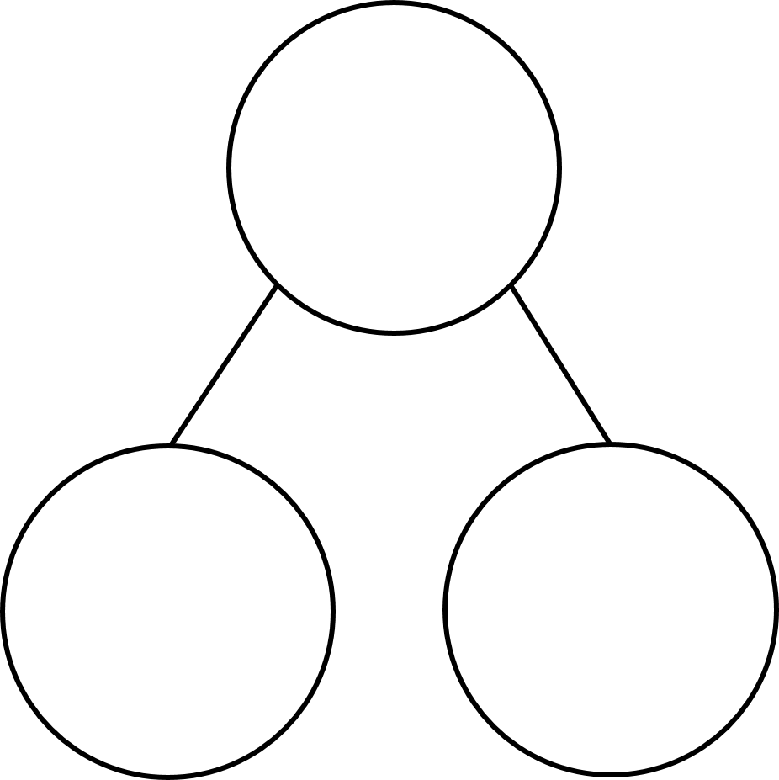




1) Write the fraction as an improper fraction.
2) Write the fraction as an improper fraction.
3) Complete the part-whole models
$$\frac{\text{11}}{\text{6}}$$
$$\frac{\text{5}}{\text{5}}$$
$$\frac{\text{3}}{\text{5}}$$
$$\frac{\text{6}}{\text{6}}$$

Slide 4







$$\frac{\text{4}}{\text{3}}$$
1) Write the fraction as an improper fraction.
2) Write the fraction as an improper fraction.
3) Complete the part-whole models
$$\frac{\text{9}}{\text{4}}$$
$$\frac{\text{8}}{\text{5}}$$
$$\frac{\text{11}}{\text{6}}$$
$$\frac{\text{5}}{\text{5}}$$
$$\frac{\text{3}}{\text{5}}$$
$$\frac{\text{5}}{\text{6}}$$
$$\frac{\text{6}}{\text{6}}$$

Slide 6


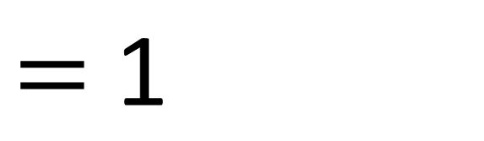

This is an improper fraction.
An improper fraction is where the numerator is greater than the denominator.
$$\frac{}{\text{2}}$$
This is a mixed number.
It is a number with a whole and a fraction.
$$\frac{\text{3}}{\text{2}}$$
$$\frac{\text{1}}{\text{2}}$$
$=$ $\text{1}$

Slide 7



$$\text{2 }\frac{\text{1}}{\text{4}}$$
$$\frac{\text{1}}{\text{4}}$$
$$\text{2}$$

Slide 8
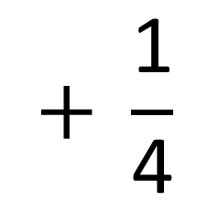
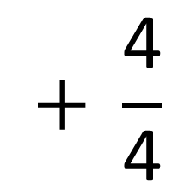
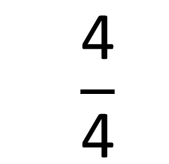
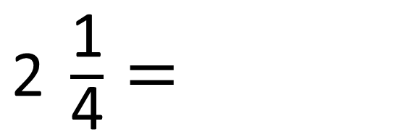
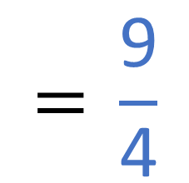
$$\frac{\text{4}}{\text{4}}$$
$$+ \frac{\text{4}}{\text{4}}$$
$$+ \frac{\text{1}}{\text{4}}$$
$$\text{=} \frac{\text{9}}{\text{4}}$$
$\text{2 }\frac{\text{1}}{\text{4}}$ $=$

Slide 9



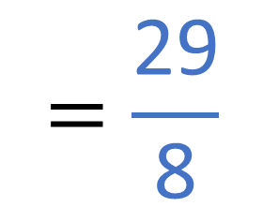
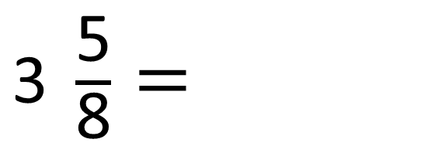


Convert the mixed number to an improper fraction
$$\frac{\text{8}}{\text{8}}$$
$$+ \frac{\text{8}}{\text{8}}$$
$$+ \frac{\text{8}}{\text{8}}$$
$$+ \frac{\text{5}}{\text{8}}$$
$$=\frac{\text{29}}{\text{8}}$$
$\text{3 }\frac{\text{5}}{\text{8}}$ $=$
Have a think

Slide 10
Have a go at questions 1 and 2 on the worksheet

Slide 11

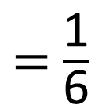

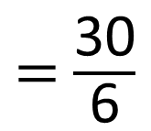

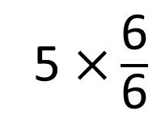
Convert the mixed numbers to improper fractions.
$$\frac{\text{31}}{\text{6}}$$
5 $\frac{\text{1}}{\text{6}}$
$$=$$
5 $\text{×}\frac{\text{6}}{\text{6}}$
$=$ $\frac{\text{30}}{\text{6}}$
$=$ $\frac{\text{1}}{\text{6}}$

Slide 12
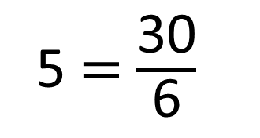


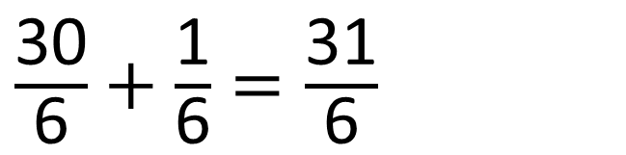
Convert the mixed numbers to improper fractions.
5 $\frac{\text{1}}{\text{6}}$
$$\frac{\text{31}}{\text{6}}$$
$$=$$
5 $=$ $\frac{\text{30}}{\text{6}}$
$\frac{\text{30}}{\text{6}}+$ $\frac{\text{1}}{\text{6}}=\frac{\text{31}}{\text{6}}$

Slide 13
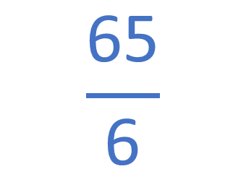
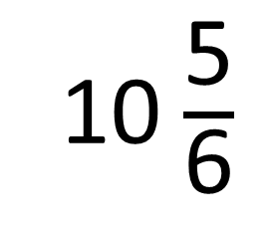
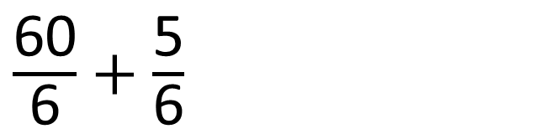
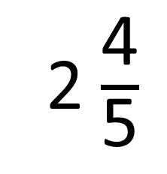

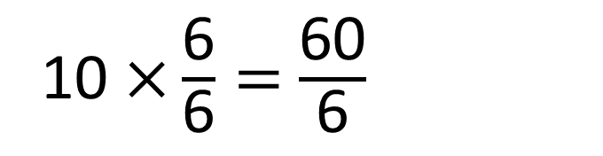
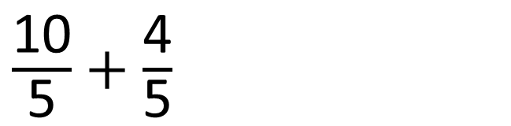

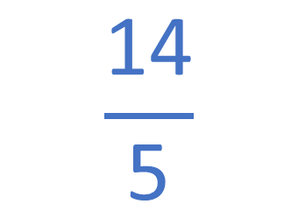
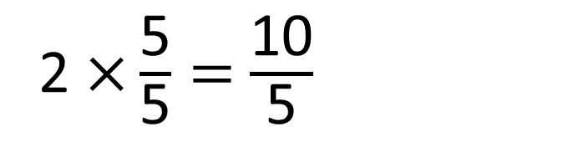
Have a think
Convert the mixed numbers to improper fractions
2 $\frac{\text{4}}{\text{5}}$
$$\frac{\text{14}}{\text{5}}$$
10 $\frac{\text{5}}{\text{6}}$
$$\frac{\text{65}}{\text{6}}$$
$$=$$
$$=$$
2 $\text{×}\frac{\text{5}}{\text{5}}=$ $\frac{\text{10}}{\text{5}}$
10 $\text{×}\frac{\text{6}}{\text{6}}=$ $\frac{\text{60}}{\text{6}}$
$\frac{\text{10}}{\text{5}}+$ $\frac{\text{4}}{\text{5}}$
$\frac{\text{60}}{\text{6}}+$ $\frac{\text{5}}{\text{6}}$

Slide 14
Have a go at the rest of the questions on the worksheet

