Slide 1

English Monday 8 February
We are practising question marks and exclamation marks today.
First, complete the sentences with the correct punctuation mark.
Read each sentence.
Decide, is it a question an exclamation or just an ordinary sentence?
What time is it?
That’s amazing!
The cat likes sleeping.
Sound button
Did you get these right?
Sentence - it needs .
Question – it needs ?
Exclamation - it needs !

Slide 2
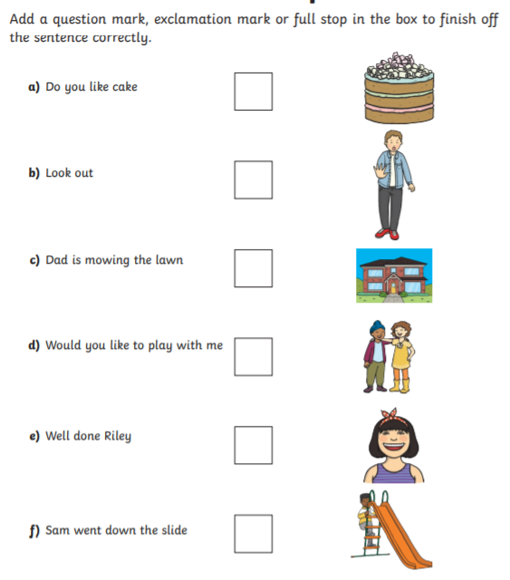
Sound button

Slide 3
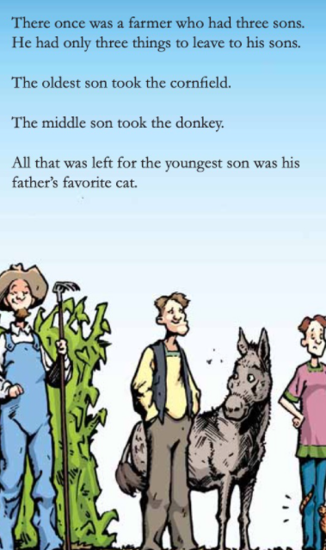
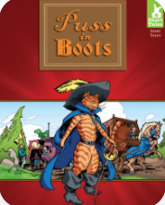
On Epic, I have sent you a story, Puss in Boots. Read it to yourself or ask a grown up to read it to you. You might already know the story.
Class code: nsc3249
Let’s use it to help us with our question marks.
Here is the answer:
The oldest son took the cornfield.
You write the question.
…………………………………………
………………………………………….
………………………………………….
I am going to give you the answers and you need to write the questions. Remember the ?
Sound button

Slide 4
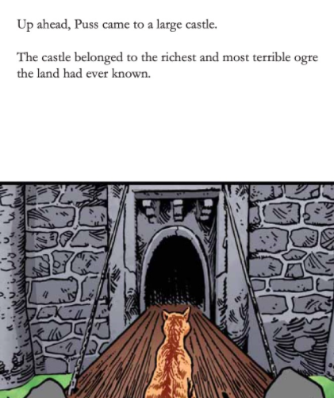
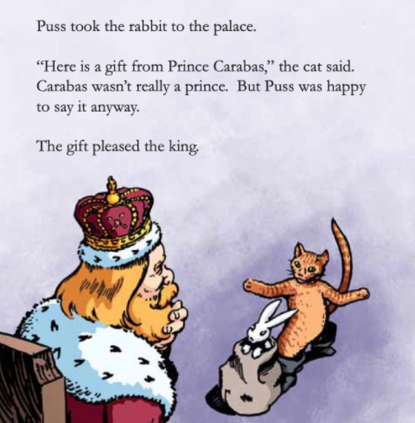
Use this page to write two questions of your own.
Puss took the rabbit to the palace. What is the question?
……………………………………………………………………..
………………………………………………………………………
…………………………………………………………………………………………….
……………………………………………………………………………………………..
……………………………………………………………………………………………..

Slide 5
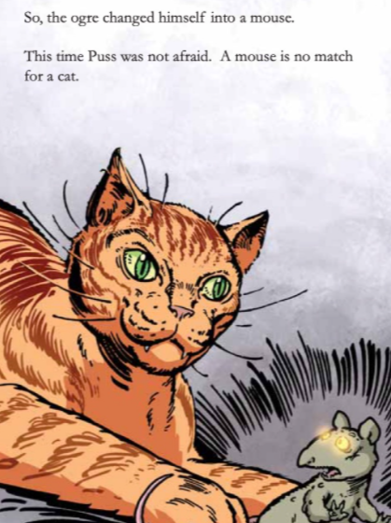
Use this page in the story to write three exclamations of your own.
What might Puss in Boots exclaim?
Yes!
Finally!
I got you!
………………………………………………………………………………………….
………………………………………………………………………………………….
…………………………………………………………………………………………..
Sound button

