Slide 1



Maths Monday 8 February
Let’s recap multiplication. Remember to show your working out. Bus stop maths will help you today.
8
6
3 x 6
2 x 9

Slide 2
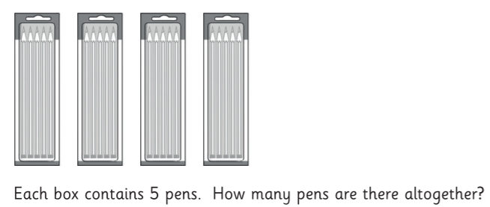
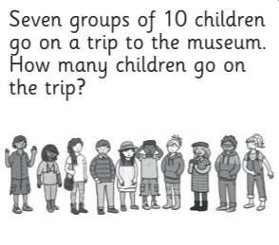
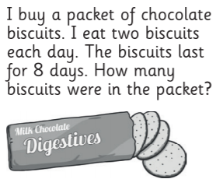
Remember to show your working out.
Try 2 questions on the next page. They are not easy so choose carefully!

Slide 3
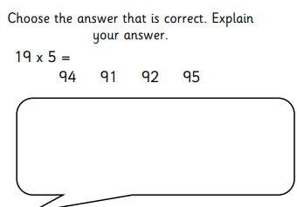
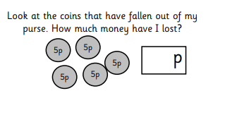
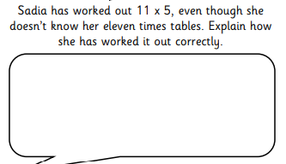
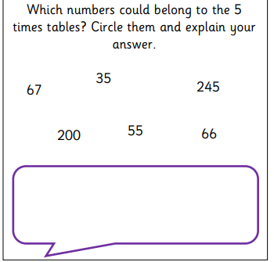
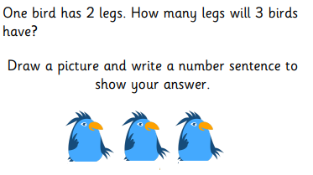
**
***
*
Use a different number in each box.
20 = x
20 = x
20 = x

