Slide 1
Monday 8th February 2021
We were so impressed with your volcano poetry last week that, this week, we’ve decided to create a completely different style of poetry- looking at earthquakes.

Slide 2
Brain warmup!
Write down as many synonyms (words that mean the same) as you can think of for these emotions:
Happy
Excited

Slide 3
Your Task
The following two images are of two streets before an earthquake struck.
Can you fill in each box on the “Before” grid?
What questions do you have about the image?
If you were there, what might you be able to see/hear/smell?
How might you be feeling if you were there?
When you are thinking of emotions- try and think of interesting synonyms you could use!

Slide 4
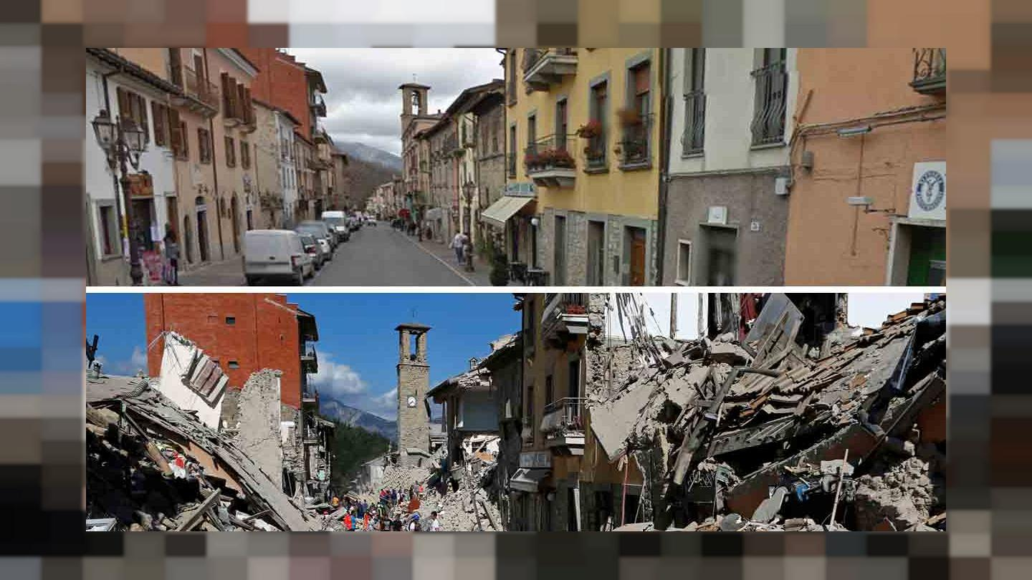
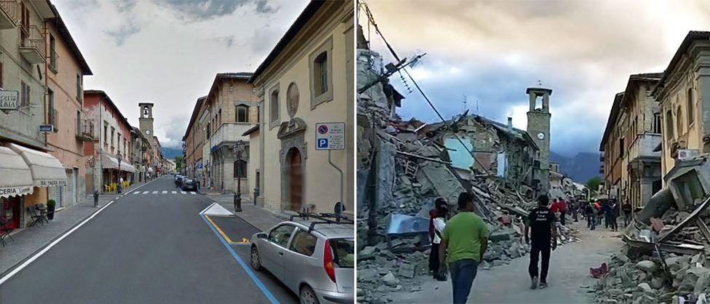
BEFORE

Slide 5
Questions
BEFORE
What can you see?
Emotions
What can you smell?
What can you hear?

Slide 6
Tuesday 9th February 2021
Today, We are continuing to collect ideas for our Earthquake poem

Slide 7
Brain warmup!
Write down as many synonyms (words that mean the same) as you can think of for these emotions:
Scared
Sad

Slide 8
Your Task
The following two images are of the same two streets, after an earthquake struck.
Can you fill in each box on the “after” grid?
What questions do you have about the image?
If you were there, what might you be able to see/hear/smell?
How might you be feeling if you were there?
When you are thinking of emotions- try and think of interesting synonyms you could use!

Slide 9
AFTER

Slide 10
Questions
AFTER
What can you see?
Emotions
What can you smell?
What can you hear?

Slide 11
Wednesday 10th February 2021
Today, you are going to bring together your ideas to create your own poem about an earthquake .
The key feature of this poem is going to be the comparison between before and after the earthquake struck.
You can choose to do this either by alternating your verses between “before” and “after” (like the wAGOLL on the next slide), or you can create your “before” verses and then follow them with your “after” verses.

Slide 12
The smell of freshly baking bread,
The sight of blooming flowers,
Busy shoppers chatting away,
With goods that wouldn’t last the day,
The sound of laughter from the park,
Could this day get any better?
The smell of smoke, fire and burnt timber,
The sight of crumbling walls,
Houses not wanting to linger,
Dust clouds growing all around,
The sound of cries and choking coughs,
Will this nightmare ever end?
Contented, peaceful, happy, calm,
Children playing, not a care in the world,
Town buzzing with joyful people,
Cherish the day, spread the bliss.
Heart pounding, anxious, scared,
Quick feet, cries of fear,
Town disintegrating around them,
Duck for cover, keep loved ones near.

Slide 13
V3- Before
V1- Before
The smell of freshly baking bread,
The sight of blooming flowers,
Busy shoppers chatting away,
With goods that wouldn’t last the day,
The sound of laughter from the park,
Could this day get any better?
The smell of smoke, fire and burnt timber,
The sight of crumbling walls,
Houses not wanting to linger,
Dust clouds growing all around,
The sound of cries and choking coughs,
Will this nightmare ever end?
Contented, peaceful, happy, calm,
Children playing, not a care in the world,
Town buzzing with joyful people,
Cherish the day, spread the bliss.
Heart pounding, anxious, scared,
Quick feet, cries of fear,
Town disintegrating around them,
Duck for cover, keep loved ones near.
V2- After/ During
V4- After/ during

Slide 14
V1- Before
Both show lots of activity- but very different activity
Contented, peaceful, happy, calm,
Children playing, not a care in the world,
Town buzzing with joyful people,
Cherish the day, spread the Bliss.
Heart pounding, anxious, scared,
Quick feet, cries of fear,
Town disintegrating around them,
Duck for cover, keep loved ones near.
Both begin the verse with emotions- the contrast is really obvious
V2- After/During
Both start third line with “Town”- shows the contrast again
Both verses end with advice- but very different advice

Slide 15
V3- Before
The smell of freshly baking bread,
The sight of blooming flowers,
Busy shoppers chatting away,
With goods that wouldn’t last the day,
The sound of laughter from the park,
Could this day get any better?
The smell of smoke, fire and burnt timber,
The sight of crumbling walls,
Houses not wanting to linger,
Dust clouds growing all around,
The sound of cries and choking coughs,
Will this nightmare ever end?
Both verses follow exactly the same structure- makes the contrast really obvious- the peace and tranquillity that has become chaos and devastation.
V4- After/During

Slide 16
You could do:
“Before” Verse
“Before” verse
“After” verse
“After” verse
Or:
“Before” Verse
“After” verse
“Before” verse
“After” verse

Slide 17
You could choose to go down the emotions route
Or
The senses route
Or
Use a mix of both like the wagoll has

