Slide 1

Computing tasks!

Slide 2
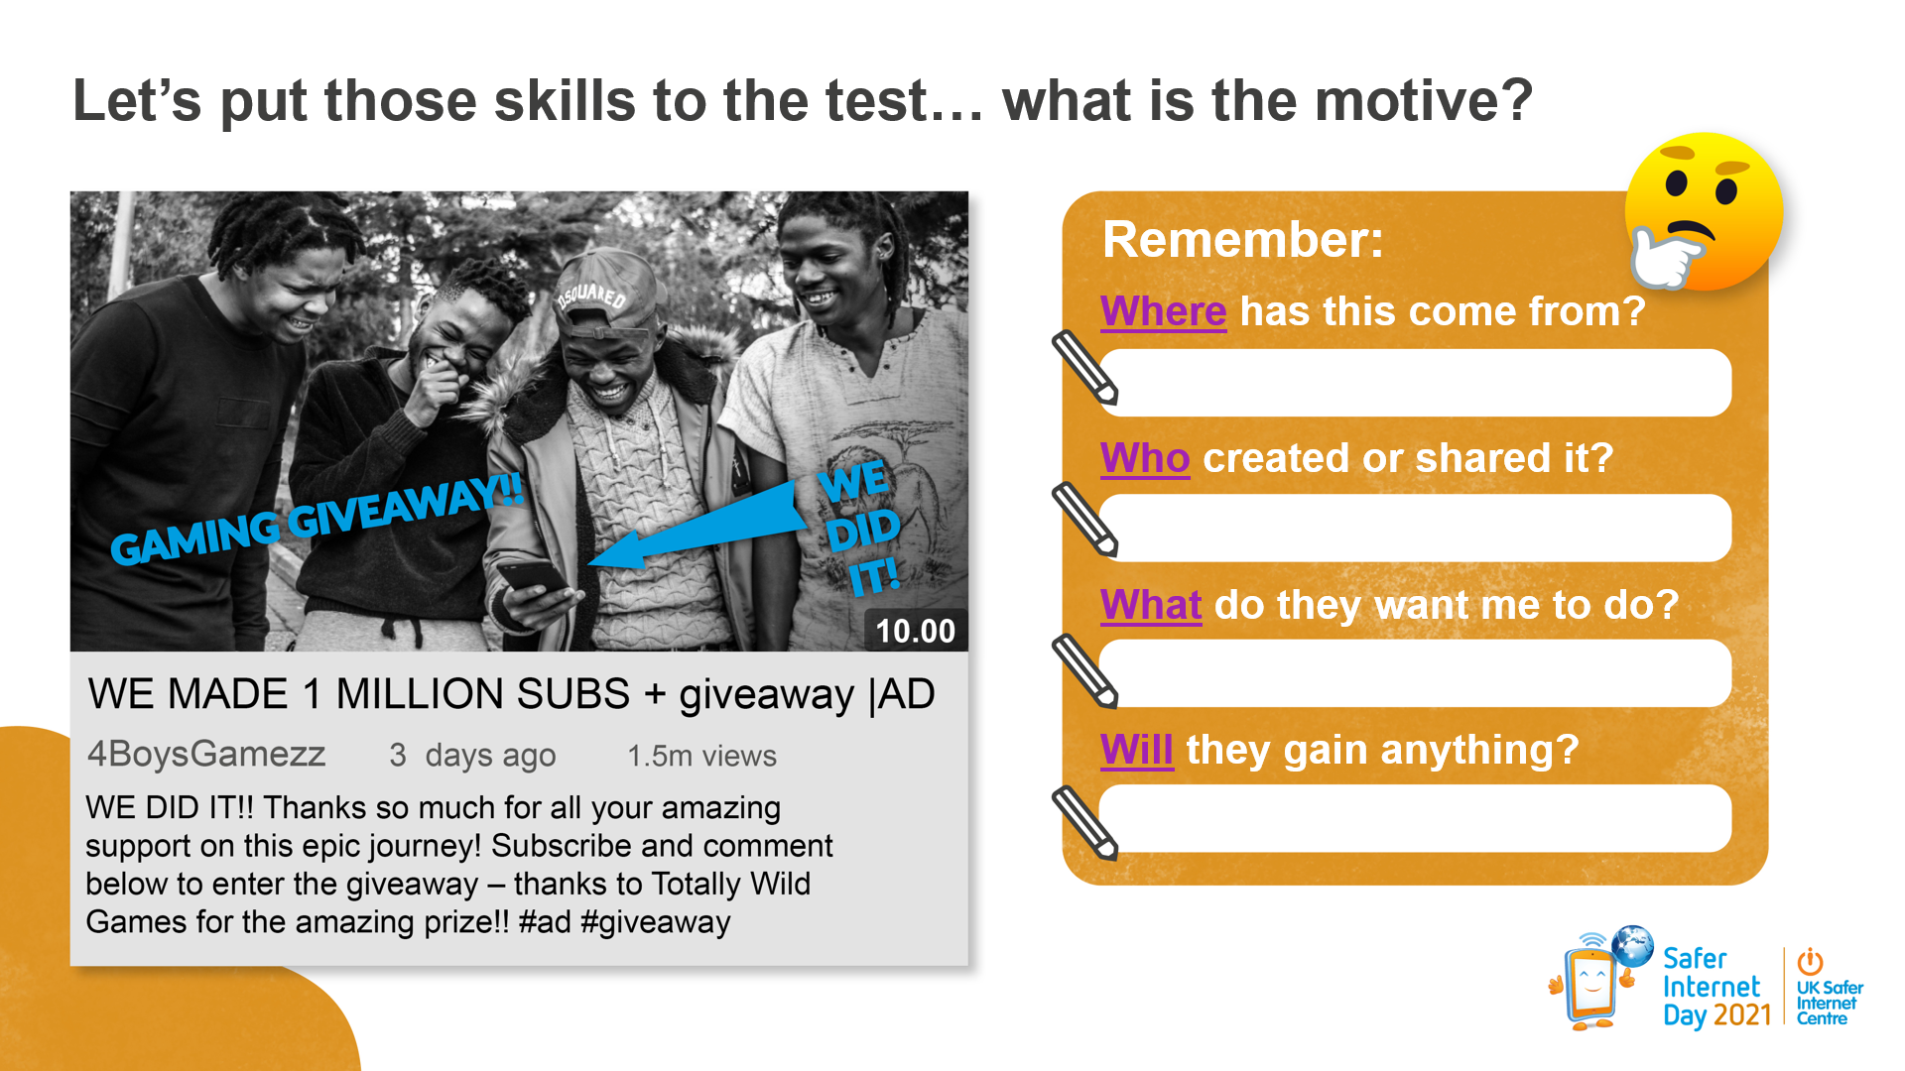
Task 3

Slide 3
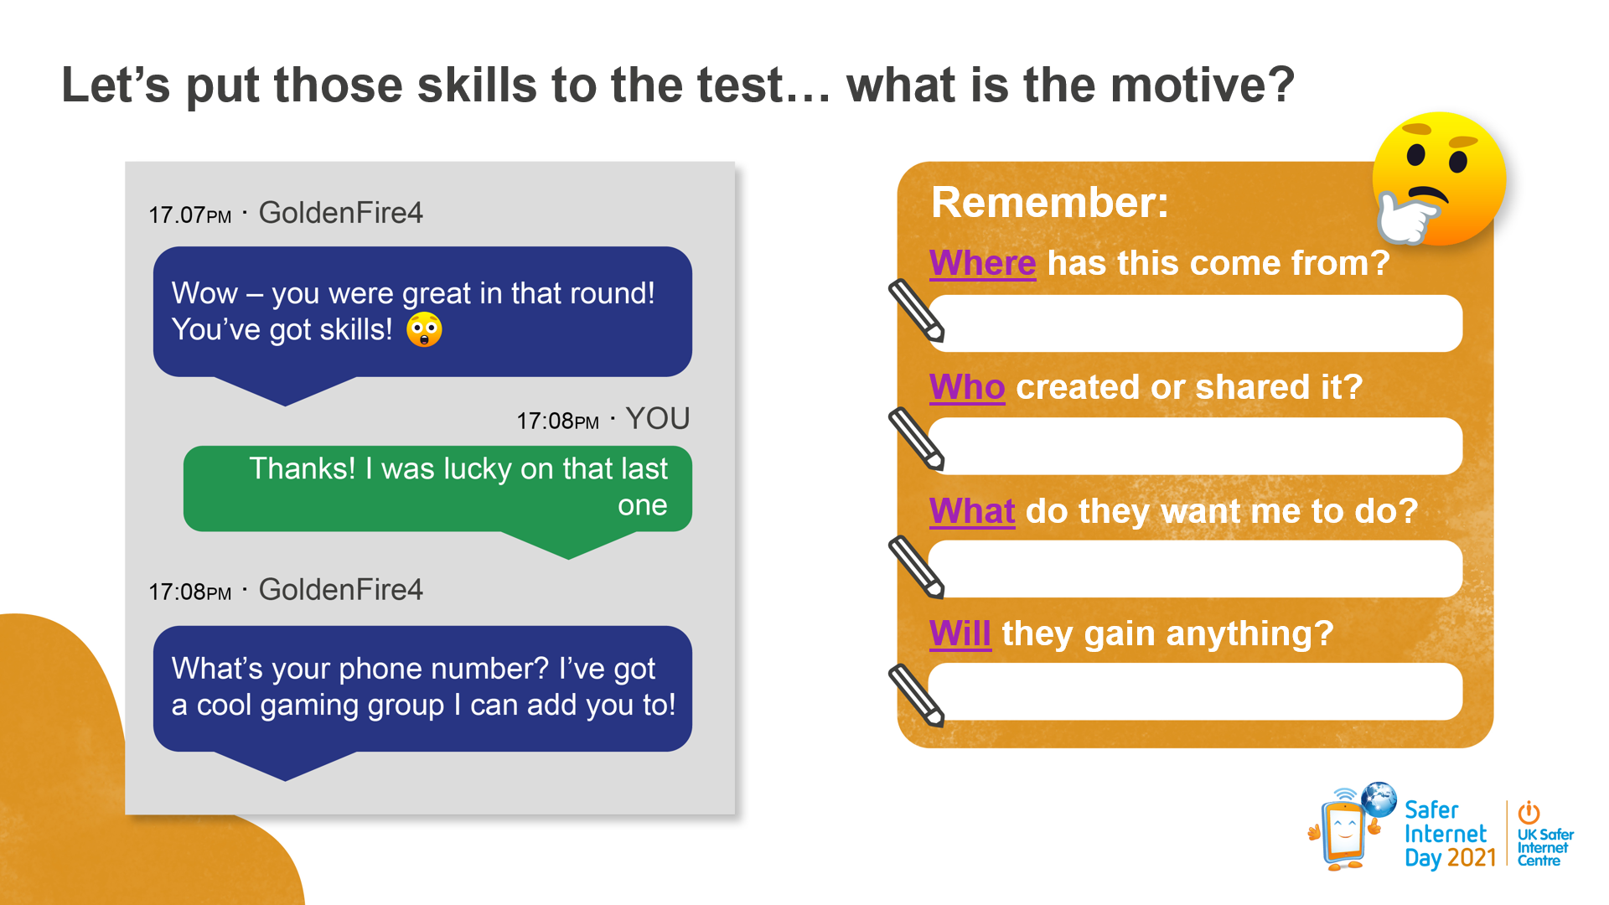
Task 3

Slide 4
Task 4- On the next slide, there are some scenarios. Can you sort them onto this line according to your opinion?
That’s okay
It depends
That’s not okay
It’s okay if no-one finds out
I’m not sure about this

Slide 5
Task 4
Scenario 1
You share a link with your friends to a website which has information that could upset people or cause offense.
Scenario 2
Someone in your class shares an article that you know is not true. You decide to message them privately and let them know.
Scenario 3
You have been chatting to someone online for a while and they start to ask you personal questions like what school you go to.
Scenario 4
Someone in your class shares something online that you know is not true. You decide to call them out publicly on their post.
Scenario 5
You are playing an online game and a pop up appears. It tells you that you have won lots of money. All you must do is click on it.

