Slide 1

Let’s play…
Scattergories!
You have 2 minutes to think of an answer for each category beginning with L .

Slide 2

Think of answers beginning with L
Something you enjoy doing online?
The name of a game or app?
A YouTuber, online show or channel?
A topic you could research online?

Slide 3

Where have you seen adverts before?
What did they look like?

Slide 4
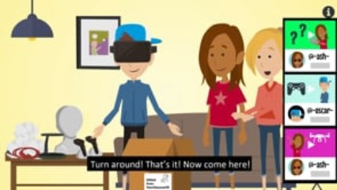
Notes:
The video on this slide is hosted online on Vimeo. You may be given the option to ‘Enable Content’ and will need to click this to allow it to play. Alternatively you can access the video by going to this URL: https://vimeo.com/481316945

Slide 5



People can profit from the things they do online…
Get something they didn’t have before
New likes, views, subscribers or followers
Money paid to advertise or promote things
Things that cost money given for free

Slide 6









Unboxing
Will the creator profit?
They might
A video where someone unpacks a parcel on camera

Slide 7

Giveaway
Will the creator profit?
They might
A competition where a
free prize can be won

Slide 8

Collab
Will the creator profit?
They might
Collaboration – where two or more people or companies work together

Slide 9

Merch
Will the creator profit?
Yes
Merchandise – products available to buy, connected with a popular person or brand

Slide 10

Affiliate link
Will the creator profit?
Yes
A link to another website (often a shop) where the creator earns money every time someone clicks on it

Slide 11


Did you know?
It’s the law!
People posting things like videos online must tell you if they’ve been paid to advertise or promote something.
Gifted
Advert
Sponsored Content
Ad

Slide 12

So there could be more to your favourite YouTuber than you thought...
It’s always helpful to think about motive
A motive is why someone does something.

Slide 13


Post a video on YouTube
Why would someone do this? What is their motive?
To make people laugh
To advertise a product
To make money
To share their opinion about something
It could be more than one!

Slide 14


Share a photo online
Why would someone do this? What is their motive?
To support an article or some information
Because they want to sell something shown in the picture
Because they want their family or friends to see it
Because they find it funny
It could be more than one!

Slide 15


Run a giveaway
Why would someone do this? What is their motive?
To get more likes or subscribers
To reward their followers
Because they’re being paid to advertise a product
To celebrate a big achievement
It could be more than one!

Slide 16

When you see something online
Ask…
Where has this come from?
Who created or shared it?
What do they want me to do?
Will they gain anything?
This will help you find the motive
(The reason why)

Slide 17
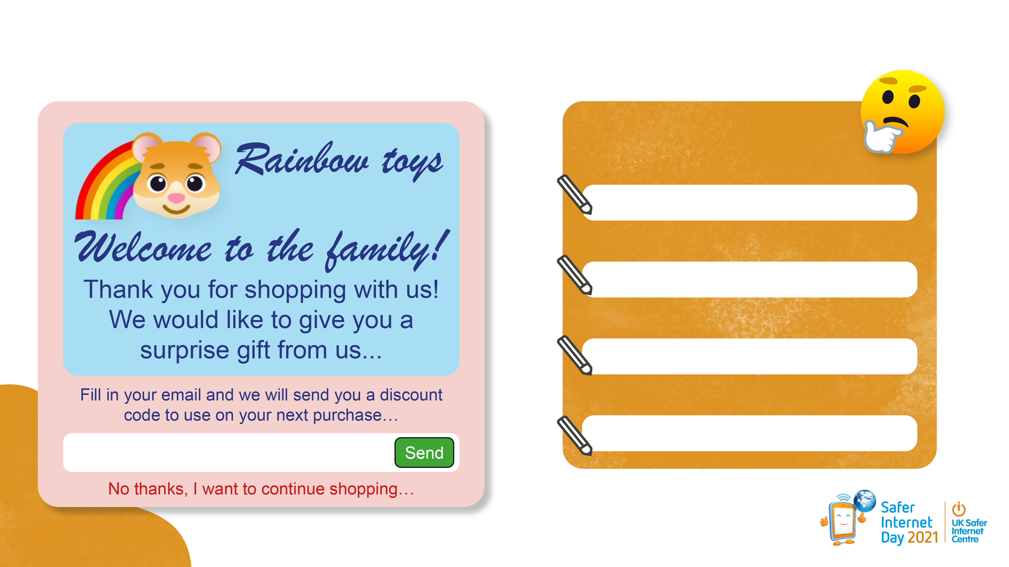
Let’s put those skills to the test… what is the motive?
Remember:
Where has this come from?
Who created or shared it?
What do they want me to do?
Will they gain anything?

Slide 18
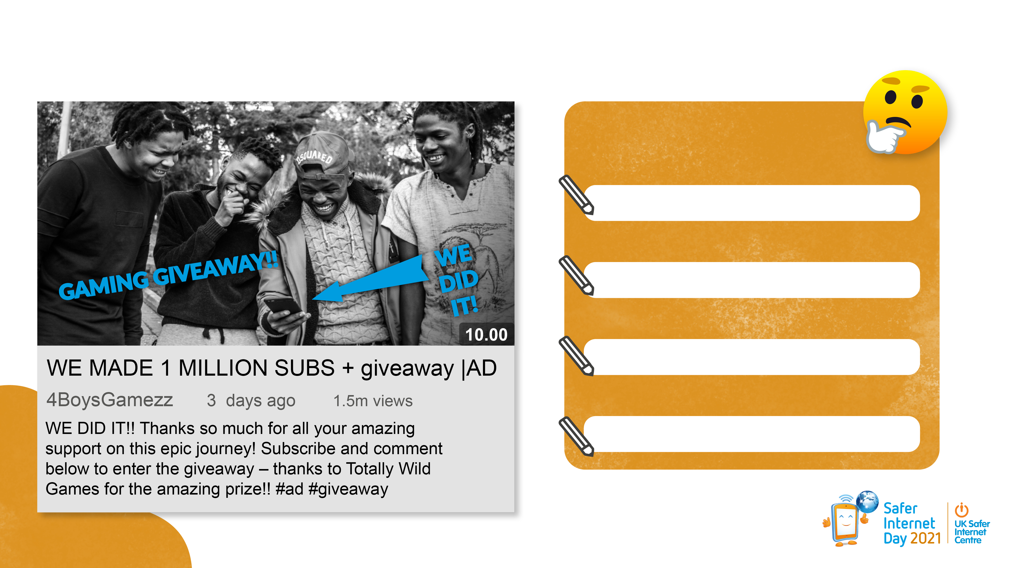
Let’s put those skills to the test… what is the motive?
Remember:
Where has this come from?
Who created or shared it?
What do they want me to do?
Will they gain anything?
Notes:
Photo by Alex Haney on Unsplash

Slide 19
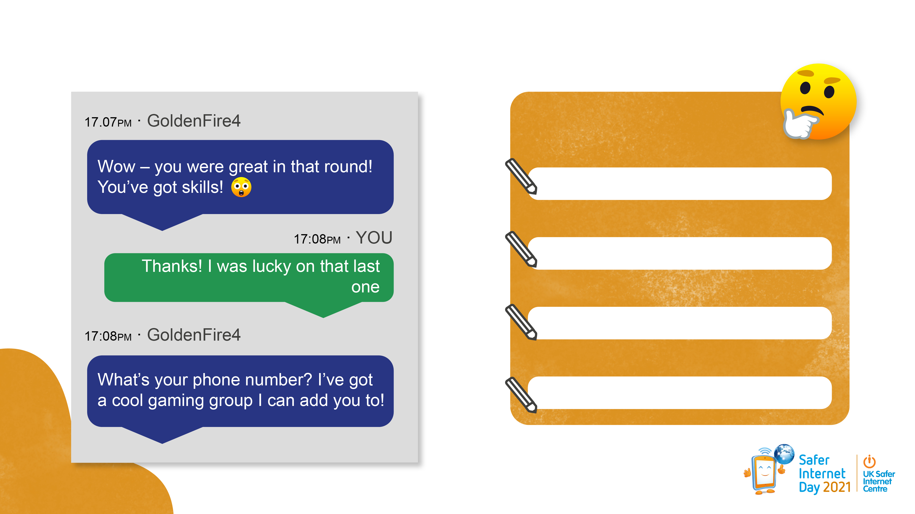
Let’s put those skills to the test… what is the motive?
Remember:
Where has this come from?
Who created or shared it?
What do they want me to do?
Will they gain anything?

Slide 20

Let’s play…
Heads Up!
We’re going to reflect on what we’ve learnt today by playing a game of Heads Up!

Slide 21



Appendices and resources provided in next slides
Notes:
All emojis by joypixels.com

