Slide 1
Caring and Responsibility Lesson 1
community
What does the word ‘community’ mean? What does it mean to you?
A community is a group of people who may work, live or play together and/or have things in common such as hobbies, interests, religion or beliefs.
Which communities do you belong to?
Excalibur Primary School
Rainbows
Beavers
Swimming group
How many community groups do you belong to?

Slide 2
Look at the pictures on the next page.
For each person think about these questions:
Who is this person?
Which community do they belong to?
How do they help people in that community?
How might they help people in other communities?
Just like us these community helpers might belong to lots of different communities.

Slide 3
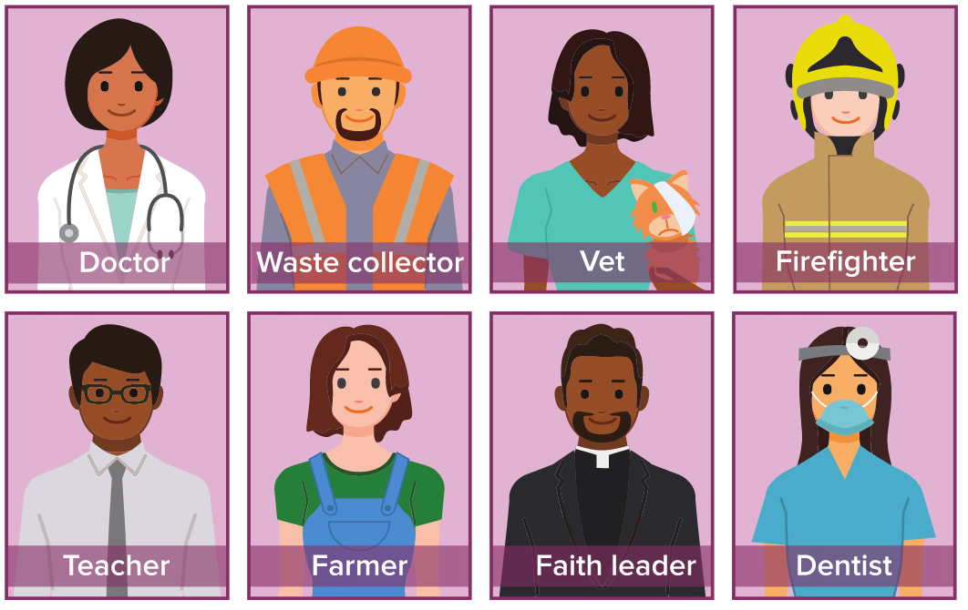

Slide 4
