Slide 1


Year 5 – Spring Block 2 – Fractions
Step 2: Improper Fractions to Mixed Numbers
© Classroom Secrets Limited 2019

Slide 2

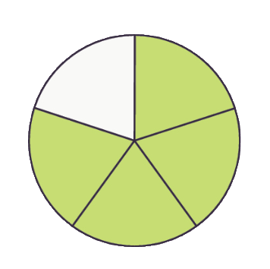

Introduction
Match the picture to the improper fraction.
16
5
12
8
6
3
© Classroom Secrets Limited 2019

Slide 3
Introduction
Match the picture to the improper fraction.
16
5
12
8
6
3
© Classroom Secrets Limited 2019

Slide 4
Varied Fluency 1
Show these improper fractions as a diagram and a mixed number.
A. | 7
 | 4
B. | 11
 | 3
C. | 14
 | 11
© Classroom Secrets Limited 2019

Slide 5
Varied Fluency 1
Show these improper fractions as a diagram and a mixed number.
A. | 7
 | 4
B. | 11
 | 3
C. | 14
 | 11
1 |  | 3
 |  | 4
3 |  | 2
 |  | 3
1 |  | 3
 |  | 11
© Classroom Secrets Limited 2019

Slide 6
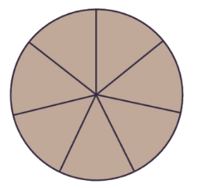

Varied Fluency 2
Which diagram matches the improper fraction?
A.
B.
C.
D.
31
7
© Classroom Secrets Limited 2019

Slide 7
Varied Fluency 2
Which diagram matches the improper fraction?
A.
B.
C.
D.
31
7
© Classroom Secrets Limited 2019

Slide 8
Varied Fluency 3
Lacey is sharing out 3 pizzas with her friends.
Each pizza is cut into 12 equal pieces. They eat 27 slices of pizza.
How much pizza has been eaten?
Give your answer as a mixed number.
© Classroom Secrets Limited 2019

Slide 9
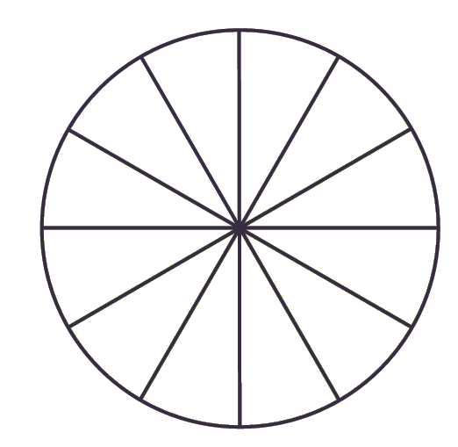
Varied Fluency 3
Lacey is sharing out 3 pizzas with her friends.
Each pizza is cut into 12 equal pieces. They eat 27 slices of pizza.
How much pizza has been eaten?
Give your answer as a mixed number.
27 slices of pizza have been eaten. or
27 | = | 2 | 3
12 |  |  | 12
2 | 1
 | 4
© Classroom Secrets Limited 2019

Slide 10
Reasoning 1
Find and correct the mistakes. Explain your answer.
A. | 19 |  | = |  | 2 | 2
 | 9 |  |  |  |  | 9
B. | 24 |  | = |  | 2 | 4
 | 7 |  |  |  |  | 7
© Classroom Secrets Limited 2019

Slide 11
Reasoning 1
Find and correct the mistakes. Explain your answer.
Fraction A is incorrect because…
Fraction B is incorrect because…
A. | 19 |  | = |  | 2 | 1
 | 9 |  |  |  |  | 9
B. | 24 |  | = |  | 3 | 3
 | 7 |  |  |  |  | 7
© Classroom Secrets Limited 2019

Slide 12
Reasoning 1
Find and correct the mistakes. Explain your answer.
Fraction A is incorrect because the numerator is incorrect.
Fraction B is incorrect because the whole number is incorrect.
A. | 19 |  | = |  | 2 | 1
 | 9 |  |  |  |  | 9
B. | 24 |  | = |  | 3 | 3
 | 7 |  |  |  |  | 7
© Classroom Secrets Limited 2019

Slide 13
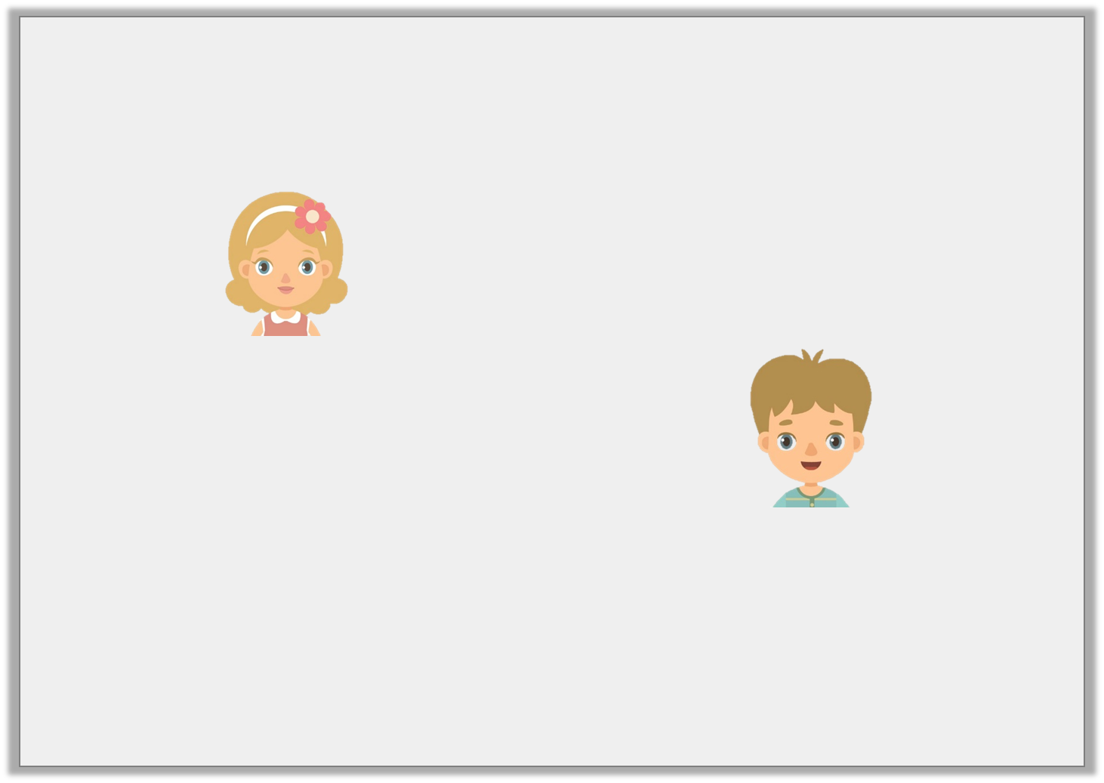
Reasoning 2
Tom has 4 pizzas for a party. They are cut into 6 equal slices. At the end of the party, there are 9 slices of pizza left.
Who is correct? Prove it.
There is left.
1 | 3
 | 6
Jane
There is left.
1 | 9
 | 6
Tom
© Classroom Secrets Limited 2019

Slide 14
Reasoning 2
Tom has 4 pizzas for a party. They are cut into 6 equal slices. At the end of the party, there are 9 slices of pizza left.
Who is correct? Prove it.
Jane is correct because …
There is left.
1 | 3
 | 6
Jane
There is left.
1 | 9
 | 6
Tom
© Classroom Secrets Limited 2019

Slide 15
Reasoning 2
Tom has 4 pizzas for a party. They are cut into 6 equal slices. At the end of the party, there are 9 slices of pizza left.
Who is correct? Prove it.
Jane is correct because there is of the pizza left which, as a mixed number, is 1 .
There is left.
1 | 3
 | 6
Jane
There is left.
1 | 9
 | 6
Tom
9
6
3
6
© Classroom Secrets Limited 2019

Slide 16
Problem Solving 1
Use the number cards to show an improper fraction as a mixed number.
1
3
7
1
6
7
=
© Classroom Secrets Limited 2019

Slide 17
Problem Solving 1
Use the number cards to show an improper fraction as a mixed number.
1
3
7
1
6
7
1
3
6
1
=
7
7
© Classroom Secrets Limited 2019

