Slide 2

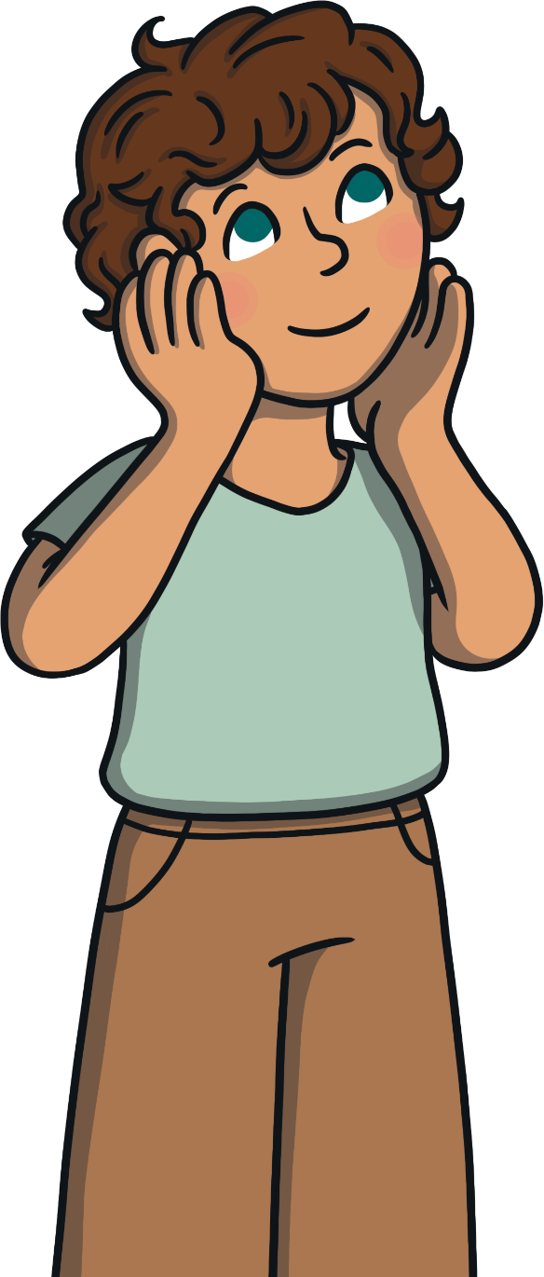
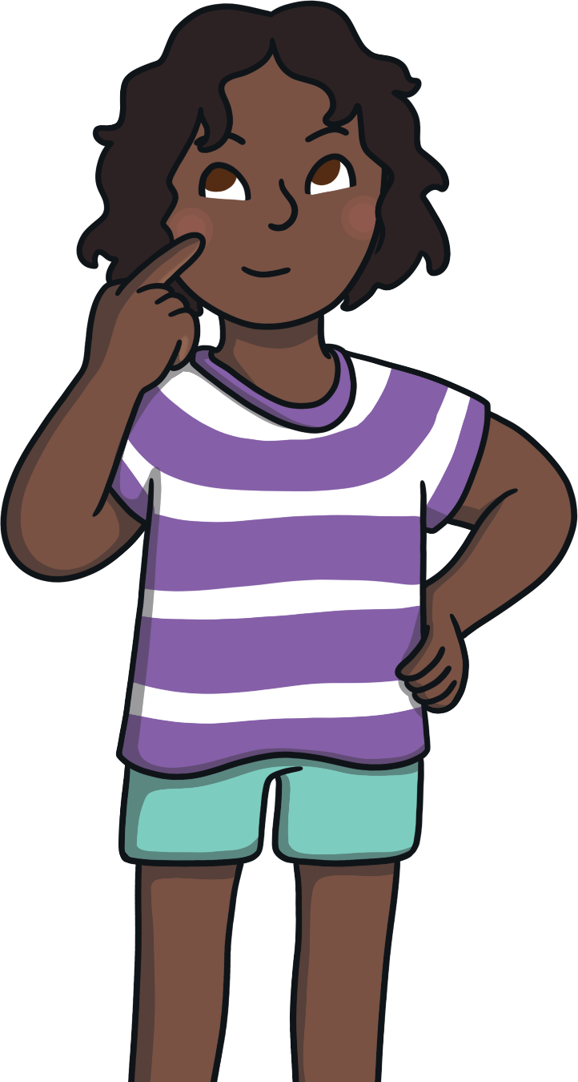

This Is Me!
What makes you, you?
It might include the things you enjoy doing, the things you believe in and what you’re like as a person.

Slide 3
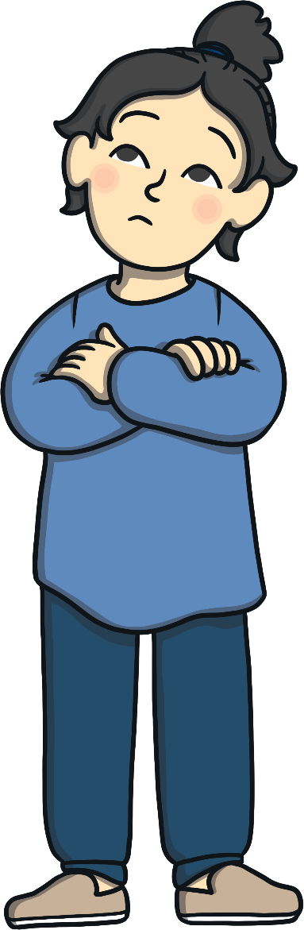
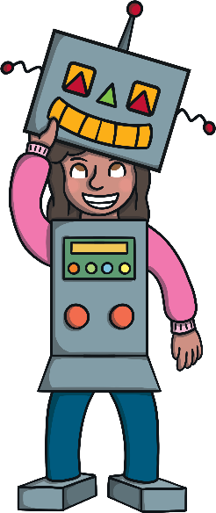
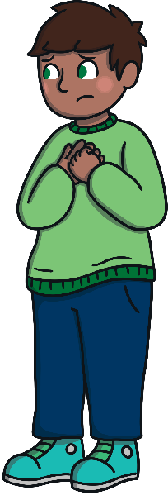
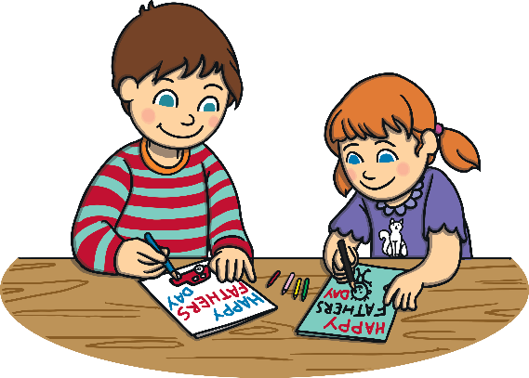
Expressing Yourself
It can be great for our mental health!
What does it mean to express yourself?
Expressing yourself means letting others see who you are as a person.
It means letting your feelings and emotions out and sharing them with others.
It means doing something you love – something that makes you feel good.

Slide 4



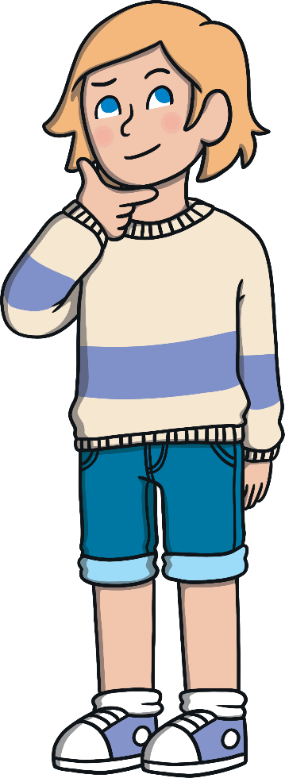
Expressing Yourself
We can all express ourselves in different ways.

Slide 5
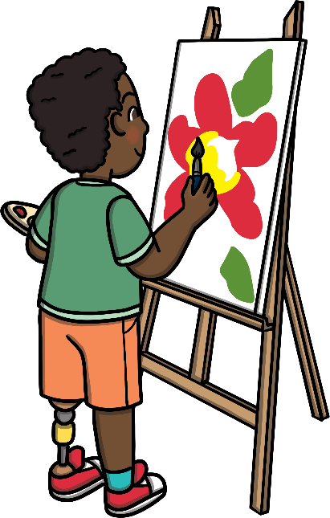
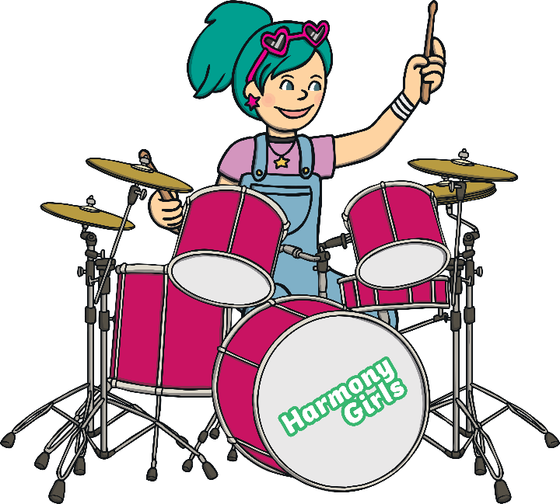
Expressing Yourself
Lots of people express themselves through drawing or painting. The colours they use and the things they draw reflect how they are feeling.
Some people express themselves through music. This could be singing, playing an instrument or dancing. They often find that this helps them to feel happy or calm.

Slide 6
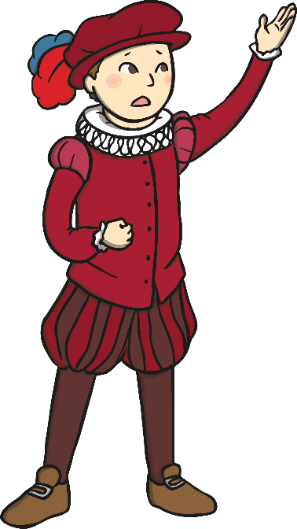
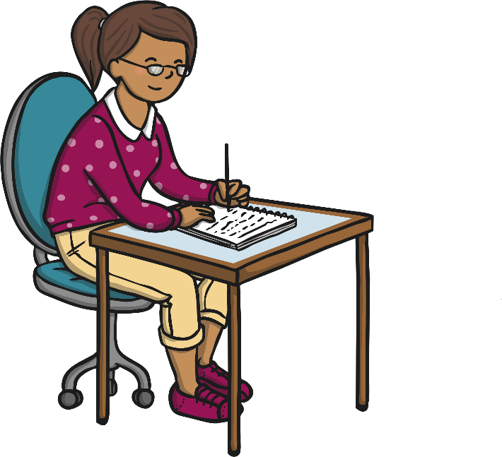
Expressing Yourself
You can also express yourself through acting and drama. Some people like to dress up, pretend to be someone else or perform on a stage.
Others express themselves through writing. It could be writing your feelings down in a diary or a letter. It could be expressing creative ideas through stories or poems.

Slide 7
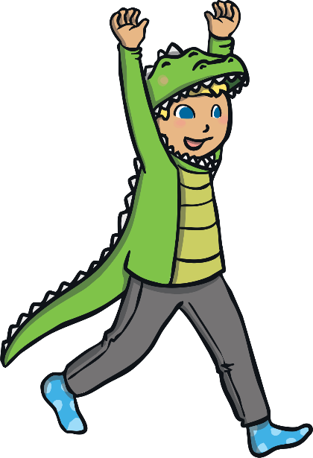
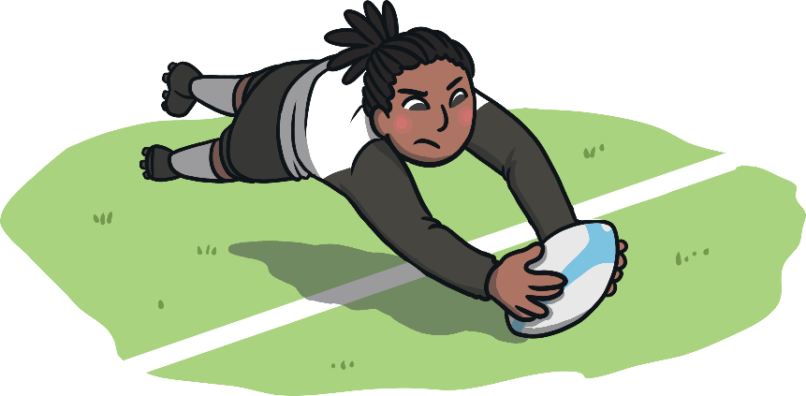
Expressing Yourself
You can also express yourself through the clothes you wear or the way you style your hair. Some people like to get really creative with their appearance!
You can even express yourself through your hobbies. This could be anything from chess to rugby!

Slide 8
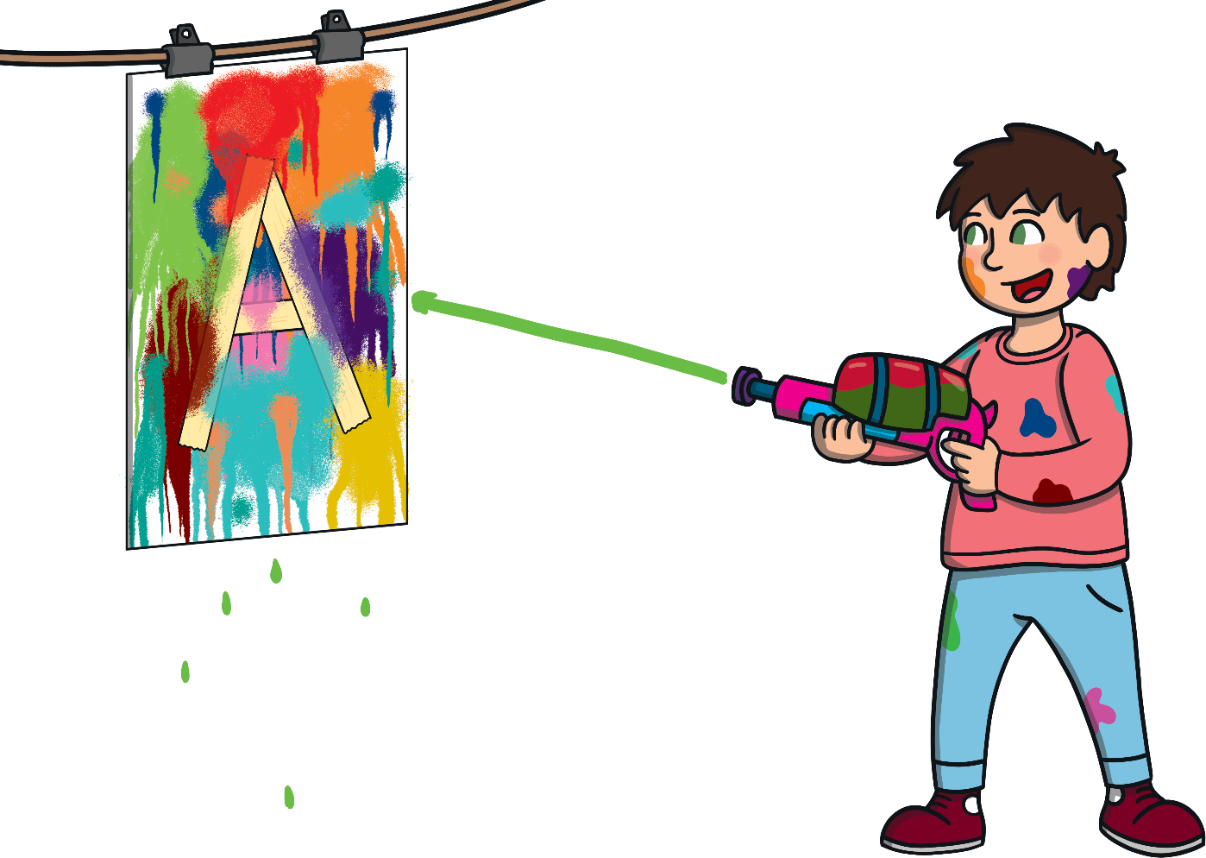

Expressing Yourself
How do you like to express yourself?
Remember, expressing yourself creatively doesn’t mean being really good at something or having to perform for others. It’s about doing something that makes you feel good.

Slide 9
Can you think of ways to express yourself? Check out the following ideas to choose from.
Choose as many as you want!
These activities can be done at any point over this week- they don’t have to be done today.

Slide 10
Design or create an outfit that you think expresses who you are- your personality/ your interests.
Create a piece of artwork that you think expresses who you are. (This would link nicely to our art topic – self-portraits.)
Paint/draw/model an island that you would like to live on. What would make it perfect for you?
Is there a song/songs that make you feel really happy? Could you play them and sing along to them? Why not make up your own dance routine?
Do you enjoy writing? You could write a letter to a friend that you haven’t seen for a while. Let them know how your feeling and what you hope to do when we are allowed to be together again.
It’s getting to that tine of year when gardens need to be cleared from old leaves and debris. Could you go outside and do a bit of gardening?

Slide 11

Are you good at baking? Some people find baking and cooking therapeutic.
Do you enjoy being activity? Is there a sport that you are good at or you would like to improve in? Why not try it out.
Being in lockdown is quite tough but one day it will end. Why not create a “Things To Look Forward To” box or jar. You can decorate it however you wish and write down on bits of paper all the things you are going t do when we can.
Whatever you decide to do, remember to have fun and express yourself. Take time out to relax and work on a project for you!

