Slide 1


Year 5 – Spring Block 2 – Fractions
Equivalent Fractions
© Classroom Secrets Limited 2019

Slide 2
Introduction
Which images show ?
2
9
© Classroom Secrets Limited 2019

Slide 3
Introduction
Which images show ?
is 2 of 9 equal parts.
2
9
2
9
© Classroom Secrets Limited 2019

Slide 4
Varied Fluency 1
Colour of each shape.
2
6
© Classroom Secrets Limited 2019

Slide 5
Varied Fluency 1
Colour of each shape.
2
6
2 | = | 4
6 |  | 12
© Classroom Secrets Limited 2019

Slide 6
Varied Fluency 2
Colour the second image to show an equivalent fraction.
Write the fractions underneath.
=
=
© Classroom Secrets Limited 2019

Slide 7
Varied Fluency 2
Colour the second image to show an equivalent fraction.
Write the fractions underneath.
=
1
3
5
15
=
© Classroom Secrets Limited 2019

Slide 8
Varied Fluency 3
Fill in the missing divisor.
÷ ?
2 | = | 6
6 |  | 18
÷ ?
© Classroom Secrets Limited 2019

Slide 9
Varied Fluency 3
Fill in the missing divisor.
÷ 3
2 | = | 6
6 |  | 18
÷ 3
© Classroom Secrets Limited 2019

Slide 10
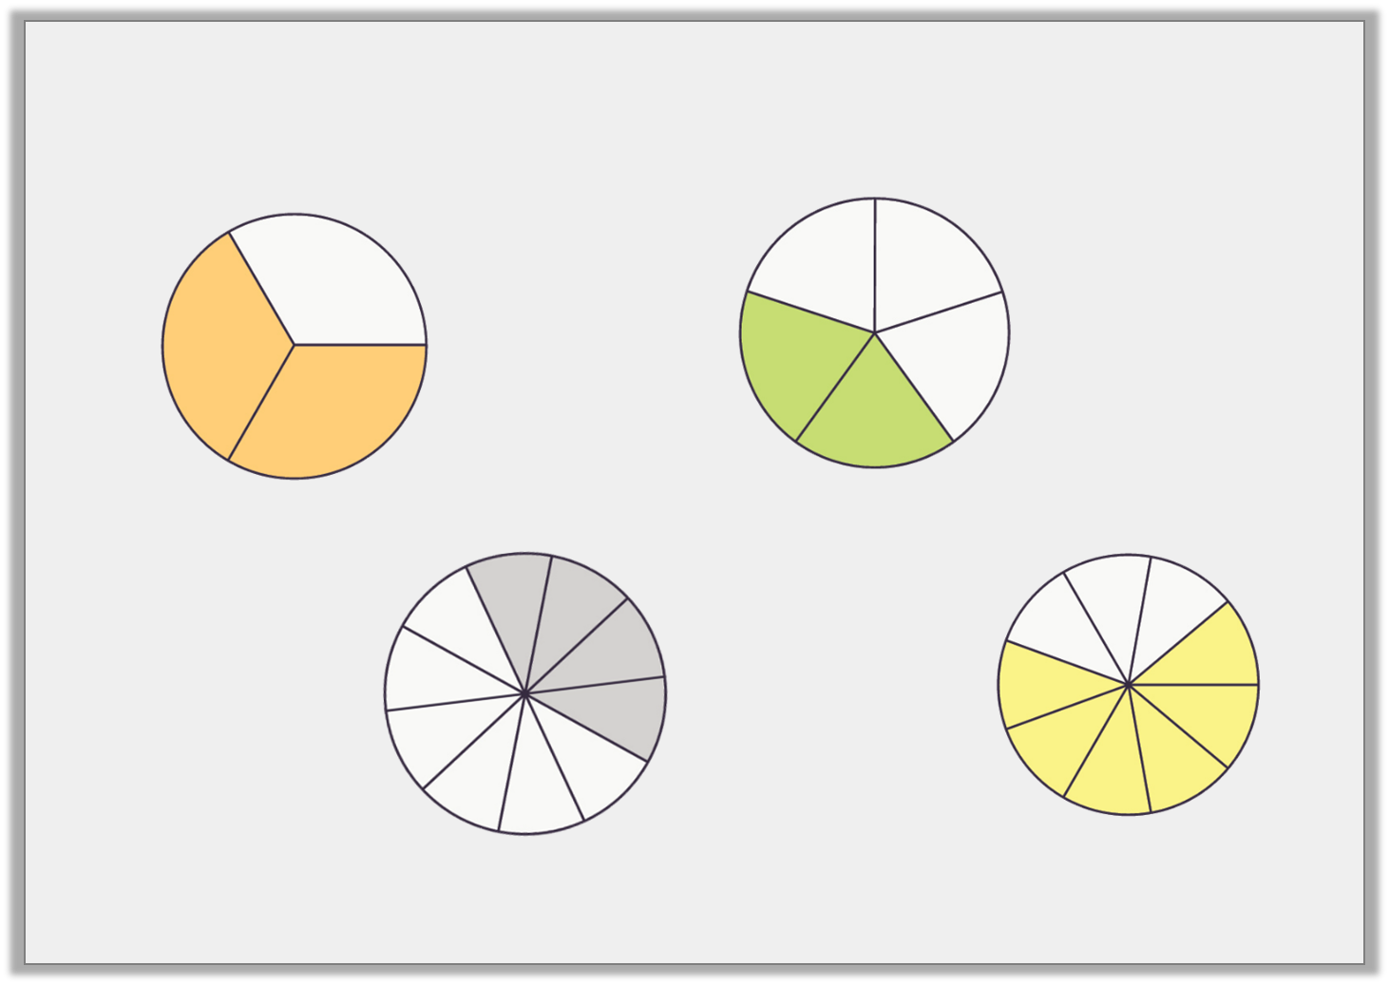
Varied Fluency 4
Match the equivalent fractions.
A.
B.
C.
D.
© Classroom Secrets Limited 2019

Slide 11
Varied Fluency 4
Match the equivalent fractions.
A and D match; B and C match.
A.
B.
C.
D.
© Classroom Secrets Limited 2019

Slide 12

Reasoning 1
Leida has coloured two grids to create an equivalent fraction.
Is Leida correct? Explain your answer.
=
I doubled the denominator and halved the numerator.
© Classroom Secrets Limited 2019

Slide 13
Reasoning 1
Leida has coloured two grids to create an equivalent fraction.
Is Leida correct? Explain your answer.
Leida is incorrect because…
=
I doubled the denominator and halved the numerator.
© Classroom Secrets Limited 2019

Slide 14
Reasoning 1
Leida has coloured two grids to create an equivalent fraction.
Is Leida correct? Explain your answer.
Leida is incorrect because if you double the denominator you
should do the same to the numerator.
=
I doubled the denominator and halved the numerator.
2 | = | 4
8 |  | 16
© Classroom Secrets Limited 2019

Slide 15
Reasoning 2
Chaz has drawn some equivalent fractions.
=
=
Find and correct any mistakes.
A
B
© Classroom Secrets Limited 2019

Slide 16
Reasoning 2
Chaz has drawn some equivalent fractions.
=
=
Find and correct any mistakes.
A should have…
B should have…
A
B
© Classroom Secrets Limited 2019

Slide 17
Reasoning 2
Chaz has drawn some equivalent fractions.
=
=
Find and correct any mistakes.
A should have 3 more parts shaded in because .
B should have 2 parts crossed out because .
A
B
2 | = | 6
5 |  | 15
3 | = | 6
7 |  | 14
© Classroom Secrets Limited 2019

Slide 18
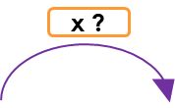
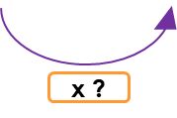
Problem Solving 1
Give 2 possible values for A and B.
2 | = | B
A |  | 12
© Classroom Secrets Limited 2019

Slide 19
Problem Solving 1
Give 2 possible values for A and B.
Various answers, for example:
or or
2 | = | B
A |  | 12
2 | = | 8
3 |  | 12
2 | = | 6
4 |  | 12
2 | = | 4
6 |  | 12
© Classroom Secrets Limited 2019

