Slide 1
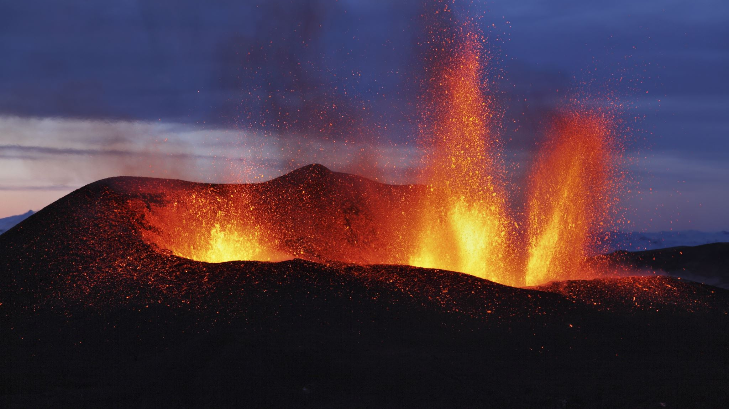
Creating your volcano poem!

Slide 2
Have a look at some examples over the next couple of slides of different styles of poetry.

Slide 3
The harmless volcano slept soundly, looming in the distance,
Finally awakening with a grumble, fire king bellowed with all its might,
Spitting scorching hot lava angrily at anyone who dared come near,
Rivers of thick treacle-like lava claimed anything in their path- not so sweet!
Not picky on its victims, it doesn’t care!
Like a blanket over the sky, the ash cloud submerged the city in darkness,
The beast roared its final roar before silence deafened the citizens,
Laid to rest in its dusty grave, the city was hidden but never forgotten.

Slide 4
A harmless hill, looming in the distance,
Overlooking Pompeii.
A gentle giant, causing no threat,
Or so it seemed…
Everyone is watching,
Talking turns to screams,
It lets out a huge groan,
Like a monumental awakening.
Bang! Crash! Poof!
Rivers of thick honey-like lava flowing,
Down, around.
One last Boom!
No one had ever heard silence quite this loud.
Gone, but never forgotten,
Pompeii.

Slide 5
Burning, running slowly,
As fierce as a snake,
Boiling, bursting lava.
Smoking, choking quickly,
Like an angry chimney,
Misty, murky steam.
Waving, burning fast,
Like fiery, orange ribbons,
Brightly burning flames.

Slide 6
Bubbling, killing quickly,
Like the sun,
Boiling, bulging lava.
Destroying, fiery, crackling,
As hot as an oven,
Scorching, striking volcano.
Crashing, rumbling, deadly,
As strong as an avalanche,
Rumbling, rugged rocks.

