Slide 1
Natural
Disaster
P4C

Slide 2
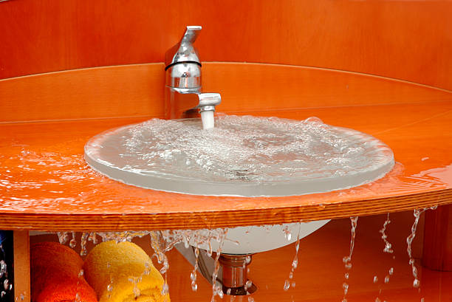
Scenario 1
I leave my tap on and it fills up the sink. The sink overflows and floods the bathroom.

Slide 3
Scenario 1
Is that a natural disaster?
If someone was hurt from the flooded water is it now a natural disaster?
If it was started by someone is it a natural disaster?

Slide 4
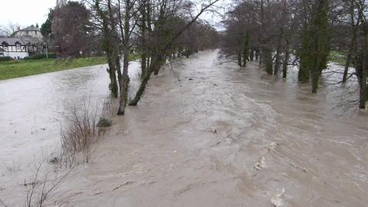
Scenario 2
A river bursts its banks and floods a large area.

Slide 5
Scenario 2
Is that a natural disaster?
How big does a flood need to be a natural disaster?
If it was caused by rain, which is a natural thing, does that mean it is a natural disaster?

Slide 6
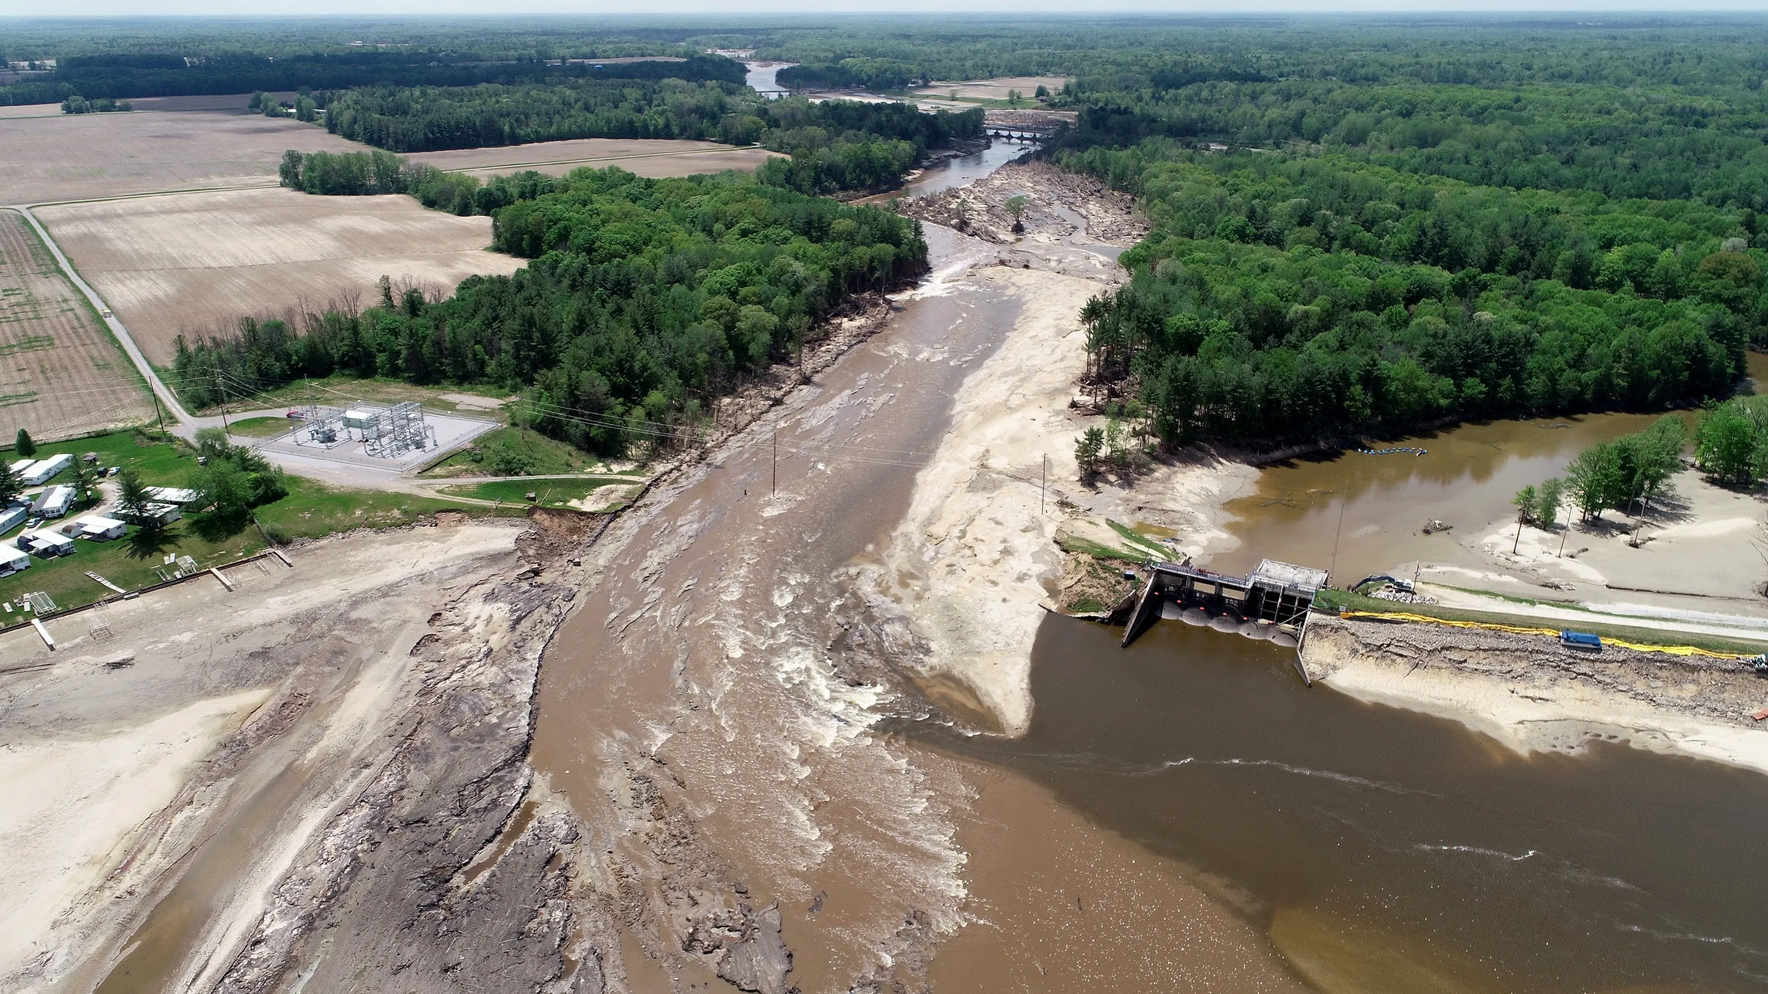
Scenario 3
A dam that was poorly built breaks and the water floods a large area.

Slide 7
Scenario 3
Is that a natural disaster?
Can a natural disaster be unnatural?
Is this the fault of a person? Therefore not making it a natural disaster?

Slide 8
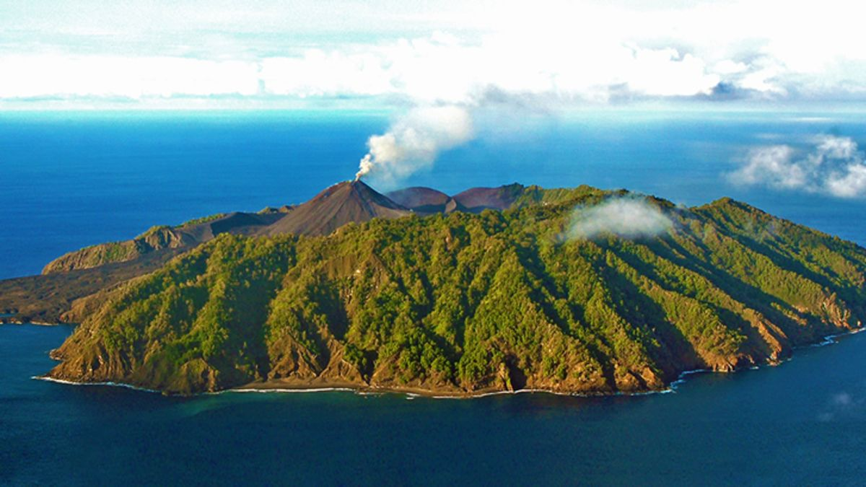
Scenario 4
A volcano erupts on a deserted island

Slide 9
Scenario 4
Is that a natural disaster?
Is it a natural disaster if nobody got hurt?
Can natural disasters be blamed for anything? As they are natural?

Slide 10
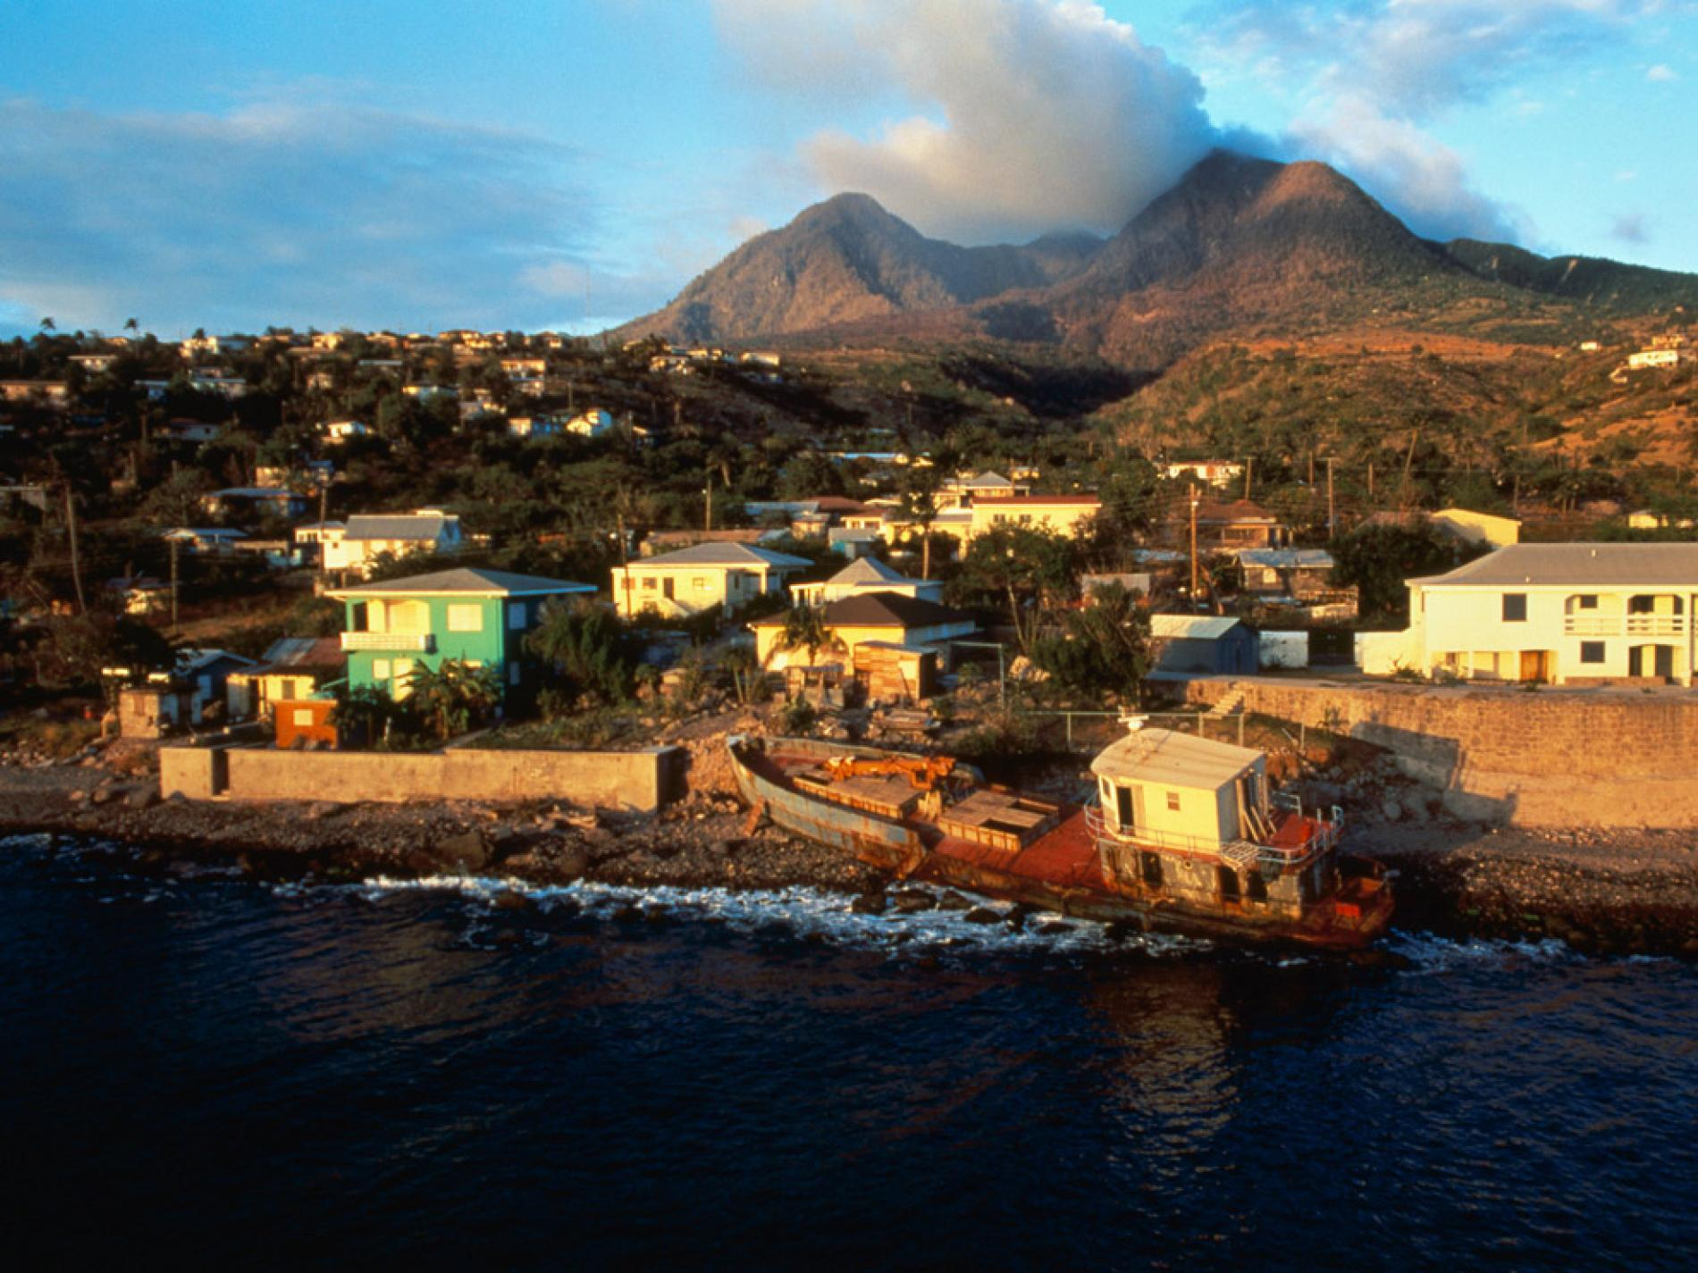
Scenario 5
A volcano destroys a village but all the people escaped.

Slide 11
Scenario 5
Is that a natural disaster?
Are natural disasters evil?
If the town is rebuilt and gets destroyed again by the volcano erupting. Are the builders responsible or the volcano?

Slide 12
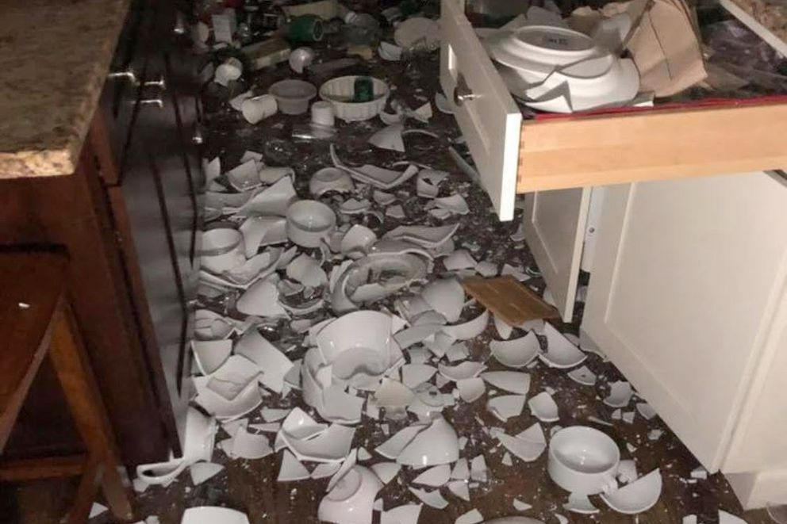
Scenario 6
An earthquake causes all the books to fall of the shelves, cups and glasses smash on the floor. Some people get hurt by falling objects. Nobody goes to hospital.

Slide 13
Scenario 6
Is that a natural disaster?
Is this natural?
As property was destroyed but nobody was hurt, is it a disaster?
Are you responsible if you didn’t know what would happen?

