Slide 1
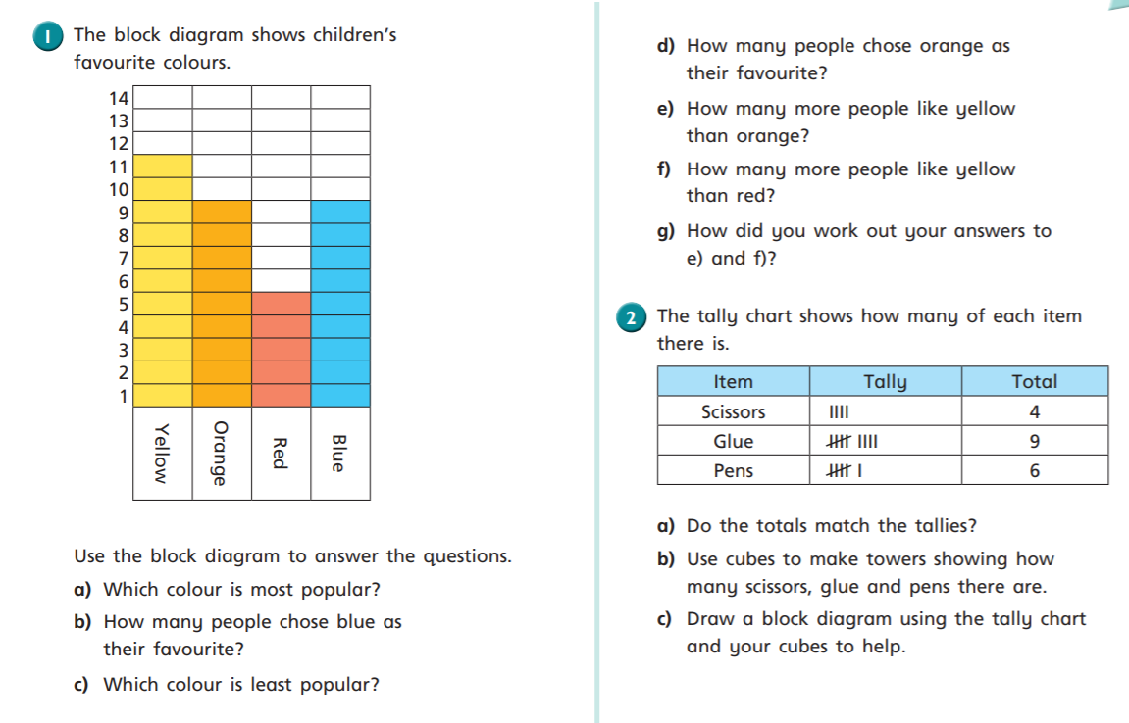
There is a blank block diagram on the next page to use.

Slide 2
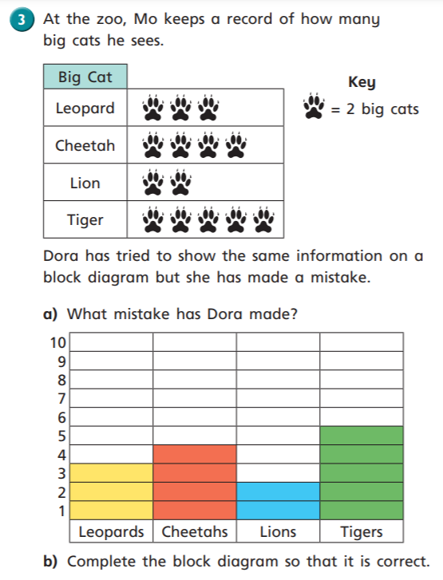
9
8
7
6
5
4
3
2
1
 | scissors | pens | glues
Now try * or ** or ***...

Slide 3





