Slide 1


Consolidation Day!
© Classroom Secrets Limited 2018

Slide 2
Multiply 3 digit by 1 digit
Which calculation has an answer with a digit sum of 18.
A. B.
 | 7 | 4 | 0
x |  |  | 5
 | 6 | 0 | 9
x |  |  | 6
© Classroom Secrets Limited 2018

Slide 3
Multiply 3 digits by 1 digit
Which calculation has an answer with a digit sum of 18.
A. B.
B: 3 + 6 + 5 + 4 = 18
 | 7 | 4 | 0
x |  |  | 5
3 | 7 | 0 | 0
 | 6 | 0 | 9
x |  |  | 6
3 | 6 | 5 | 4
2
5
© Classroom Secrets Limited 2018

Slide 4
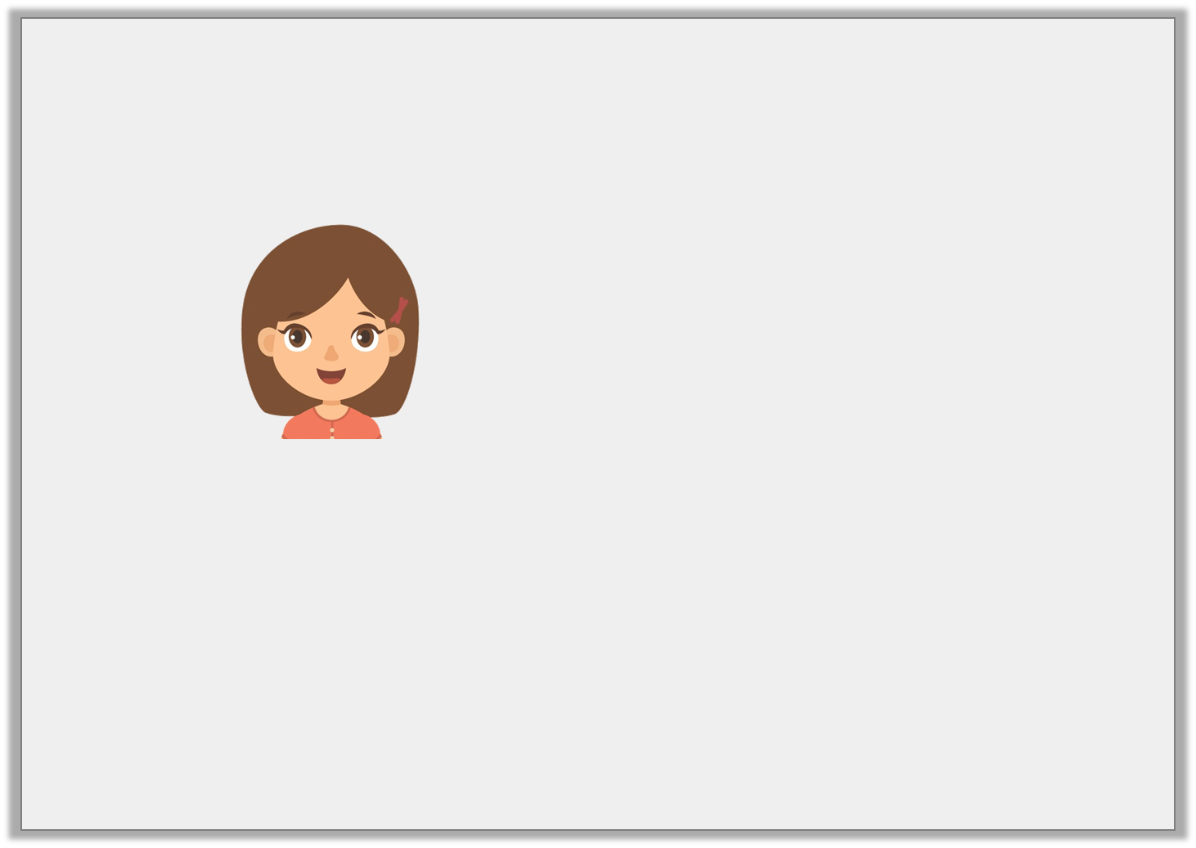
Multiply 3 digits by 1 digit
Jade says,
Is Jade correct? Prove it.
My number 5,870 is 6 times larger than 980.
© Classroom Secrets Limited 2018

Slide 5
Multiply 3 digits by 1 digit
Jade says,
Is Jade correct? Prove it.
No, Jade is incorrect because....
My number 5,870 is 6 times larger than 980.
© Classroom Secrets Limited 2018

Slide 6
Multiply 3 digits by 1 digit
Jade says,
Is Jade correct? Prove it.
No, Jade is incorrect because 980 x 6 = 5,880.
My number 5,870 is 6 times larger than 980.
© Classroom Secrets Limited 2018

Slide 7
Divide 3 digits by 1 digit
Add the symbol <, > or = to make the following statement correct.
627 ÷ 3
763 ÷ 7
© Classroom Secrets Limited 2018

Slide 8
Divide 3 digits by 1 digit
Add the symbol <, > or = to make the following statement correct.
627 ÷ 3
>
763 ÷ 7
© Classroom Secrets Limited 2018

Slide 9
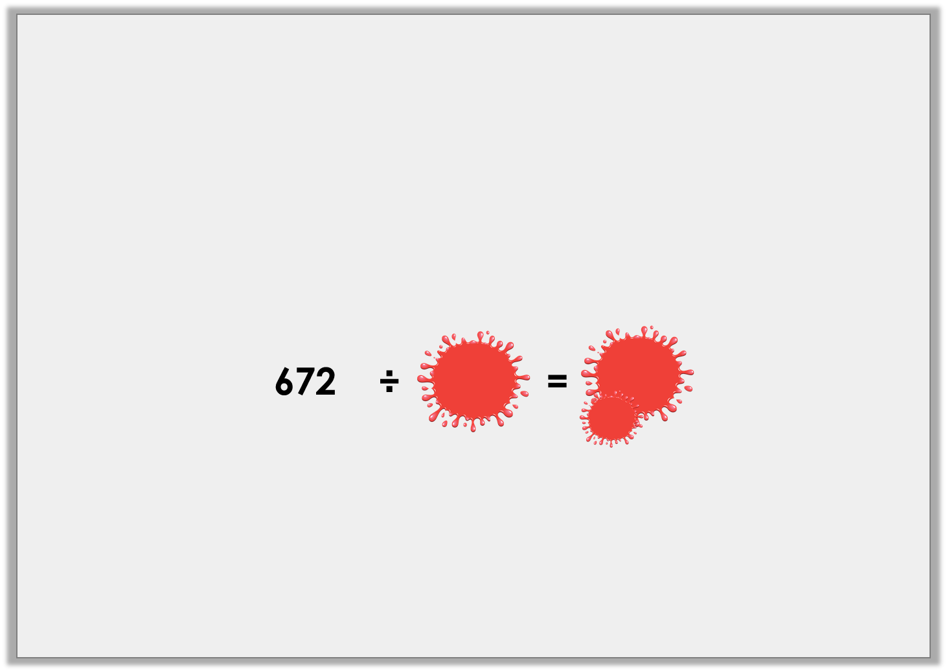
Divide 3 digits by 1 digit
Ellie has spilt paint all over her maths homework!
She was dividing 672 by a 1 digit number, and she remembers her answer was a whole number less than 300.
What could her equation have been?
© Classroom Secrets Limited 2018

Slide 10
Divide 3 digits by 1 digit
Ellie has spilt paint all over her maths homework!
She was dividing 672 by a 1 digit number, and she remembers her answer was a whole number less than 300.
What could her equation have been?
The equation could have been 672 ÷ 3 = 224 or 672 ÷ 6 = 112.
672 | ÷ | 3 | = | 224
672 | ÷ | 6 | = | 112
© Classroom Secrets Limited 2018

Slide 11
Counting Squares
Circle the correct area for the shape below.
15 squares |  | 17 squares |  | 19 squares
© Classroom Secrets Limited 2018

Slide 12
Counting Squares
Circle the correct area for the shape below.
15 squares |  | 17 squares |  | 19 squares
© Classroom Secrets Limited 2018

Slide 13
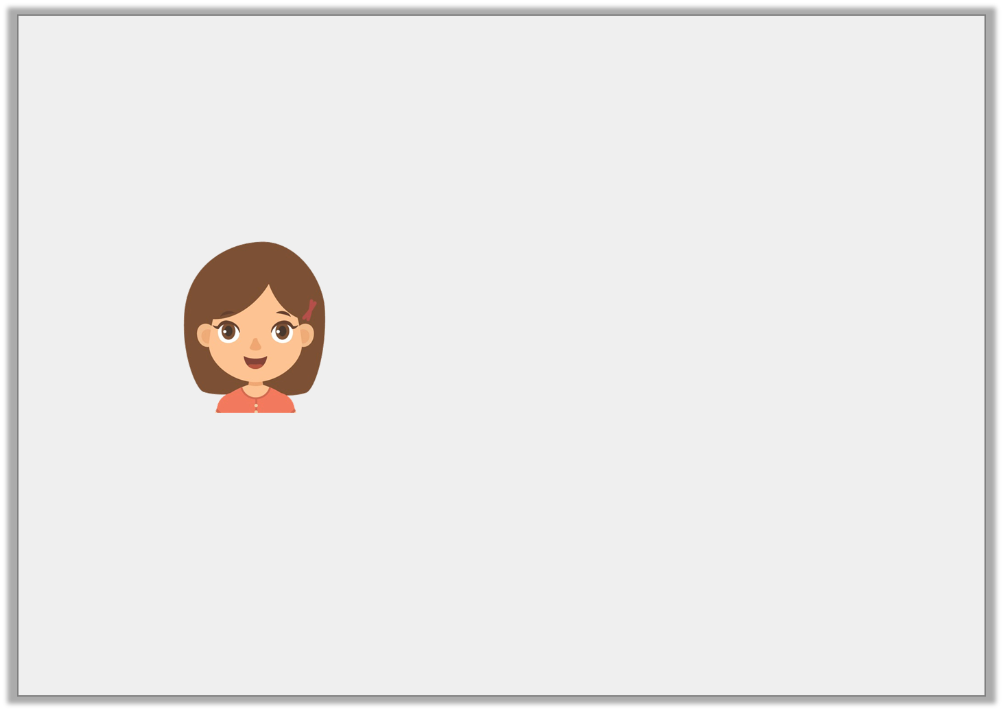
Counting Squares
Becky is trying to work out if she has enough paving slabs to make this pattern on her patio. She has 10 paving slabs.
Does she have enough slabs?
Explain how you know.
© Classroom Secrets Limited 2018

Slide 14
Counting Squares
Becky is trying to work out if she has enough paving slabs to make this pattern on her patio. She has 10 paving slabs.
Does she have enough slabs?
Explain how you know.
Becky doesn’t have enough slabs because…
© Classroom Secrets Limited 2018

Slide 15
Counting Squares
Becky is trying to work out if she has enough paving slabs to make this pattern on her patio. She has 10 paving slabs.
Does she have enough slabs?
Explain how you know.
Becky doesn’t have enough slabs because the area of her pattern is 13 squares so she needs 3 more slabs.
© Classroom Secrets Limited 2018

Slide 16
Comparing Area
Circle the shape with the largest area.
 | A |  |  |  |  |  | B
© Classroom Secrets Limited 2019

Slide 17
Comparing Area
Circle the shape with the largest area.
 | A |  |  |  |  |  | B
© Classroom Secrets Limited 2019

Slide 18
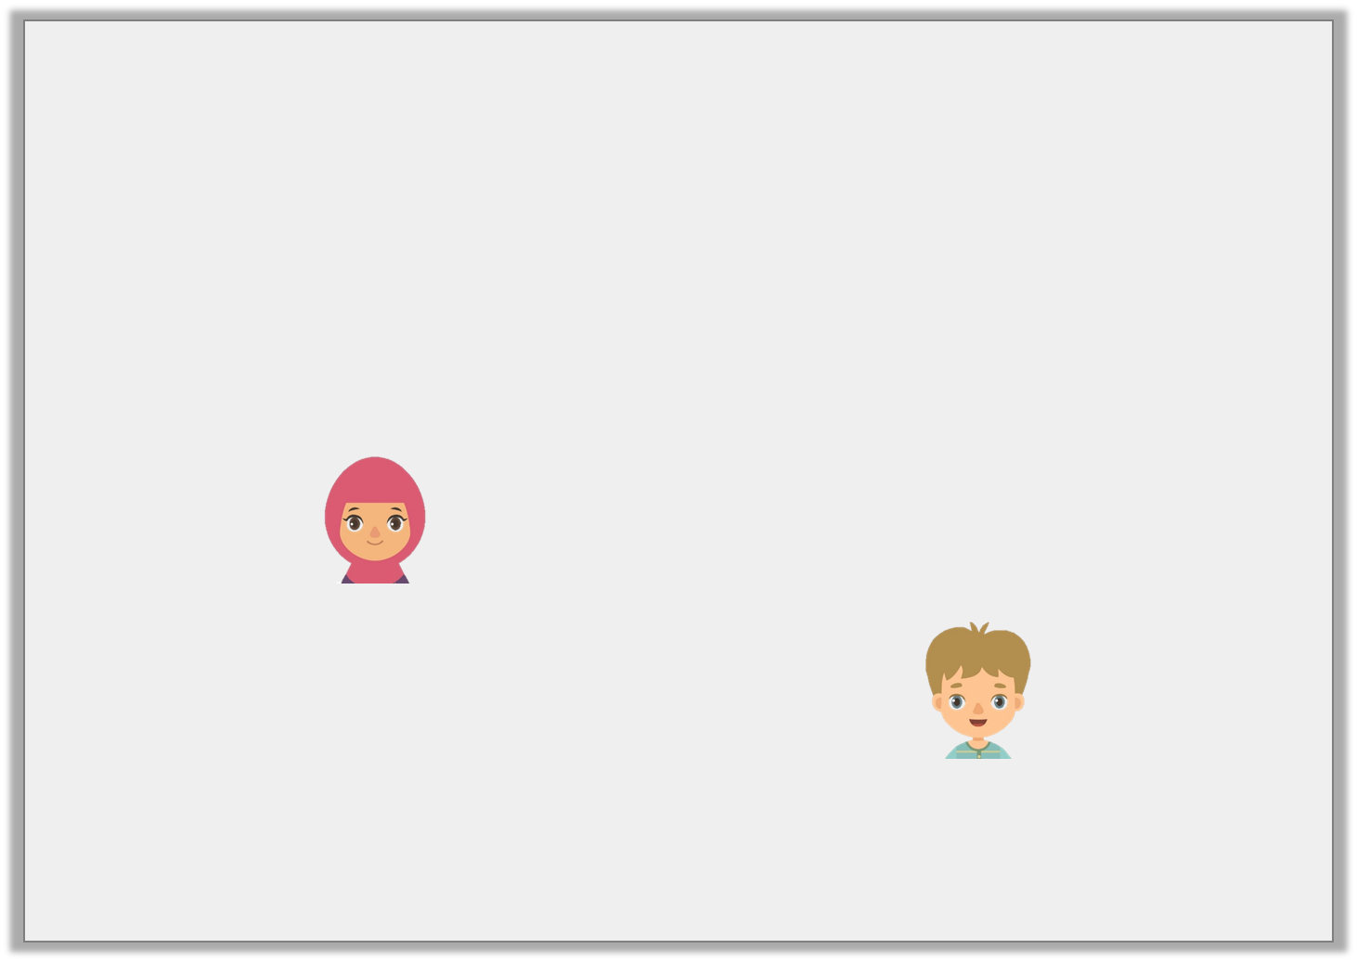
Comparing Area
Kiran and Max are comparing the area of two shapes.
Who is correct? Prove it.
A |  |  |  |  |  |  | B
Shape A has a larger area.
Kiran
The shapes have the same area.
Max
© Classroom Secrets Limited 2019

Slide 19
Comparing Area
Kiran and Max are comparing the area of two shapes.
Who is correct? Prove it.
Kiran is correct because…
A |  |  |  |  |  |  | B
Shape A has a larger area.
Kiran
The shapes have the same area.
Max
© Classroom Secrets Limited 2019

Slide 20
Comparing Area
Kiran and Max are comparing the area of two shapes.
Who is correct? Prove it.
Kiran is correct because the area of A is 11 squares and the area of B is 10 squares.
A |  |  |  |  |  |  | B
Shape A has a larger area.
Kiran
The shapes have the same area.
Max
© Classroom Secrets Limited 2019

Slide 21



What is a Fraction?
Match the fraction to the correct representation.
1
5
3
4
4
7
2
4
A.
B.
C.
D.
© Classroom Secrets Limited 2019

Slide 22
What is a Fraction?
Match the fraction to the correct representation.
1
5
3
4
4
7
2
4
A.
B.
C.
D.
© Classroom Secrets Limited 2019

Slide 23
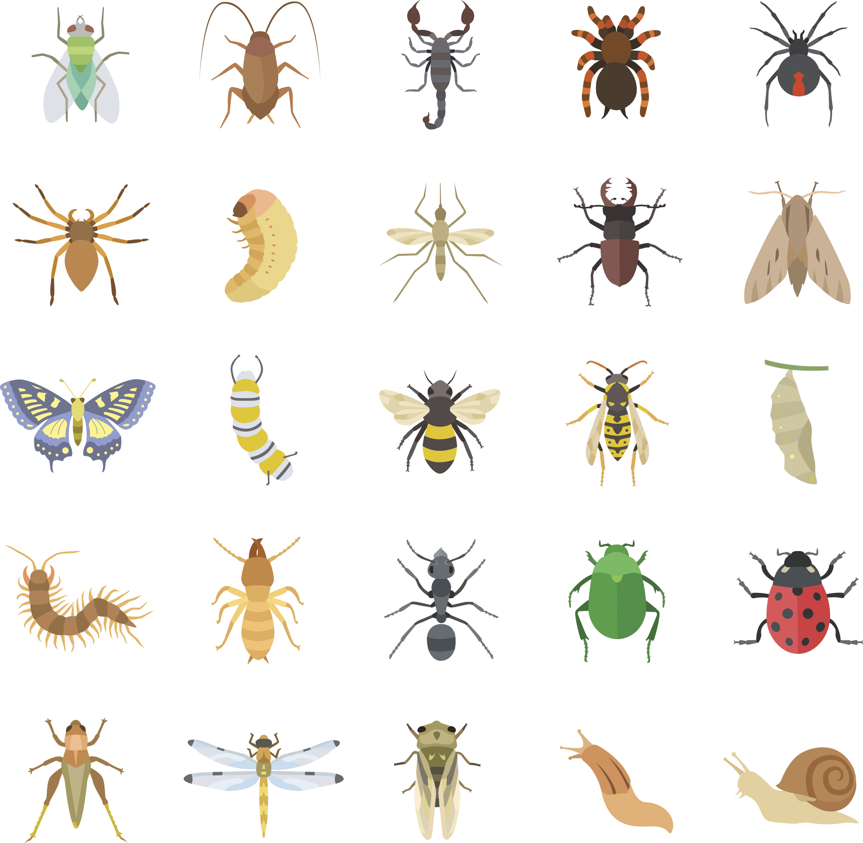
What is a Fraction?
Josh thinks one of the fractions being represented below is .
Is he correct? Prove it.
4
5
© Classroom Secrets Limited 2019

Slide 24
What is a Fraction?
Josh thinks one of the fractions being represented below is .
Is he correct? Prove it.
Josh is incorrect because…
4
5
© Classroom Secrets Limited 2019

Slide 25
What is a Fraction?
Josh thinks one of the fractions being represented below is .
Is he correct? Prove it.
Josh is incorrect because the whole is 9.
The fraction should be or .
4
5
5
9
4
9
© Classroom Secrets Limited 2019

Slide 26
Equivalent Fractions
Which two fractions are equivalent to each other?
A.
B.
C.
© Classroom Secrets Limited 2019

Slide 27
Equivalent Fractions
Which two fractions are equivalent to each other?
A and C are equivalent.
2
4
A.
2
6
B.
6
12
C.
© Classroom Secrets Limited 2019

Slide 28

Equivalent Fractions
Nissa is investigating fractions. She says,
Is she correct? Explain your answer.
Nissa is incorrect because…
is equivalent to .
5
7
10
12
© Classroom Secrets Limited 2019

Slide 29
Equivalent Fractions
Nissa is investigating fractions. She says,
Is she correct? Explain your answer.
Nissa is incorrect because is not equivalent to . She could have said is equivalent to .
is equivalent to .
5
7
10
12
5
7
10
12
5
7
10
14
© Classroom Secrets Limited 2019

Slide 30
Counting in Fractions
Which fraction comes next in the sequence below?
Circle the correct answer.
?
1
5
3
5
5
5
7
5
6
5
8
5
9
5
© Classroom Secrets Limited 2019

Slide 31
Counting in Fractions
Which fraction comes next in the sequence below?
Circle the correct answer.
?
1
5
3
5
5
5
7
5
6
5
8
5
9
5
© Classroom Secrets Limited 2019

Slide 32

Counting in Fractions
Steph has written the following sequence:
Is she correct?
Explain your answer.
2 | 1 | , | 1 | 3 | , | 1 | 1
 | 4 |  |  | 4 |  |  | 4
The next number will be 1.
© Classroom Secrets Limited 2019

Slide 33
Counting in Fractions
Steph has written the following sequence:
Is she correct?
Explain your answer.
Steph is incorrect because…
2 | 1 | , | 1 | 3 | , | 1 | 1
 | 4 |  |  | 4 |  |  | 4
The next number will be 1.
© Classroom Secrets Limited 2019

Slide 34
Counting in Fractions
Steph has written the following sequence:
Is she correct?
Explain your answer.
Steph is incorrect because the sequence decreases by each time. The next fraction is .
2 | 1 | , | 1 | 3 | , | 1 | 1
 | 4 |  |  | 4 |  |  | 4
The next number will be 1.
2
4
3
4
© Classroom Secrets Limited 2019

