Slide 2



Diving into Mastery Guidance for Educators
Each activity sheet is split into three sections, diving, deeper and deepest, which are represented by the following icons:
These carefully designed activities take your children through a learning journey, initially ensuring they are fluent with the key concept being taught; then applying this to a range of reasoning and problem-solving activities.
These sheets might not necessarily be used in a linear way. Some children might begin at the ‘Deeper’ section and in fact, others may ‘dive straight in’ to the ‘Deepest’ section if they have already mastered the skill and are applying this to show their depth of understanding.
Diving
Deeper
Deepest

Slide 3
Aim
Recognise and show, using diagrams, families of common equivalent fractions.

Slide 4


Count in Fractions
Diving
Complete the number line by filling in the missing fractions and mixed numbers.
1
5
2
3
5
4
5
6
7
5
8
5
9
5
10
0
5
5
5
5
5
0
1
5
2
5
3
5
4
5
1
1
5
2
5
3
5
4
5
1
1
1
1
2
or

Slide 5

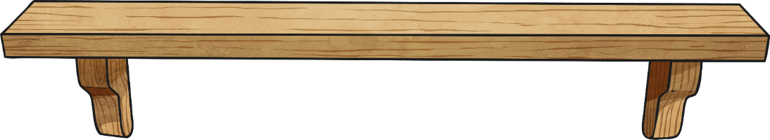
Count in Fractions
Diving
Write these fractions in descending order.
1
3
2
3
1
3
2
3
1
2
1
1

Slide 6
Count in Fractions
Diving
Complete the number line by filling in the missing fractions and mixed numbers.
1
7
2
3
7
4
5
6
7
7
8
9
7
10
0
7
7
7
7
7
7
0
1
7
2
7
3
7
4
7
5
7
6
7
1
1
7
2
7
3
7
1
1
1

Slide 7
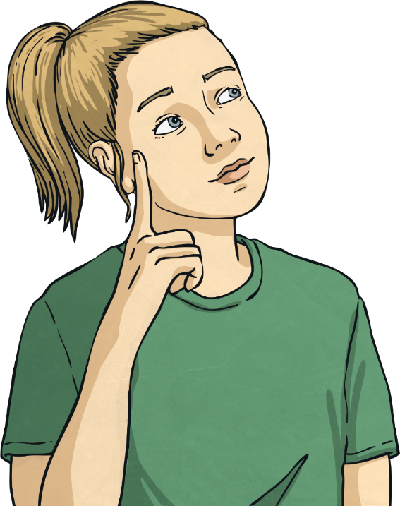
Count in Fractions
Diving
Complete the fraction number sequence and explain the pattern.
1
8
9
2
1
9
2
3
9
2
5
9
2
7
9
The fractions are increasing by 2 ninths ( ) each time.
2
9

Slide 8

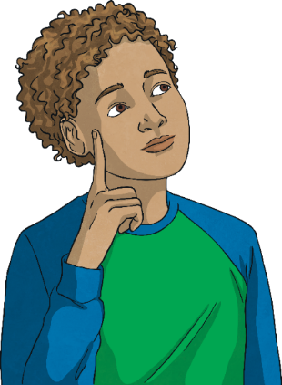
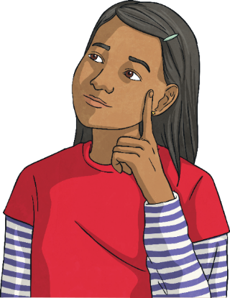
Count in Fractions
Deeper
The children have been asked to identify the missing mixed number fraction on the number line.
Check each of their answers. Who is correct? Who is incorrect?
Explain your answers.
1
1
4
2
4
3
4
3
1
4
2
4
1
1
2
3
3
Max
Mia
The missing mixed
number fraction is .
The missing mixed
number fraction is 3.
3
4
3
Max is incorrect because he has added 1 whole, instead of following the pattern of increasing by 1 quarter each time.
Mia is correct: she has added 1 more quarter to to make 3 whole ones.
3
4
2

Slide 9

Count in Fractions
Deeper
Phillipe is counting in thirds. Spot and correct his mistake.
Spot and correct his mistake.
One third, two thirds, one whole,
one whole and two thirds, two whole ones, two whole ones and one third,
two whole ones and two thirds,
three whole ones…
Philippe has missed out one whole and one third when counting in thirds.
He should have said this after saying one whole but, instead, he went
straight to one whole and two thirds.

Slide 10


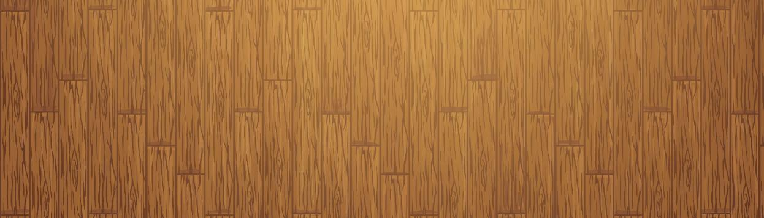


Count in Fractions
Deepest
Elliott wanted to use his ruler to measure some string. He was having trouble because most of the measuring scale on the ruler had worn away and lots of the numbers were missing.
Use Elliott's clues to redraw the scale (fraction number line) on the ruler.
The ruler has a scale that starts at 0 and ends with 3.
I can see some mixed number fractions.
There are 4 big marks for whole numbers including 0.
There are 7 little marks between each of the big marks. On one of these little marks, I can read the mixed number fraction .
7
8
2
0
1
8
2
8
3
8
4
8
5
8
6
8
7
8
1
1
8
2
8
3
8
4
8
5
8
6
8
7
8
2
1
8
2
8
3
8
4
8
5
8
6
8
7
8
3
1
1
1
1
1
1
1
2
2
2
2
2
2
2

Slide 11
Count in Fractions
Deepest
a) Look at these fraction cards. Organise them in ascending order.
A
B
C
D
15
10
two
whole
ones
2
5
10
b) Explain the pattern in this fraction number sequence.
c) What will the next card in the sequence be? Try to write it in more
than one way and draw an image of this fraction.
The fractions are increasing by 5 tenths (or 1 half) each time.
30
10
, 3,
or

Slide 12
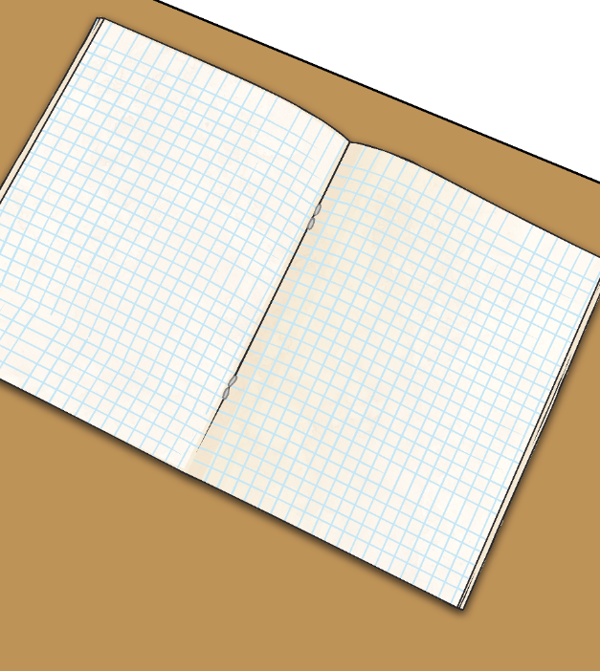
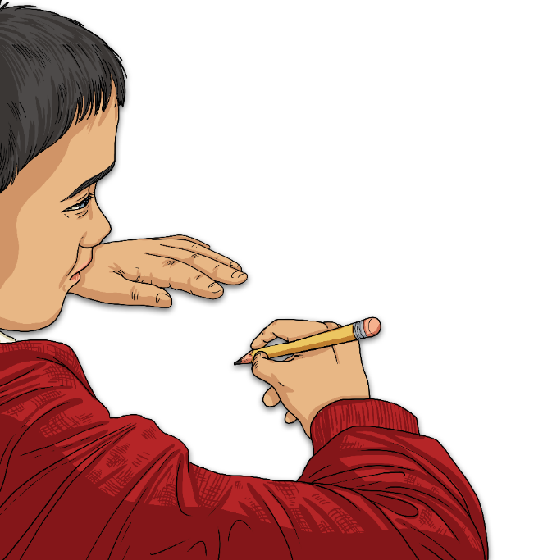
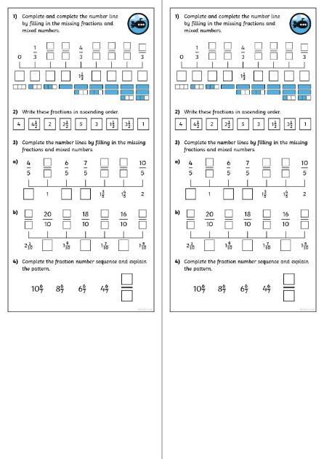
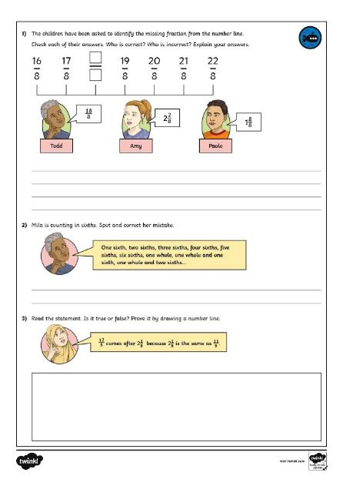
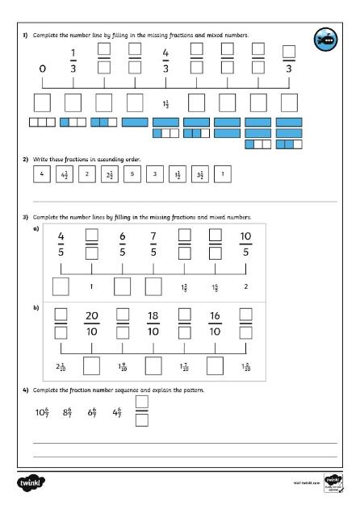
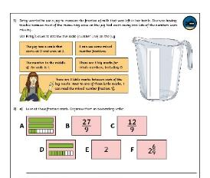
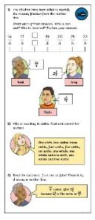
Count in Fractions
Dive in by completing your own activity!

