Slide 1


Slide 3
1) What fraction is shaded?
2) Is more or less than a third shaded?
3) What fraction of the circles are not red?
4) What is half of 72?

Slide 4


1) What fraction is shaded?
2) Is more or less than a third shaded?
3) What fraction of the circles are not red?
4) What is half of 72?
$$\frac{\text{2}}{\text{5}}$$
Less
$$\frac{\text{6}}{\text{6}}$$
36

Slide 6
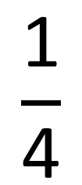
$$\frac{\text{1}}{\text{4}}$$
Numerator –
How many of the parts we are using
Denominator –
How many equal parts there are

Slide 7


Which shows $\frac{\text{1}}{\text{4}}\text{?}$
How do you know?
Have a think
a)
Yes
c)
Yes
d)
b)
No
No

Slide 8

$$\frac{\text{2}}{\text{5}}$$
5 equal parts
2 parts shaded
2 out of 5 parts shaded

Slide 9


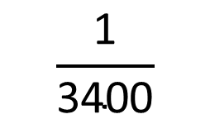
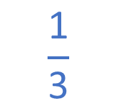
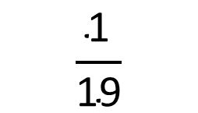


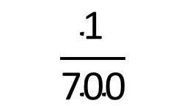
$$\frac{\text{1}}{\text{7}}$$
$$\frac{\text{1}}{\text{4}}$$
$$\frac{\text{1}}{\text{3}}$$
Numerator is 1 $=$ unit fraction
$$\frac{\text{1}}{\text{700}}$$
$$\frac{\text{1}}{\text{2}}$$
$$\frac{\text{1}}{\text{3400}}$$
$$\frac{\text{1}}{\text{19}}$$

Slide 10

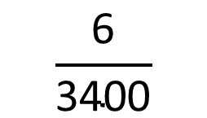
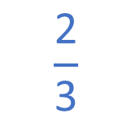
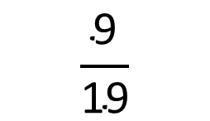


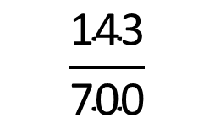
$$\frac{\text{6}}{\text{7}}$$
$$\frac{\text{5}}{\text{4}}$$
$$\frac{\text{2}}{\text{3}}$$
Numerator not 1 $=$ non-unit fraction
$$\frac{\text{143}}{\text{700}}$$
$$\frac{\text{2}}{\text{2}}$$
$$\frac{\text{6}}{\text{3400}}$$
$$\frac{\text{9}}{\text{19}}$$

Slide 11
Have a go at questions
1 - 4 on the worksheet

Slide 12






1
0
$$\frac{\text{1}}{\text{5}}$$
$$\frac{\text{2}}{\text{5}}$$
$$\frac{\text{3}}{\text{5}}$$
$$\frac{\text{4}}{\text{5}}$$
1
$$\frac{\text{5}}{\text{5}}$$
$$\frac{\text{2}}{\text{5}}$$

Slide 13
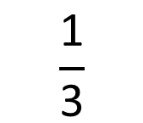


$$\frac{\text{4}}{\text{5}}$$
Have a think
1)
0
1
$$\frac{\text{3}}{\text{7}}$$
2)
0
1
$$\frac{\text{1}}{\text{3}}$$
3)
0
1

Slide 14

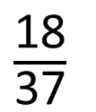

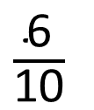
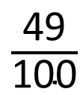
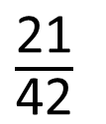

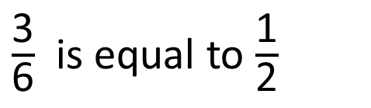




$$\frac{\text{1}}{\text{2}}$$
0
1
$$\frac{\text{1}}{\text{6}}$$
$$\frac{\text{2}}{\text{6}}$$
$$\frac{\text{3}}{\text{6}}$$
$$\frac{\text{4}}{\text{6}}$$
$$\frac{\text{5}}{\text{6}}$$
$$\frac{\text{6}}{\text{6}}$$
3 is half of 6
$\frac{\text{3}}{\text{6}}$ is equal to $\frac{\text{1}}{\text{2}}$
Have a think
$\frac{\text{6}}{\text{10}}$
$\frac{\text{21}}{\text{42}}$
$\frac{\text{49}}{\text{100}}$
$\frac{\text{18}}{\text{37}}$

Slide 15



$$\frac{\text{1}}{\text{2}}$$
1)
Have a think
0
1
$$\frac{\text{1}}{\text{2}}$$
2)
0
1
2
3)
$$\frac{\text{7}}{\text{7}}$$
0
1

Slide 16


$$\frac{\text{3}}{\text{5}}$$
What fraction are green? ___
3 are green out of 5 in total
$$\frac{\text{2}}{\text{5}}$$
What fraction are blue? ___
2 are blue out of 5 in total

Slide 17



$$\frac{\text{2}}{\text{3}}$$
Have a think
1) What fraction are yellow?
$$\frac{\text{5}}{\text{6}}$$
2) What fraction are not red?
3) What fraction are white?
$$\frac{\text{3}}{\text{8}}$$

Slide 18

Have a think
Larger than the other 3 parts
All the same size
4 parts
Is more or less than $\frac{\text{1}}{\text{4}} \text{shaded}\text{?}$
How do you know?
More

Slide 19
Have a go at questions
5 - 8 on the worksheet

