Slide 1
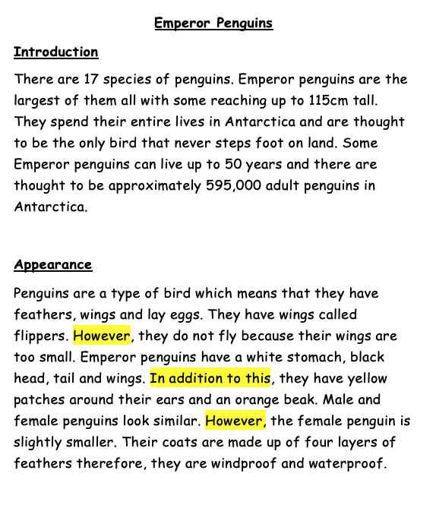

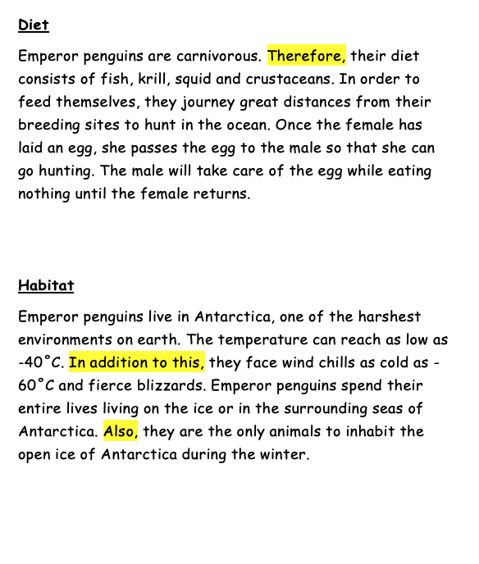
Sound button!
My non-chronological report WAGOLL was typed up on a word document.
Today, you are going to continue typing up your non-chronological report.

Slide 2
Starter:
https://www.bbc.co.uk/bitesize/topics/zf2f9j6/articles/z3c6tfr
Please ask an adult before clicking any links.
Task
You will need your Microsoft Word document that you started in the last lesson. If you did not use Microsoft Word, please continue with the program that you used last week. If you used Seesaw, you can edit your work from last week to continue to type up your writing.
Please have a go at using the keyboard commands- explained on the next slides.

Slide 3
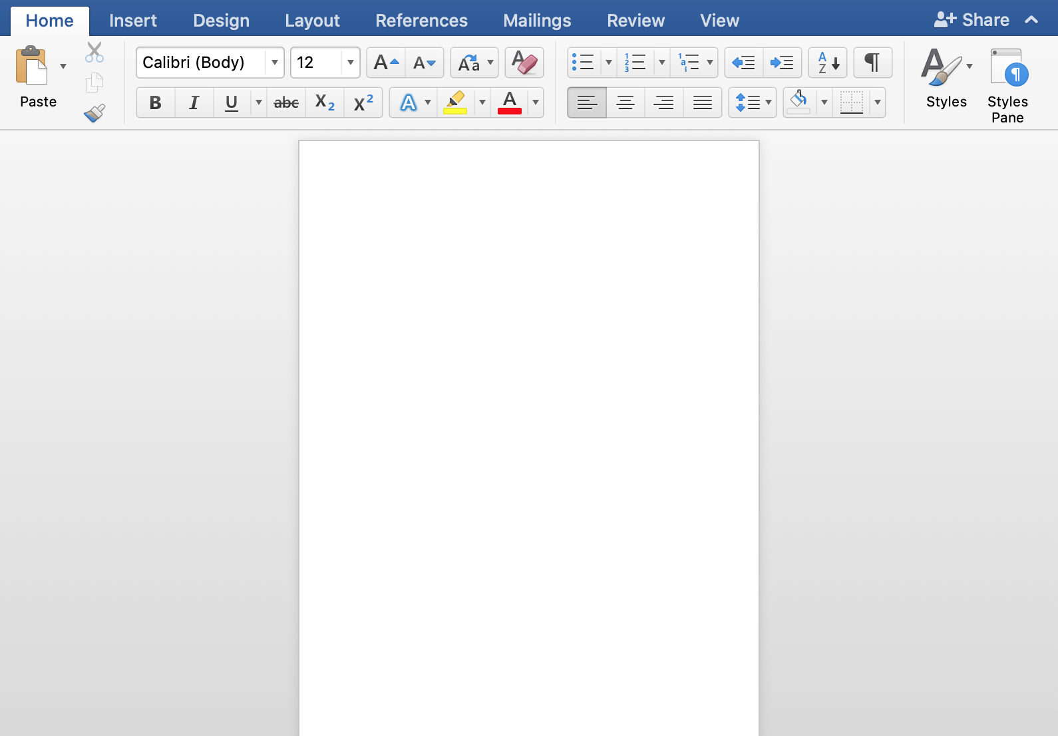
Last week we used the buttons on Word to make our typing bold and underlined.
These buttons will change the font style and size of the text.
Sound button!

Slide 4
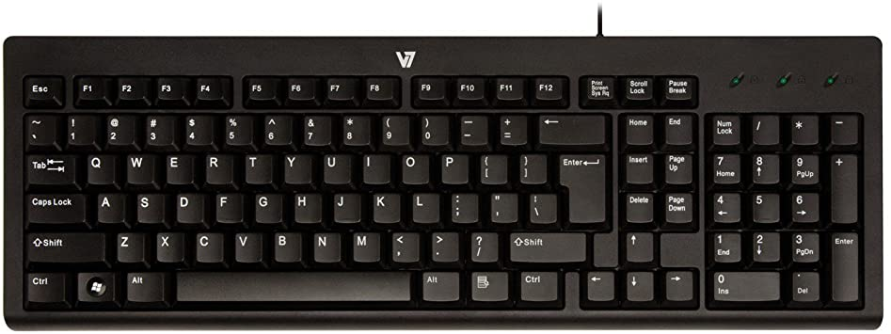
You can use the keyboard shortcut to make your typing bold. Using the mouse, highlight the text that you wish to make bold.
Then, press Ctrl and B on the keyboard (keep pressing the Ctrl button whilst you press B).
Sound button!

Slide 5
You can use the keyboard shortcut to make your typing underlined. Using the mouse, highlight the text that you wish to make bold.
Then, press Ctrl and U on the keyboard (at the same time).
Sound button!

Slide 6
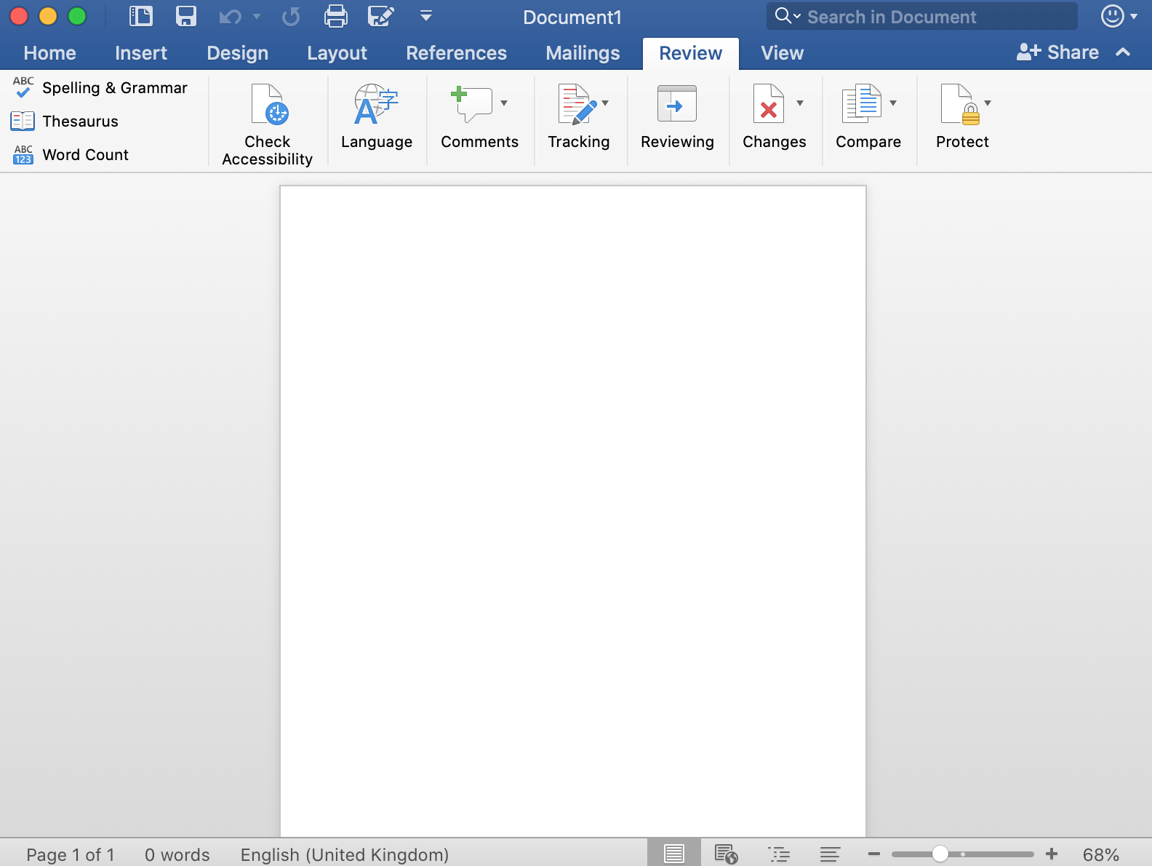
Finally, we are going to use Spellcheck to check our work.
Click on
Review
and then
Spelling and Grammar.
The program will then highlight any words that have been spelt incorrectly or if a sentence does not make sense.
Sound button!

