Slide 1
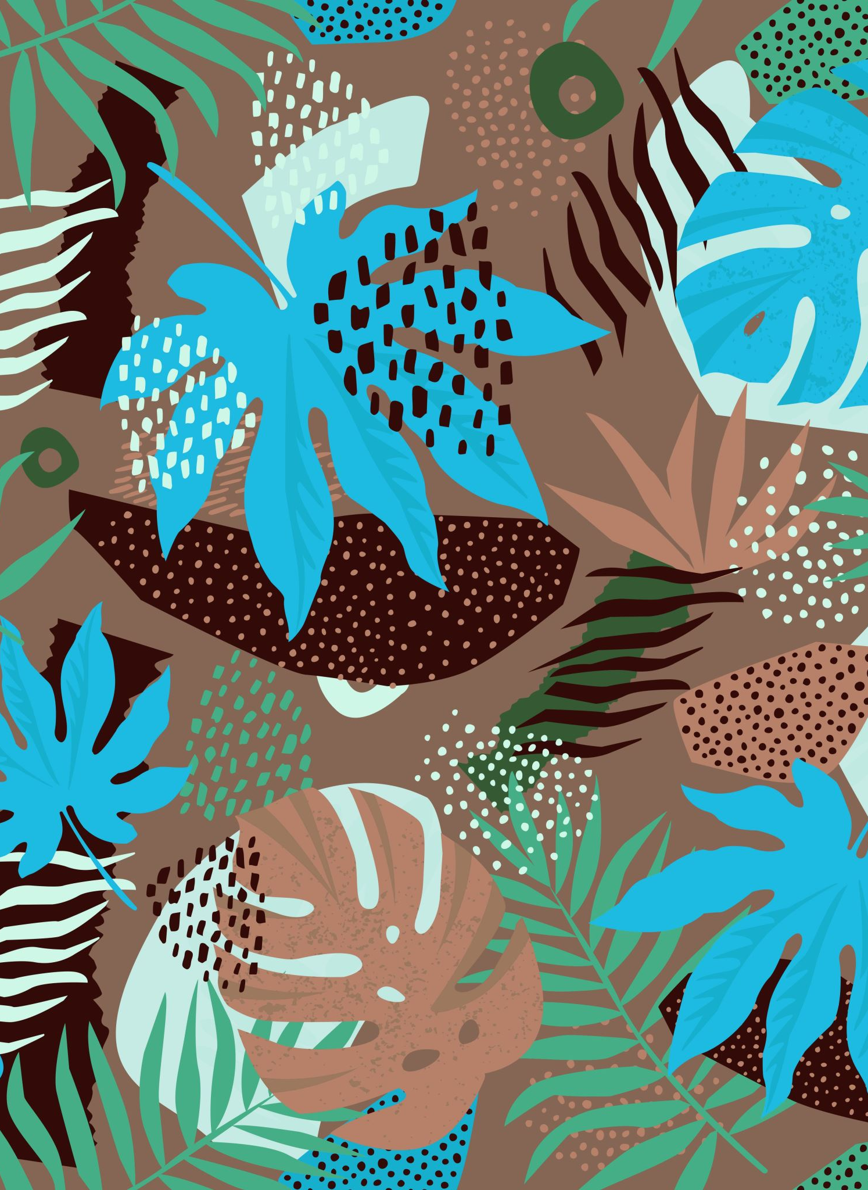

Children’s mental health week
2021
In the words of Labrinth… “Express yourself”

Slide 2
Task 1
Watch the Monday assembly by Mrs Jones to introduce the week.
Follow this link:
http://www.excalibur.cheshire.sch.uk/page/monday-whole-school-assemblies/93125

Slide 3
Task 2
Now, you have a choice of different activities you could have a go at this week to express yourself!
Choose as many as you want!
These activities can be done at any point over this week- they don’t have to be done today.
Upload any videos or pictures to Seesaw of you “expressing yourself”
There are some ideas on the next couple of slides.

Slide 4
Design/create an outfit that you think expresses who you are- your personality/ your interests.
Create a piece of artwork that you think expresses who you are- you could use bits out of magazines/ print images off the internet/ a portrait of yourself as a cartoon character
Design an island/ a world that you would enjoy living in- you could make a model of it using recycled materials
Have a go at drawing your feelings https://www.youtube.com/watch?v=STdJ__8ORyE&feature=youtu.be
You could design a pizza/ a cake/ a cookie that expresses who you are. If your parents say it’s ok, you could make it!

Slide 5
You could choreograph a dance that expresses how you feel/ what kind of person you are
Choose a song that you think resonates with you- you could sing along to it/ dance to it/ play along to it using junk instruments
Write a poem or a rap all about you!
Design and make a mask that expresses your emotion/ you as a character in a film, comic or book

Slide 6
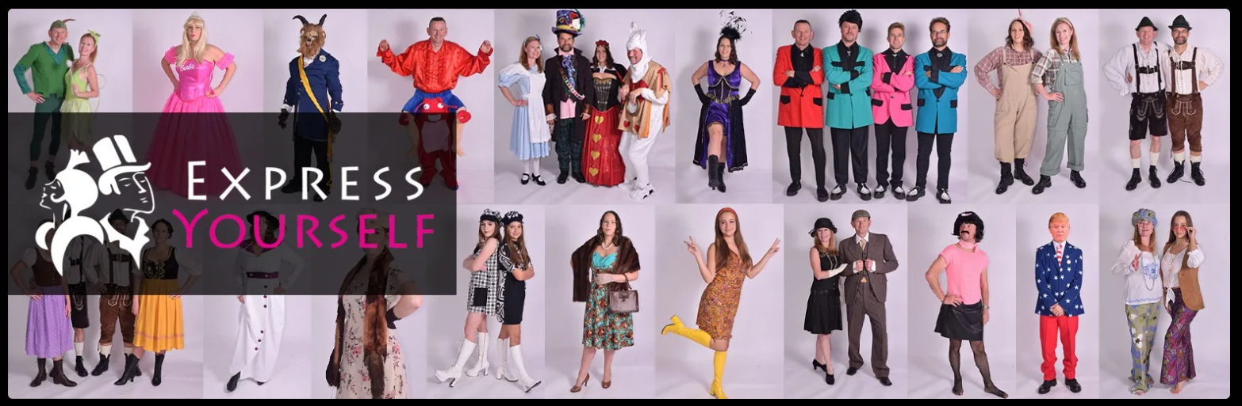

Slide 7
Task 3
Lockdown is meaning that lots of us are missing various different things
Create a “Things To Look Forward To Jar” (or basket or pot)
You could do this on your own or as a whole family!
Decorate your jar or pot in whichever way you like.
Write down, on scraps of paper, anything you are looking forward to doing in the future, once lockdown is over and restrictions are lifted.
Having things to look forward to ensures you keep a positive mindset and makes you realise all the things you would usually take for granted!

Slide 8
