Slide 1
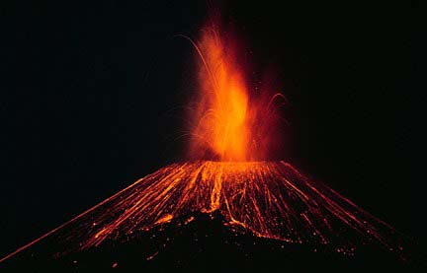
Personification
Metaphors and similes
thick like treacle
spat lava out
the city’s protector
Onomatopoeia
Alliteration
crackle
violent, vicious volcano

