Slide 1
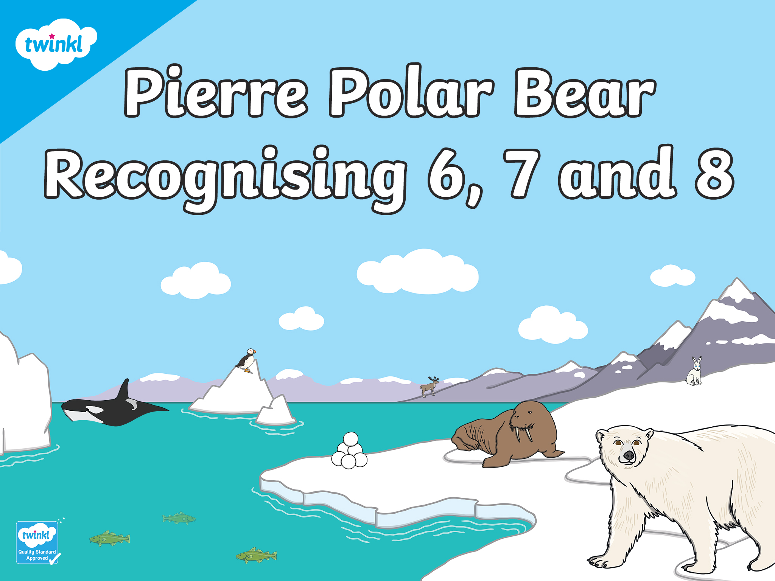

Slide 2

Hello! I’m Pierre
Polar Bear and I love wandering in my Arctic habitat, counting things! Can you help me?

Slide 3



I’ve been busy catching some fish. Can you help me count how many fish I caught? Click the bucket to find out.
Try again.
Well done!
How many fish did you count?
6
7
8
next

Slide 4

That’s right! There are 7 fish. Can you talk about how the fish are arranged in a ten-frame?
Let’s go!
next

Slide 5

I’ve been playing with snowballs! Can you count how many snowballs I have made? Click to find out.
Try again.
Well done!
How many snowballs did you count?
6
7
8
next

Slide 6

That’s right! I made 6 snowballs. Can you talk about how we see 6 on the ten-frame ?
Let’s go!
next

Slide 7

I’ve been watching the puffins! Can you watch the puffins? How many can you count? Click to find out.
Try again.
Well done!
How many puffins did you count?
6
7
8
next

Slide 8

That’s right! I saw 8 puffins. Can you talk about how the puffins are arranged on the ten-frame?
Let’s go!
next

Slide 9

It’s snowing! Can you count the snowflakes falling from the sky? How many can you count? Click to find out.
Try again.
Well done!
How many snowflakes did you count?
6
7
8
next

Slide 10
That’s right! I saw 6 snowflakes. Can you tell me how 6 is shown on the ten-frame? How is it different?
Let’s go!
next

Slide 11





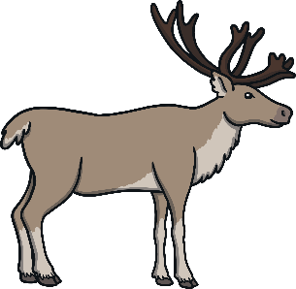


I’ve been playing a game of hide-and-seek with my friends! How many Arctic animals can you see? Click to find out.
Try again.
Well done!
How many animals did you find?
6
7
8
next

Slide 12




That’s right, 8 friends were hiding! How is 8 shown differently on the ten-frame this time?
Let’s go!
next

Slide 13






The orcas are here! Can you see how many orcas are out swimming in the bay? How many can you count? Click to find out.
Try again.
Well done!
How many orcas can you see?
6
7
8
next

Slide 14

That’s right, 7 orcas were in the bay! Can you tell me how 7 is arranged on this ten-frame?
Let’s go!
next

Slide 15

Let’s look at the different ways we saw 6.
Can you tell me how the ten-frames are different?
next

Slide 16


Can this be the same number even though they look different? How do you know?
Let’s look at the different ways we saw 7.
next

Slide 17





How many empty spaces are left on each
ten-frame? Are they in the same place? Why?
Let’s look at the different ways we saw 8.
next

Slide 18
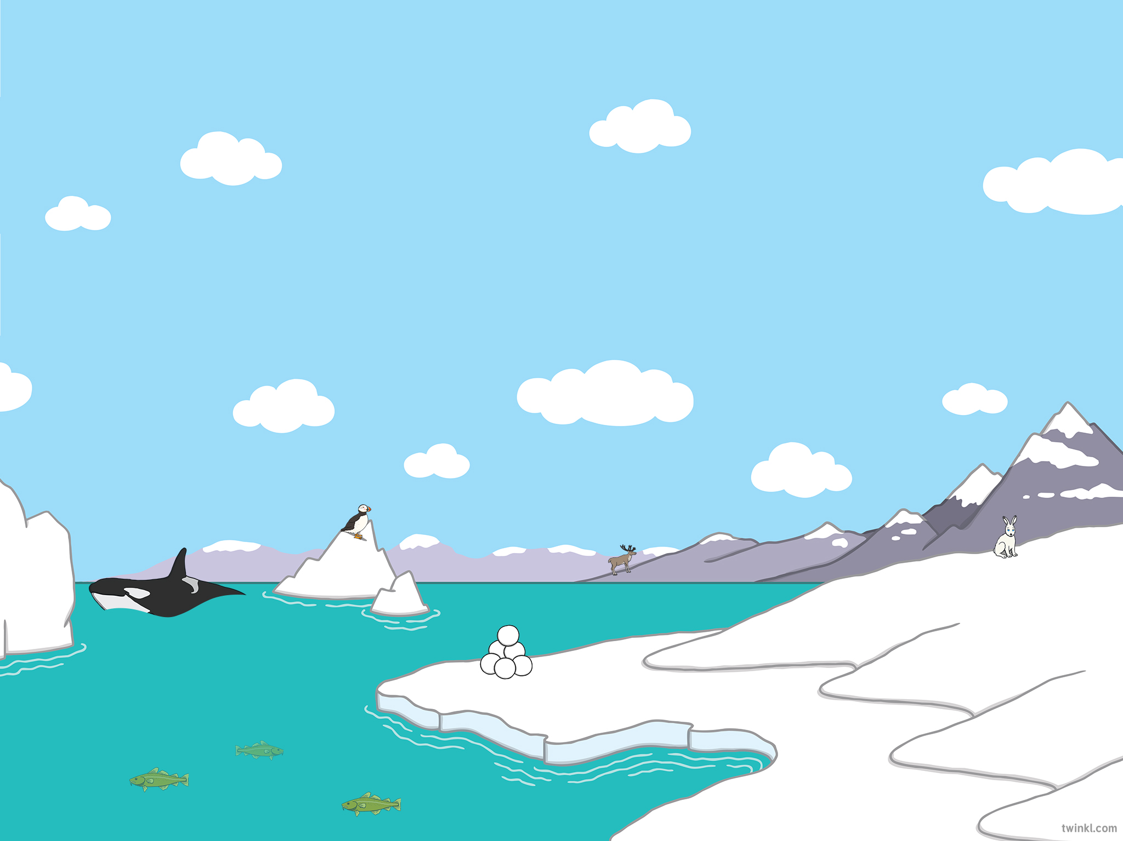

Thank you for helping me to count 6, 7 and 8!

Slide 19
