Slide 1
Maths Friday 29 January
Today we are looking at the key to our pictograms.
Try the questions below being careful to check the key.
If you are not sure you could use this link to watch a video. (Copy and paste).
vimeo.com/504480875
Can you count in 2’s?

Slide 2
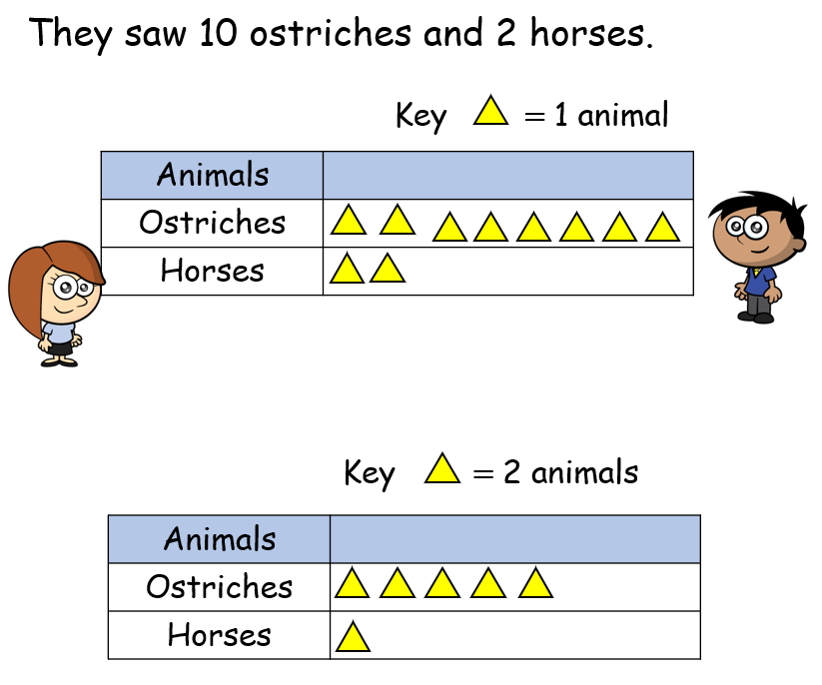

Oh dear in this pictogram the ostriches will not all fit on!
Let’s change the key.
Now they all fit on, because each means 2 animals.

Slide 3
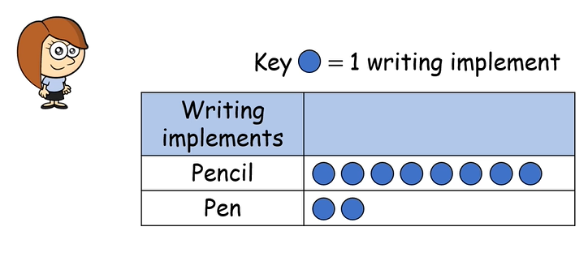

Look at Rosie’s pictogram. Check the key.
Can you draw another pictogram using a different key?

Slide 4
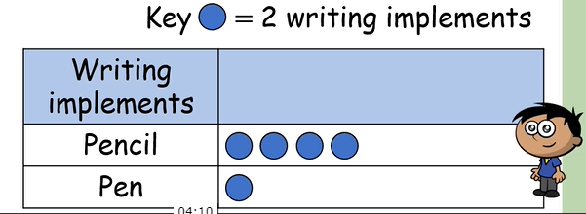
Does your pictogram look like this?
Check the key.

Slide 5
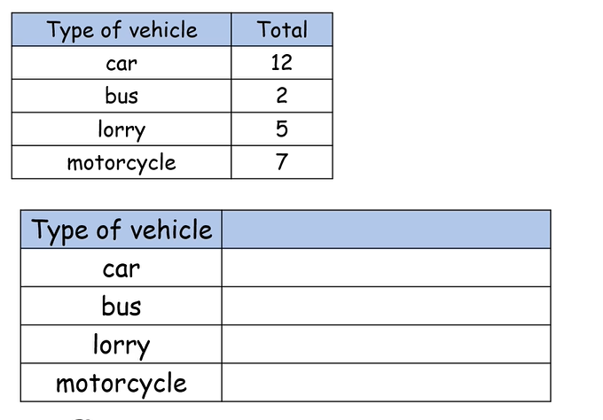

Can you draw the pictogram?
Check the key.
Is there a problem with odd and even numbers?

Slide 6
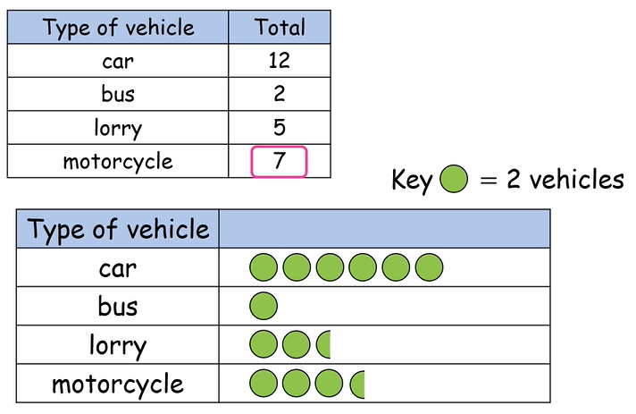
Does your pictogram look like this?
Great.
If not, check the key and count in twos.
What does half a circle mean?

Slide 7
Let’s make our own pictogram. First, sort the names into the table according to the number of letters in each name. Find the total of each column.
Albie Ben Bodhi Cerys Charlie Daniel Dorie Edward Ella Elliot | Finn Freddie Freddie Gabriel Harriet Imogen Iwan Jack Jack Jack | James Joshua Kai Maggie Matthew Max Owain Oliver Reuben-James Zak
3 | 4 | 5 | 6 | 7 | 8 | 9 | 10 | 11

Slide 8
Use your data in the table to draw a pictogram. Use the key.
Key = 2 children
Think about how to show 1 child = = 1 child.
Who has the most letters?
Who has the least letters?
Which children have 4 letters in their name?
Which children have 6 letters in their name?
letters
3
4
5
6
7
8
9
10
11
You do not need to send all the questions because we checked them together but I would like to see this pictogram. Please send it via the maths link on Seesaw.

