Slide 1

English Friday 29 January
Today we are writing about what Nyasha did everyday in her garden and the visit of Nyoka the little garden snake, so that we can write a paragraph.
Task 1
Nyasha spent a lot of time in her garden. Think about gardeners. What do they do? Which verbs can you think of?
Use your ideas to write lots of phrases for Nyasha. They do not have to be full sentences, just ideas.
weed - weed around the feathery carrot tops
rake - rake between the rhubarb stems
plant - plant delicate seedlings
sew -
sprinkle -
water -
cut -
prune -
harvest -
dig -
You can use these ideas to make list sentences in your paragraph later.
sound button

Slide 2
Task 2
Nyasha is often visited by a little garden snake.
Shall we try some alliteration. Let’s think of lots of words to describe the snake that start with sssssss.
Words like: smooth, slithery, silent
Nyasha welcomes the snake so our word choices should be positive and cheerful like: smooth, slithery and silent, not negative and menacing like: slimy and scaley.
How many ssssssssssssssssss words can you think of?
Write a lissssssst. The more the better!
sound button

Slide 3
Task 3
We can not forget about Manyara.
We know that she is bad tempered and teased Nyasha.
Think of four adjectives to describe Manyara.
Write a list.
sound button
Task 4
Let’s write all our ideas together in one paragraph, a number of sentences that belong together.
A good paragraph will include:
Accurate punctuation
Lists sentences
Alliteration
Adjectives
A fabulous paragraph will include:
Accurate punctuation
Lists sentences
Alliteration
Adjectives
Different sentence starts
Exciting word choices

Slide 4
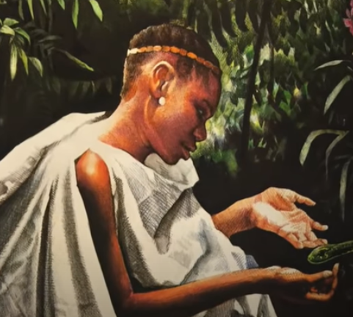
Mufaro’s daughters were very beautiful, but very different. Nyasha loved her garden. Every day, she weeded between the feathery carrot tops, watered the emerald lettuces and sprinkled tiny dark seeds onto the soft soil. Sometimes, she was visited by Nyoka, a silent, resssssserved snake that slid and slithered amongst the stems of her vegetables. Manyara, on the other hand, was bad tempered, mean and unkind to Nyasha when her father was not looking.

