Slide 1

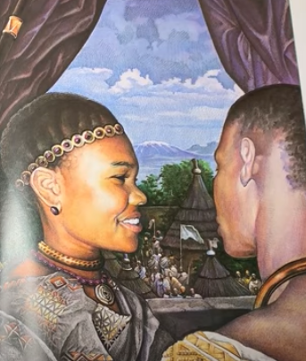
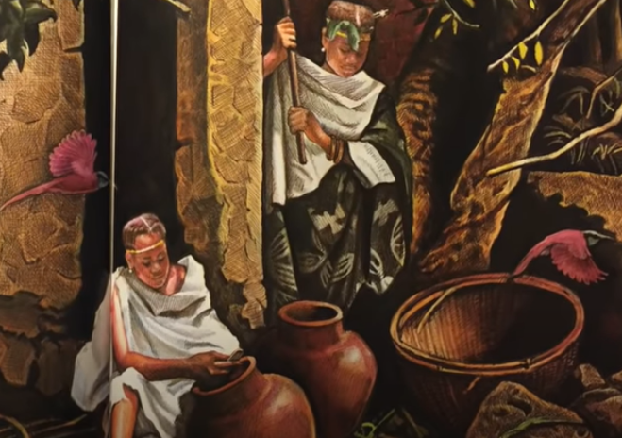
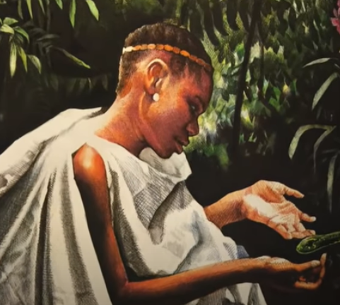
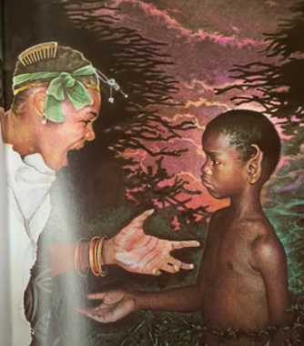
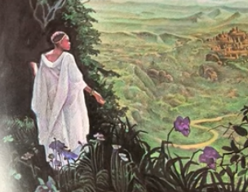
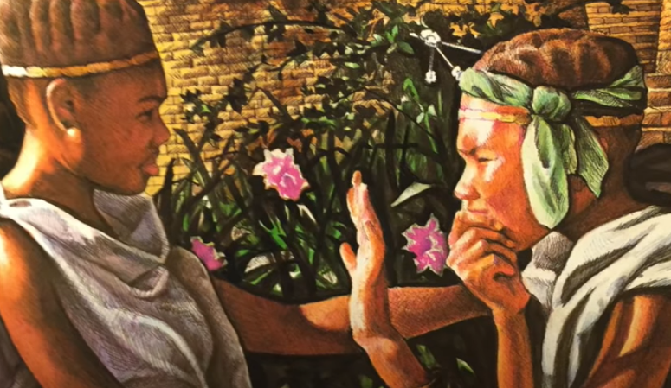
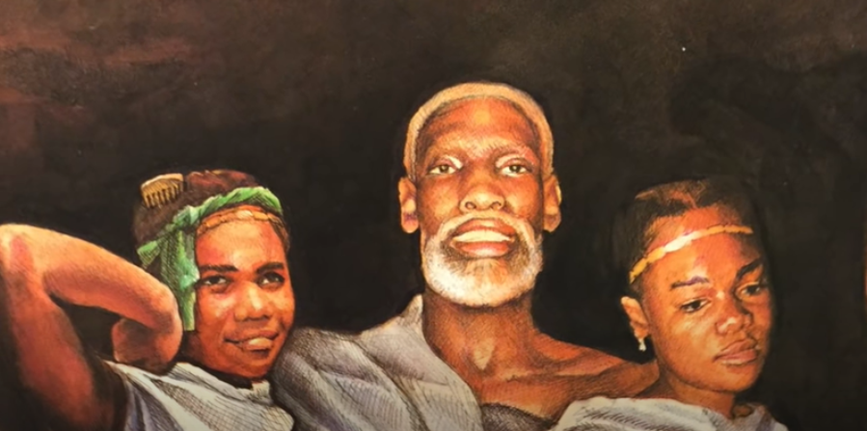
English Thursday 28 January
sound button
Are your pictures in this order? Great. If you would like to watch the story again, use this link:
https://www.youtube.com/watch?v=PEhwQfOvpkI
We are going to retell the story using these 7 pictures.
Today we are using:
Proper nouns
Prepositions
Adjectives

Slide 2
A long, long time ago, in a certain place in Africa, a small village lay across a river and half a day’s journey from a city where a great king lived. A man named Mufaro lived in this village with his two daughters, who were called Manyara and Nyasha. Everyone agreed that Manyara and Nyasha ere very beautiful.
We are going to concentrate on the beginning, the setting of the story.
We will need:
A story opening
A description of where the village is
Who are the characters?
Task 1
How do stories start?
Write a list of 4 different ways like:
* Once upon a time
* Long, long ago
*
*
sound button

Slide 3
Task 2
Now lets think about where the village is.
In the story it says ‘across a river and half a day’s journey’
Use your prepositions to think of some different ideas to describe where the village is:
* Between the mountains
* Over the hills
* Across a stream
* Through a forest
* Along the valley
*
*
*
sound button
Task 3
Who are the characters? Can we describe them? Remember proper nouns need capital letters. Write a sentence for each character. Choose your adjectives carefully.
Mufaro was a quiet and gentle man.
Manyara was beautiful but mean to her sister.
Nyasha was a caring and kind girl.
sound button

Slide 4
Task 4
Now you can use all your ideas and write the first paragraph of the story.
I’ll have a go!
Once upon a time, there was a village. It was a days journey from a great city, through the forest, along a valley and across a fast flowing river. At the edge of the village lived a quiet and gentle man named Mufaro. His daughters were both beautiful. Nyasha was caring and kind. Manyara was beautiful but she was also mean and spiteful to her sister.
sound button
Can you spot these things in my story?
A story opening
A description of where the village is
Who are the characters?
Now you try.
Don’t forget, send me your paragraph via Seesaw, please.

