Slide 1
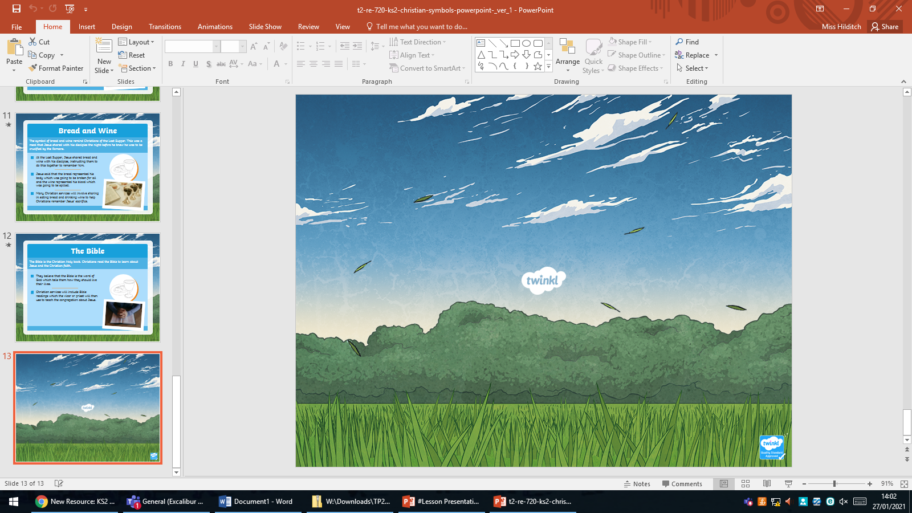

Slide 2
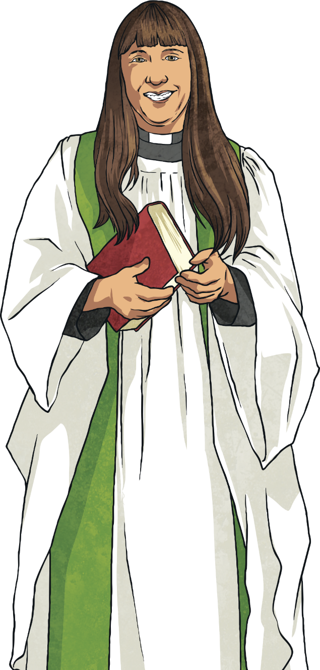
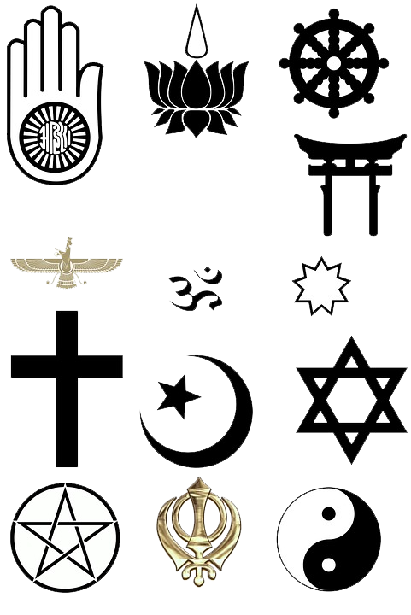
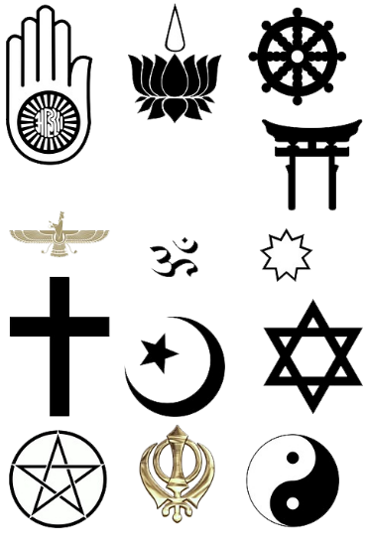
Religious Symbols
Most religions have symbols that represent their beliefs or aspects of their faith.
They are used to unite members of a common faith and to signify their religious beliefs to others.
Christianity has many religious symbols that represent different aspects of the Christian faith.

Slide 3
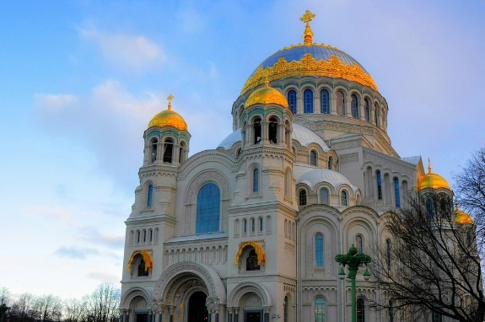
The Cross
The most recognisable Christian symbol is probably that of the cross.
The cross reminds Christians of the sacrifice that Jesus made when he gave his life and died on the cross to save others.
Many Christians wear a cross around their necks as a daily reminder of this and the cross can be seen in almost all Christian meeting places such as churches and cathedrals.

Slide 4
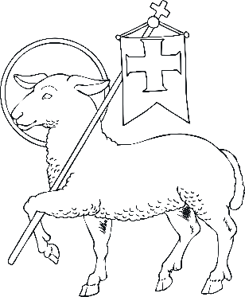
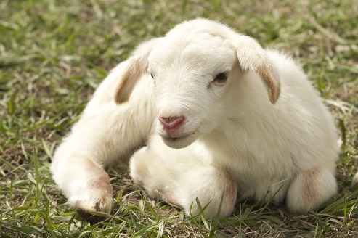
The Paschal Lamb
Jesus is often referred to in the Bible as being like a shepherd and that his people are the sheep.
Christians believe that Jesus cares for people like a shepherd looks after and cares for his flock.
Therefore, the Paschal Lamb is often used as a symbol for Jesus.
This symbol is also used in reference to the fact that the Jewish people used to sacrifice lambs as an offering to God and because Jesus made the ultimate sacrifice, the lamb is thought to represent him too.

Slide 5
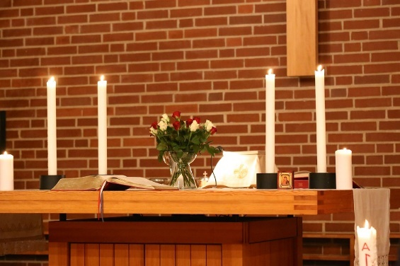
The Candle
Another very important Christian symbol is the candle.
The candle is often used as a tool to help Christians focus on the fact that Jesus brought light into a world of darkness and sin by showing them how they should live their lives.
The Bible tells us that Jesus taught people to love each other and to live peacefully and shed light on how they could receive eternal life.
Jesus is referred to by Christians as the ‘Light of the World’ and the candle is a clear representation of this.

Slide 6
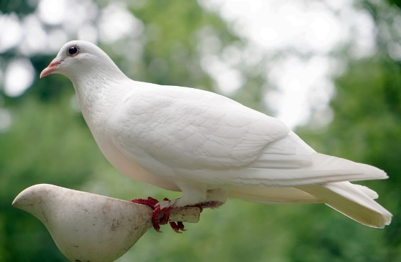
The Dove
As with other symbols, there is often more than one interpretation of the dove.
The dove is a symbol of peace and hope.
It is linked to the story in the Old Testament of how Noah sent out a dove to find land and came back with a leaf. This gave him hope that the floods were receding and that they would soon find land.
The dove is also mentioned in the New Testament when Jesus is baptised by John the Baptist. It says that as Jesus emerged out of the water, he saw the Holy Spirit descending on him ‘like a dove.’
Therefore, in Christianity, the dove represents peace, hope and the holy spirit.

Slide 7
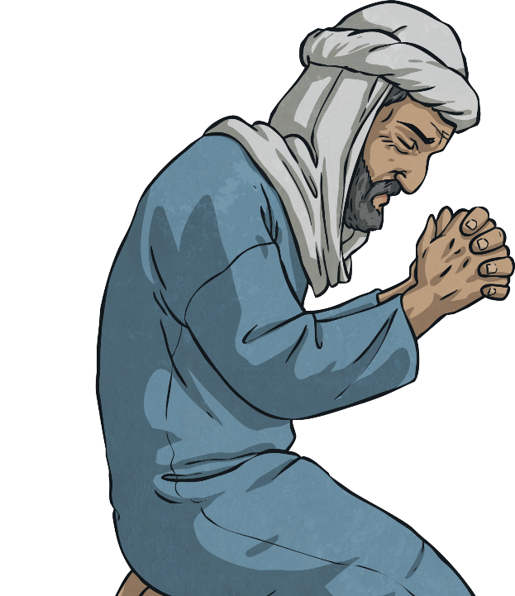

The Ichthus
The Ichthus represents the phrase of ‘Jesus Christ God’s Son is Saviour’ and originates from the Greek word for fish.
The ichthus has historical significance too. In the first centuries, Christians were persecuted by the Romans and were forced to meet and worship in secret. The fish symbol was used among Christians in hiding to display meeting places for everyone to meet and worship.
Next Page

Slide 8
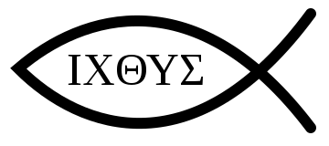
The Ichthus
The Ichthus represents the phrase of ‘Jesus Christ God’s Son is Saviour’ and originates from the Greek word for fish.
The fish is referred to many times in the Bible. For example, Jesus fed the five thousand with five loaves and two fish, he called his disciples ‘fishers of men’ and Jesus would often gather with his followers and enjoy a meal of fish.
It is not surprising then that the fish is used as a Christian symbol.

Slide 9
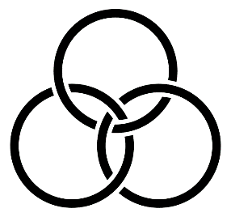
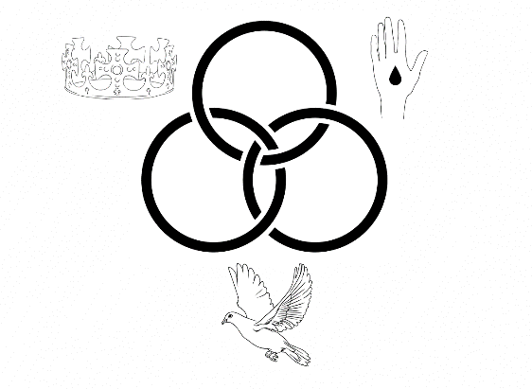
The Borromean Rings
Christians believe that God is made up of three entities; Father, Son and Holy Spirit. This is referred to as the trinity.
The word trinity comes from the Latin noun ‘trinitas’ which means ‘three as one’.
The Borromean Rings is actually a mathematical concept and demonstrates that the rings fall apart if any one of them are removed. This represents that each part of the trinity is important and that together they are strong and unified.

Slide 10

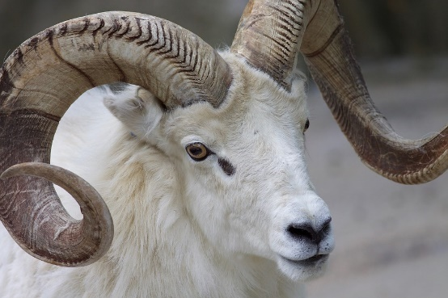
The Horn
The Horn is a symbol of strength and honour because horns are the chief weapons of animals such as stags and rams.
Horns were used as an instrument to signify the start of a battle and they would also be filled with oil and poured on someone who was to be anointed.
Horns are referred to many times in the Bible and it is not surprising that it is used to represent the strength and dominance of God.

Slide 11
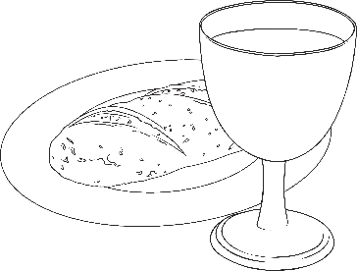
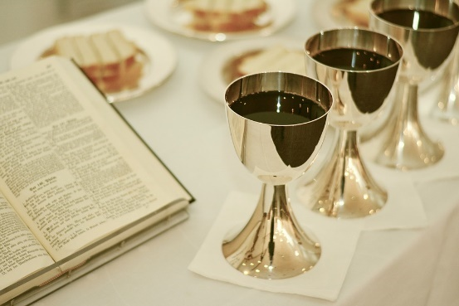
Bread and Wine
The symbol of bread and wine remind Christians of the Last Supper. This was a meal that Jesus shared with his disciples the night before he knew he was to be crucified by the Romans.
At the Last Supper, Jesus shared bread and wine with his disciples, instructing them to do this together to remember him.
Jesus said that the bread represented his body which was going to be broken for all and the wine represented his blood which was going to be spilled.
Many Christian services will involve sharing in eating bread and drinking wine to help Christians remember Jesus’ sacrifice.

Slide 12
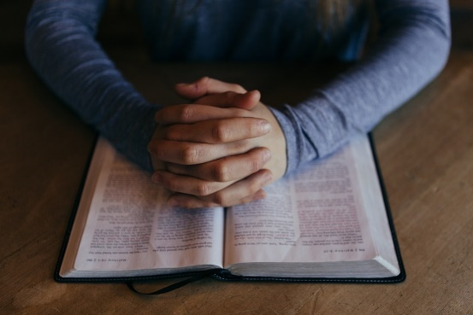
The Bible
The Bible is the Christian Holy book. Christians read the Bible to learn about Jesus and the Christian faith.
They believe that the Bible is the word of God which tells them how they should live their lives.
Christian services will include Bible readings which the vicar or priest will then use to teach the congregation about Jesus.

