Slide 1
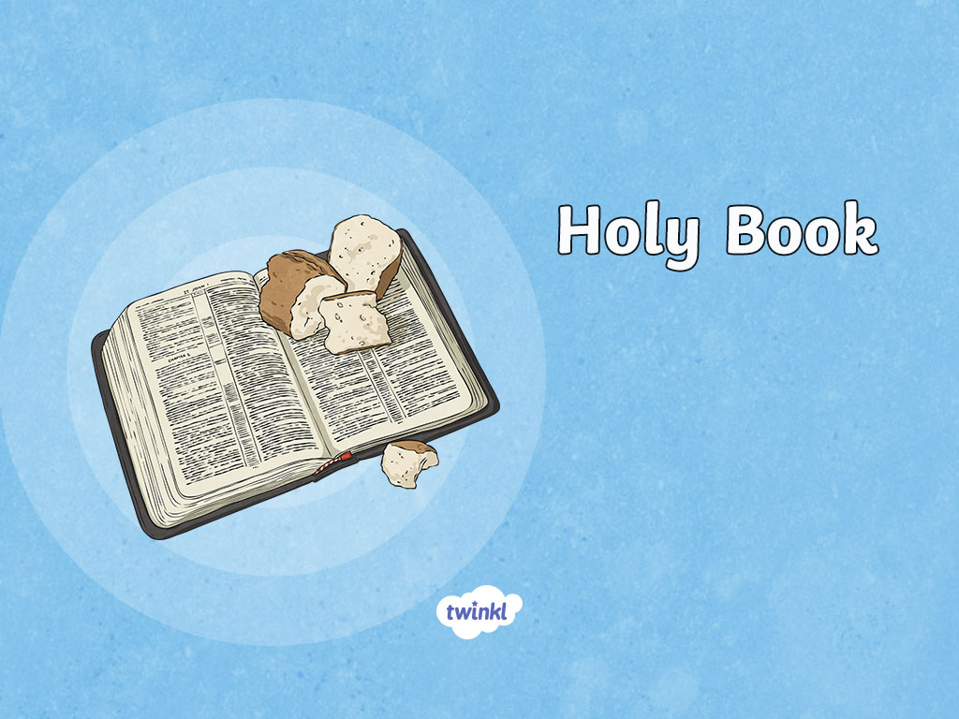
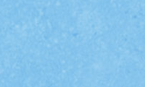

Slide 2
Aim
I understand how the Bible is organised and can navigate my way around it.
Success Criteria
I can explain what the Bible is and the two key sections.
I can locate passages within the Bible.

Slide 3
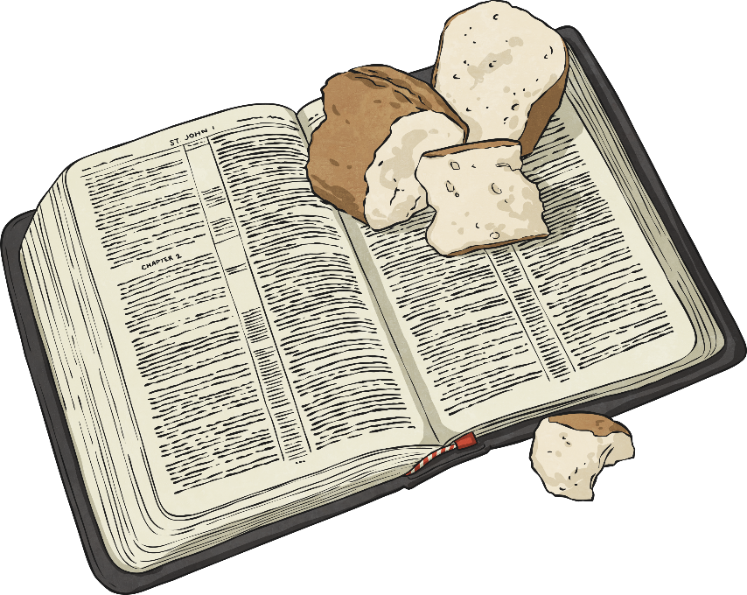
Library
What is within a library?
Books!
The Christian Holy Book is called the Bible.
It is a library of 66 books.

Slide 4

Library
The Christian Holy Book is called the Bible.
It is a library of 66 books.
Bible Categories:
history
gospels
letters
prophecy
law
poetry and wisdom

Slide 5
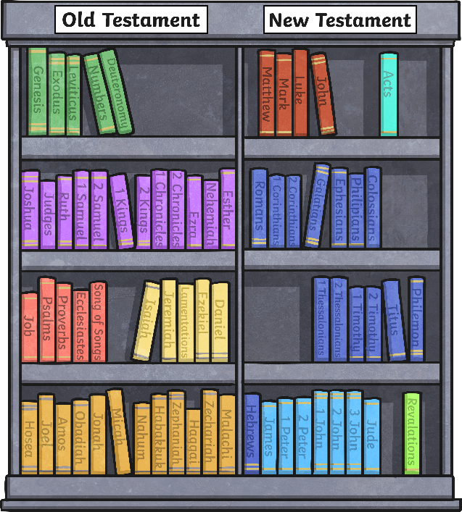
Library
The books of the Bible are split into two sections
Law
Gospels
History
Church History
Poetry
Pauline Letters
Major Prophets
Letters
Minor Prophets
Prophecy
It was written over a period of 2000 years by 40 different authors, and it is now in 2018 languages.

Slide 6
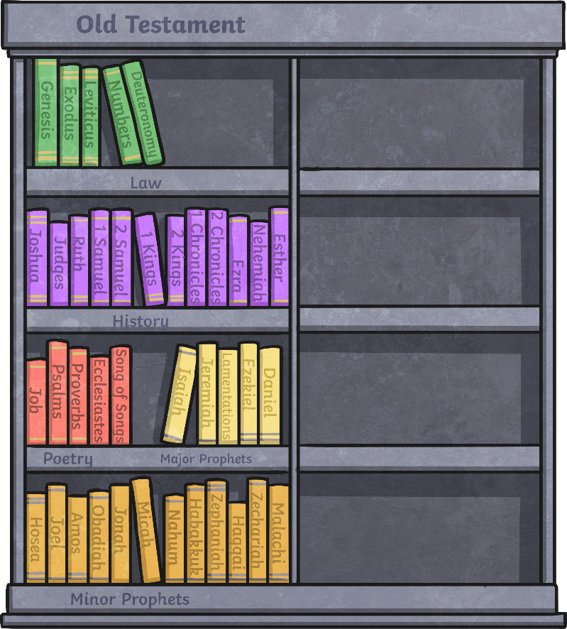
Old Testament
The Old Testament is the first (and biggest) part of the Bible.
The Old Testament is a collection of writing by ancient Israelites. It was originally written in Hebrew (language of the Israelites) and Aramaic (language of the Assyrians from Syria).
Now you know what is in the Old Testament, what do you think will be in the New Testament?
It is made up of 39 different books.
These books were written between 1200 and 100 BC (before Jesus was born).
The Old Testament contains guidance, instructions, stories and sayings of prophets.

Slide 7
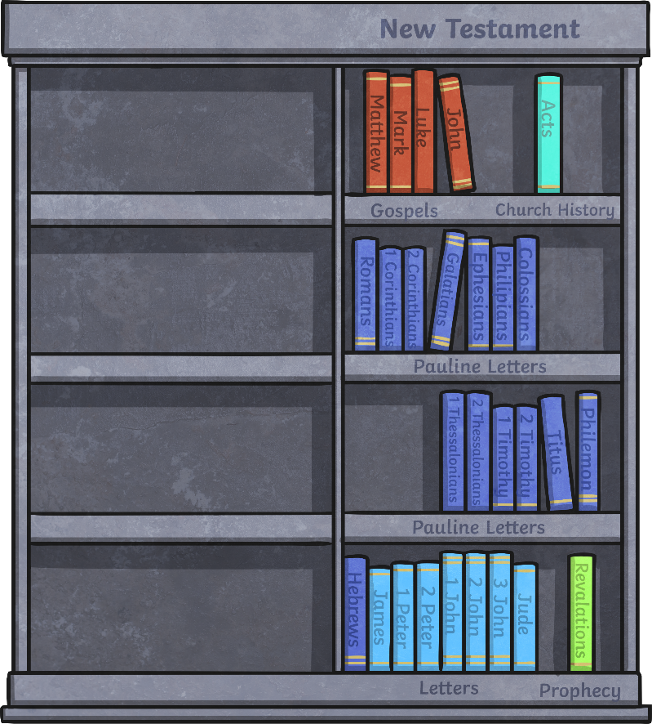
New Testament
The New Testament is made up of 27 books.
It was originally written in Greek.
It was written between 50 and 100 AD (after Jesus was born).
It contains stories of Jesus and letters written by Christian leaders to provide guidance to early church communities about how to live.

Slide 8
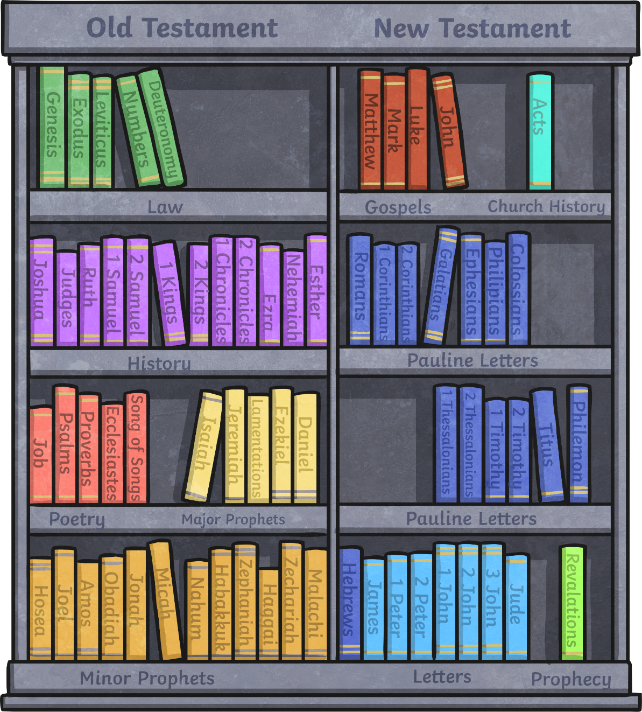

Slide 9

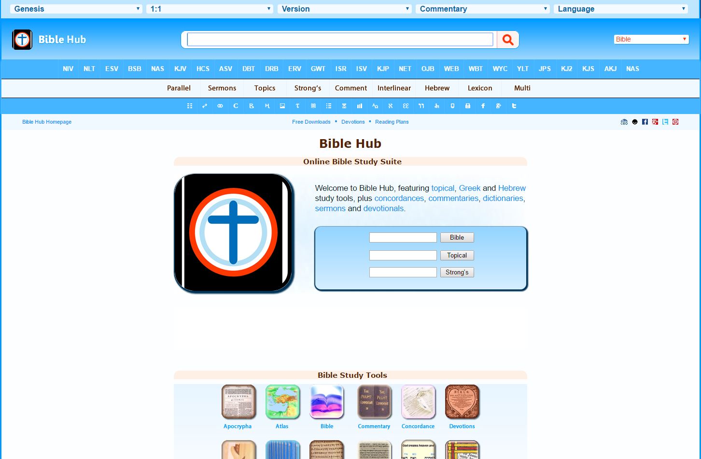
Bible Hunt
Search using a Bible (offline)
Instructions
Next
Go to www.biblehub.com

Slide 10
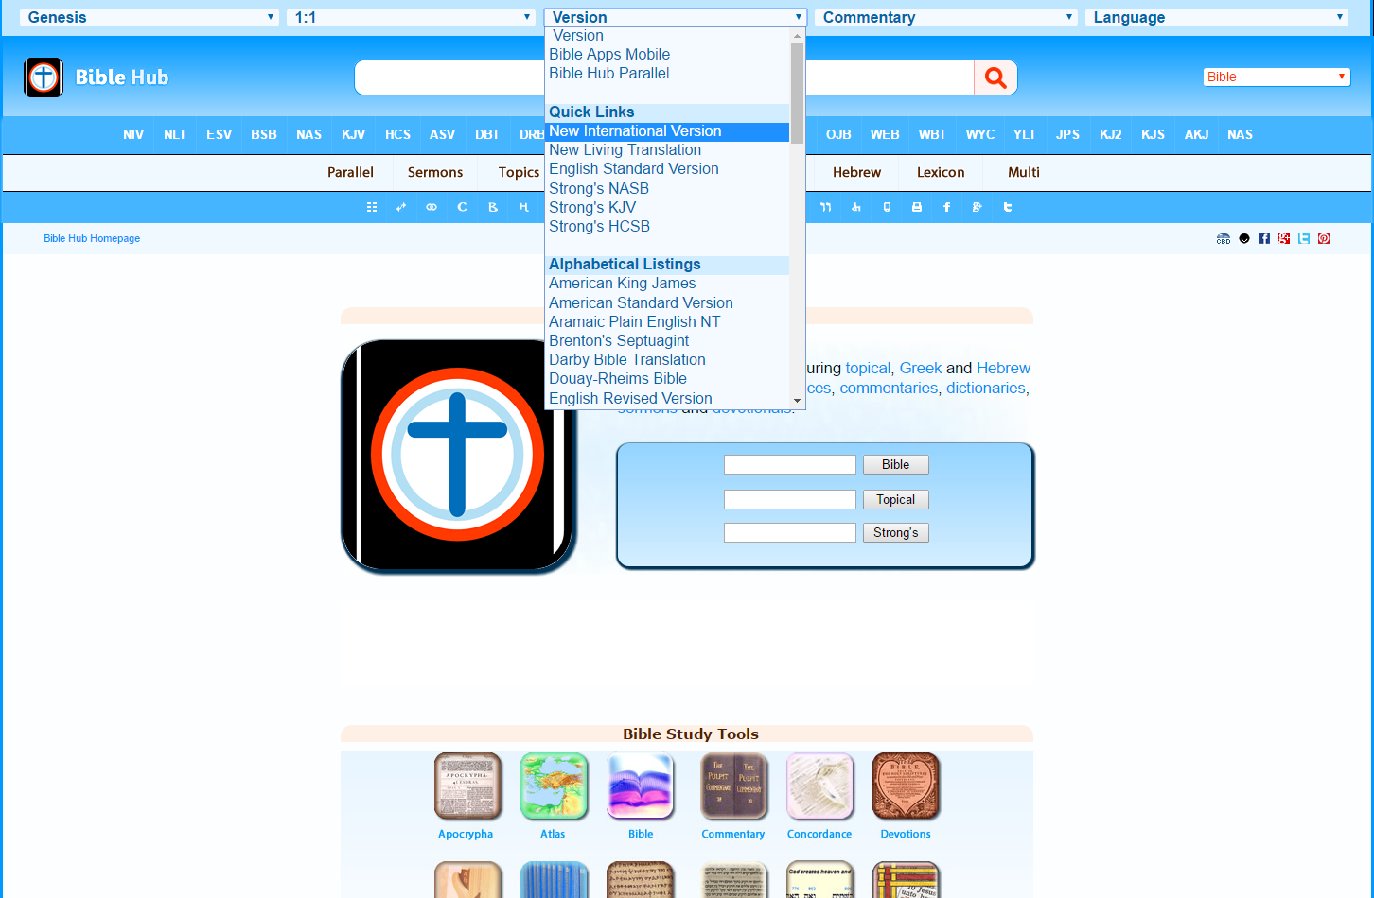
Bible Hunt
Search using a Bible (offline)
Instructions
Back
Next
From the drop-down menu, select New International Version

Slide 11
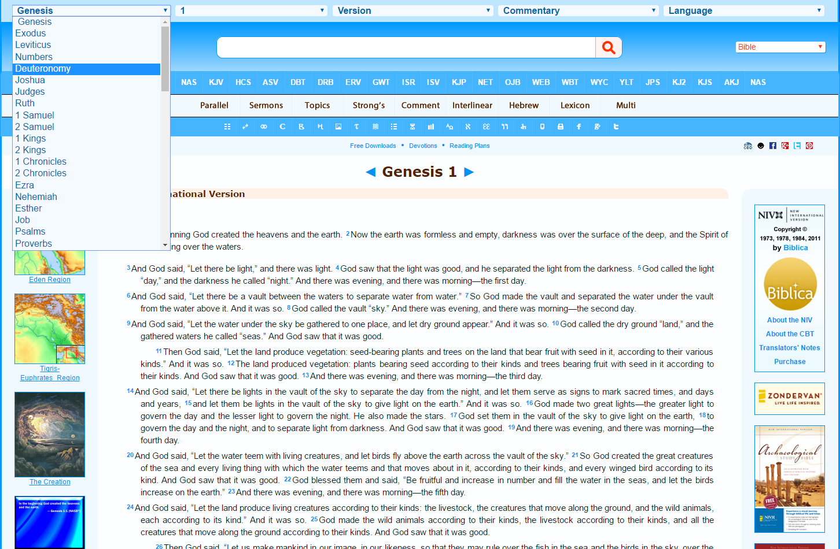
Bible Hunt
Search using a Bible (offline)
Instructions
Back
Next
Select the book called ‘Deuteronomy’

Slide 12
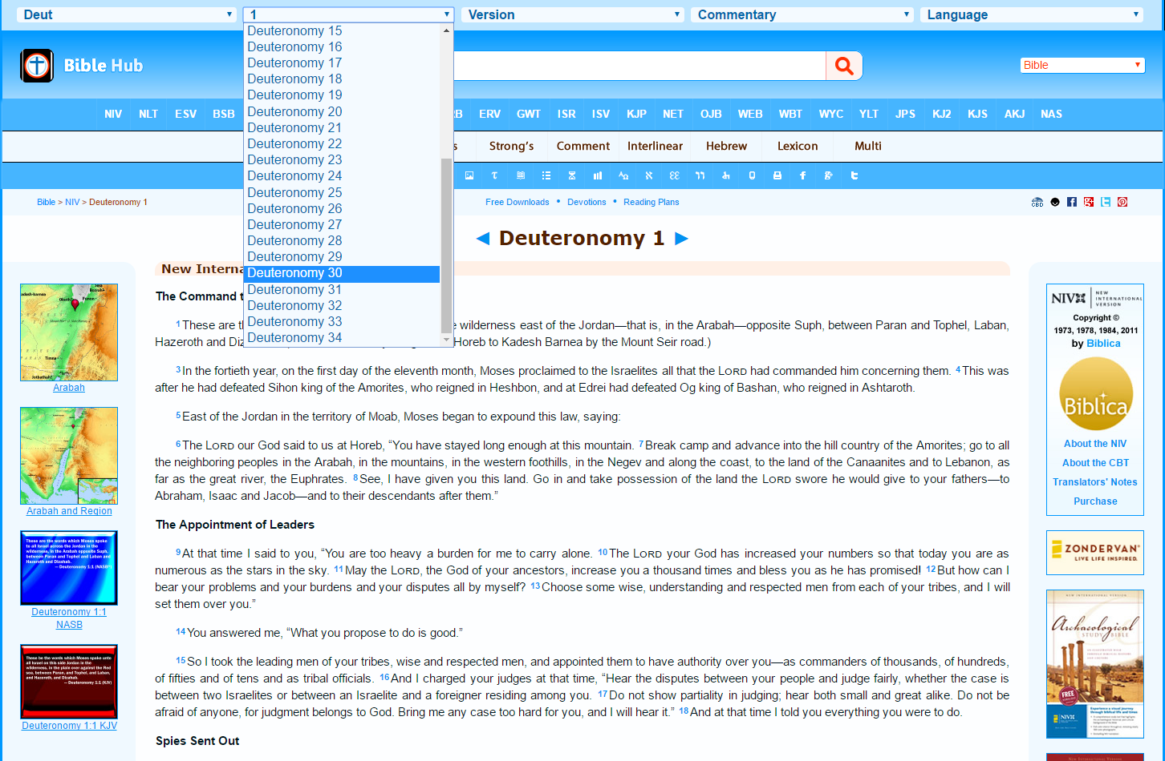
Bible Hunt
Search using a Bible (offline)
Instructions
Back
Next
Select Chapter 30 and read the passage it shows you.

Slide 13
Bible Hunt
Search using a Bible (offline)
Instructions
Now what I am commanding you today is not too difficult for you or beyond your reach. It is not up in heaven, so that you have to ask, “Who will ascend into heaven to get it and proclaim it to us so we may obey it?” Nor is it beyond the sea, so that you have to ask, “Who will cross the sea to get it and proclaim it to us so we may obey it?” No, the word is very near you; it is in your mouth and in your heart so you may obey it.
Back
Next
Can you find this part?

Slide 14
Bible Hunt
Search using a Bible (offline)
Instructions
11Now what I am commanding you today is not too difficult for you or beyond your reach. 12It is not up in heaven, so that you have to ask, “Who will ascend into heaven to get it and proclaim it to us so we may obey it?” 13Nor is it beyond the sea, so that you have to ask, “Who will cross the sea to get it and proclaim it to us so we may obey it?” 14No, the word is very near you; it is in your mouth and in your heart so you may obey it.
Back
Next
Look at the small numbers at the start of some sentences.
These are called verses. Which verses does this passage cover?

Slide 15

Bible Hunt
Search using a Bible (offline)
Instructions
Deuteronomy. Chapter 30 verses 11 - 14
Back
Write down the answer

Slide 16

Bible Hunt
Search using the Internet
Tips
Find the contents page.
Look for the book of Deuteronomy and locate the right page.
Each chapter has a larger heading
– find Chapter 30.
Can you find this part?
Now what I am commanding you today is not too difficult for you or beyond your reach. It is not up in heaven, so that you have to ask, “Who will ascend into heaven to get it and proclaim it to us so we may obey it?” Nor is it beyond the sea, so that you have to ask, “Who will cross the sea to get it and proclaim it to us so we may obey it?” No, the word is very near you; it is in your mouth and in your heart so you may obey it.

Slide 17
Bible Hunt
Search using the Internet
Tips
Look at the small numbers at the start of some sentences. These are called verses. Which verses does this passage cover?
Write down the answer
Deuteronomy. Chapter 30 verses 11 - 14

Slide 18
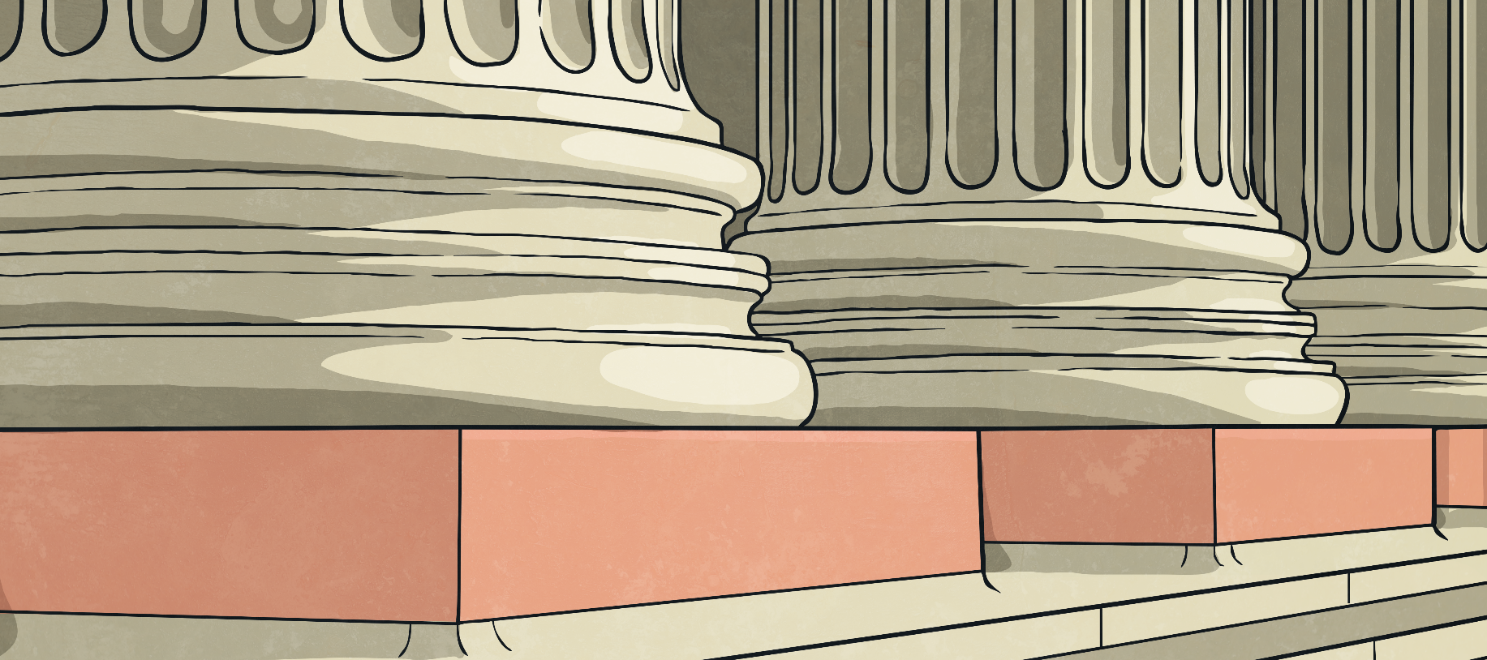
Foundations
The Old Testament lays the foundations for everything that is in the New Testament.
The New Testament builds upon these foundations.

Slide 19
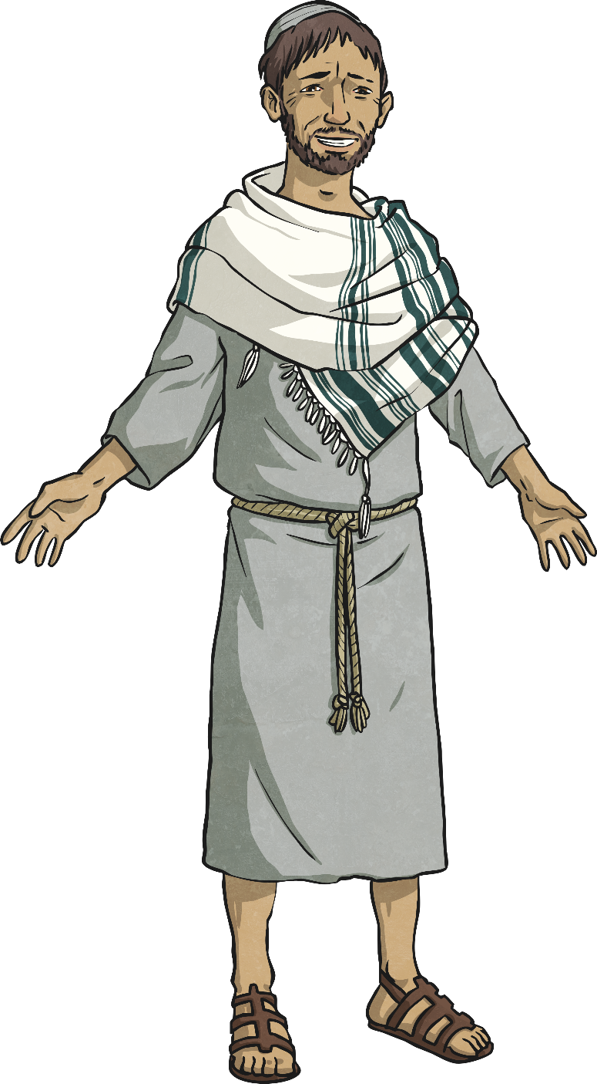
Foundations
For example, in the Old Testament, it is promised that a prophet and a king would come.
Can you think of a famous person from the New Testament, that the Old Testament might have been referring to?
The Old Testament might have been referring to
Jesus

Slide 20

Aim
I understand how the Bible is organised and can navigate my way around it.
Success Criteria
I can explain what the Bible is and the two key sections.
I can locate passages within the Bible.

