Slide 1

English Wednesday 27 January
Proper Nouns
We already know that nouns are the names of things, objects that you can touch.
chair, tree, pencil, floor, sky are all nouns.
Proper nouns are the names of people, countries, places. They must have a capital letter.
Watch this video to help you remember the difference between nouns and proper nouns.
https://www.bbc.co.uk/bitesize/topics/zrqqtfr/articles/zpd8ng8
Sort these words into nouns and proper nouns.
I have not used capital letters so you will have to
correct the proper nouns.
chair alsager paper england wales tree
table orange london belfast edinburgh
sound button
nouns | proper nouns

Slide 2
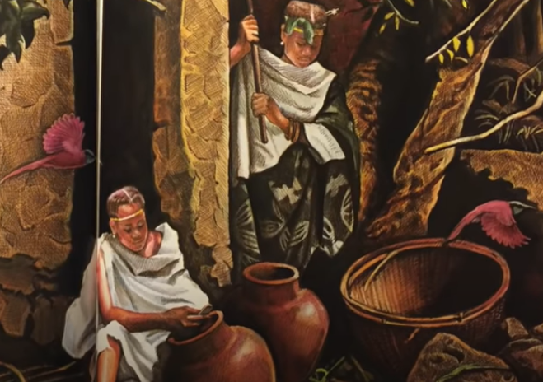
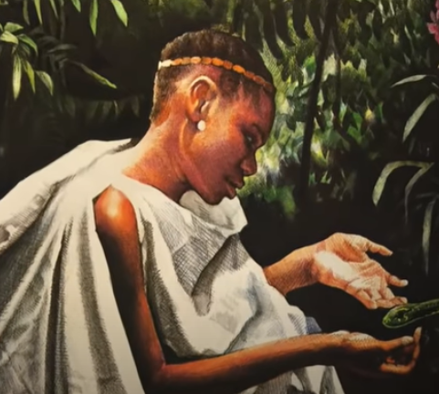
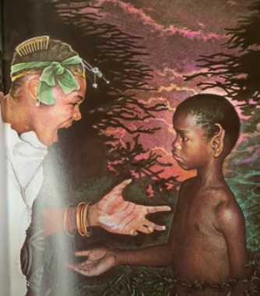
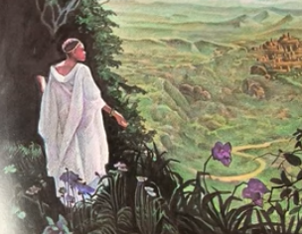
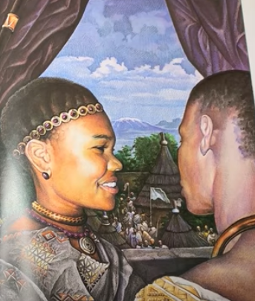
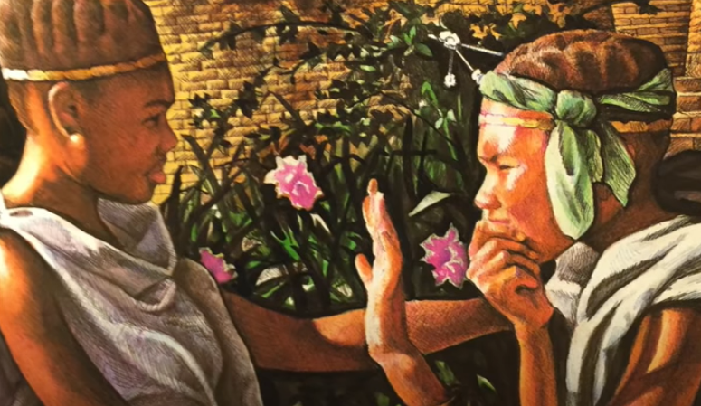
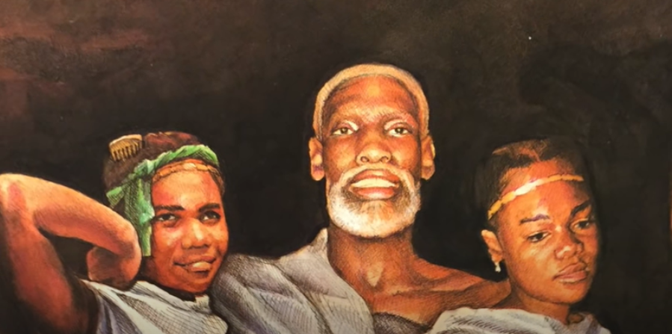
https://www.youtube.com/watch?v=PEhwQfOvpkI
If you would like to watch again, use this link.
These seven pictures tell the story of Mufaro’s Beautiful Daughters. Can you line them up in the correct order? You might want to number them or cut them out. Choose four pictures and write a sentence for each remembering to use a capital letter when you use a proper noun.

